Slide 1
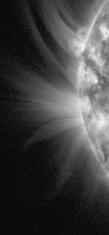
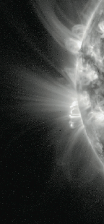
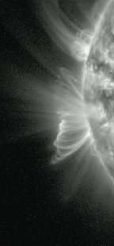
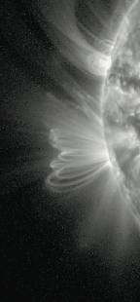
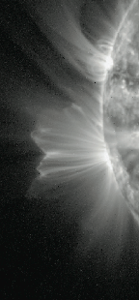
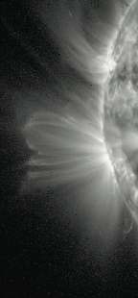
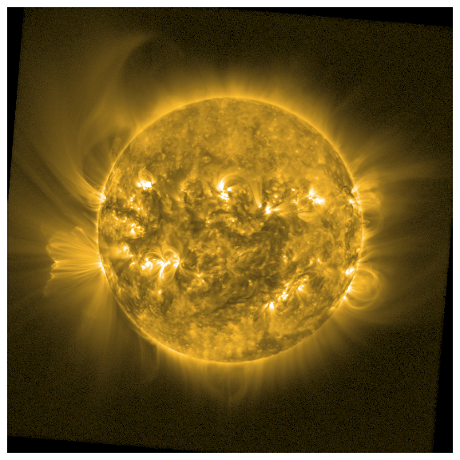
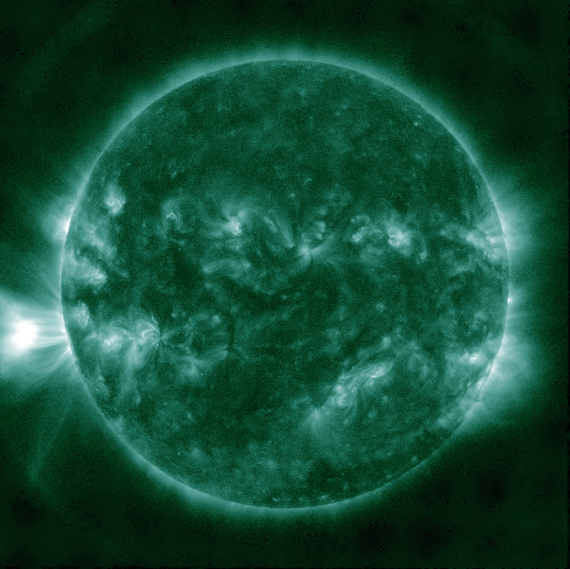
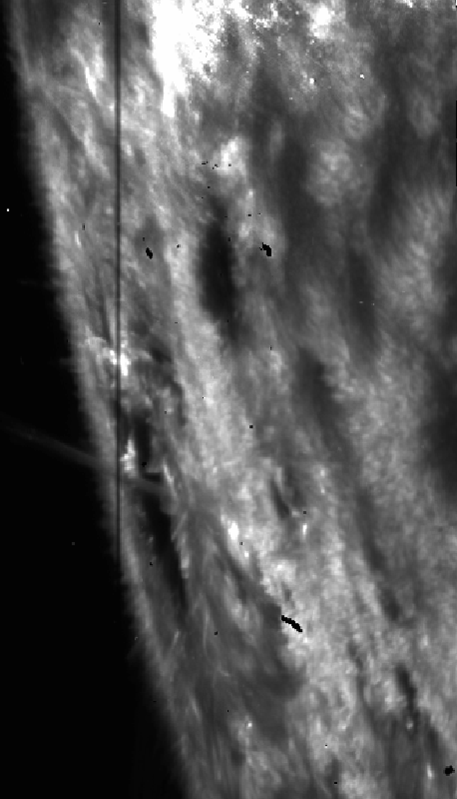
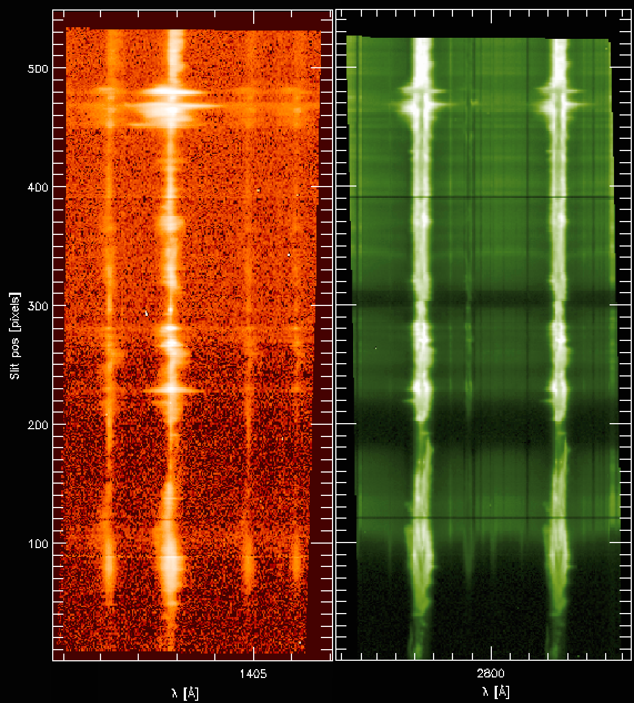
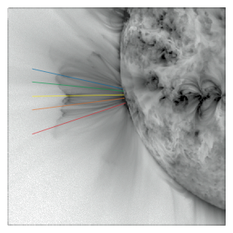
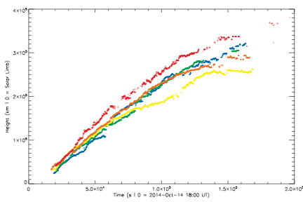
SWAP & IRIS Observations of Post-Flare Giant Arches
Matthew J West & Daniel B Seaton - Royal Observatory Belgium
AR 12192, the most prolific of Solar Cycle 24, rotated into view on 18 Oct 2014 but announced its presence on 14 Oct 2014 with a powerful and unusual eruption. Producing the largest post-eruptive loop system of the solar cycle.
These loops appear to be the EUV counterparts of X-ray “post-flare giant arches” (see de Jager & Šveska, 1985). Which are usually interpreted as a signature of reconnection in the post-eruption current sheet.
The signatures of reconnection are not just localised, and are evident at the loop foot-points as late as the 16 Oct.
The following figure shows IRIS signatures at the loop foot-point, where the post eruption loops are anchored, there is a discernible emission increase.
Growth of post eruption loops observed by SWAP
The initial eruption occurred at 18:30 UT behind the east Solar limb, and was observed as a CME (v=1300 kms⁻¹) and an M2.2 solar flare.
SWAP 174 Å (Fe IX/X at log T ≈ 6; left) and AIA 94 Å (T = 10^{6.8} K; Right) images of the loops on 15-Oct.
The above figure shows an SDO AIA 94Å image mid-way through the loops’ growth cycle. The peak temperature response is T ≈ 10^{6.8} K, thus the bright emission is extremely hot.
Reconnection reorganises the global field and accelerates outflows. These jets heat the surrounding plasma creating a “thermal halo,” (Seaton & Forbes 2009) characterised by bright, very hot (T > 10⁷ K) plasma.
IRIS signatures of reconnection flows on 16-Oct at the base of the post eruption loops. The slit position (left) Si IV (middle) and Mg II (right)
These observations lead to a number of tantalizing questions. Such as:
-Why does the reconnection process cease so much earlier in most events?
-Why are giant arches so uncommon?
-What determines when, and at what height, reconnection is switched off?
See: West & Seaton ApJ 2015
Growth rate of post eruption loops observed by SWAP
In the 48 hr following the eruption, the associated post-eruptive loops grew to a height of approximately 4 ×10⁵ km (>0.5 R) at rates between 2 - 6 km s⁻¹.

