Slide 1
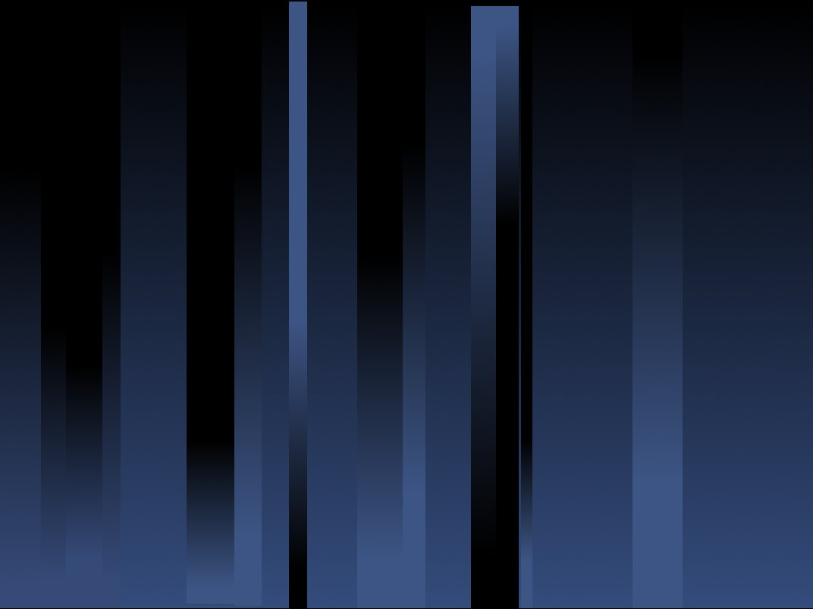
LYRA on-board PROBA2
EUV irradiance inter-calibration workshop
M. Dominique + LYRA team
October 2011, LASP

Slide 2
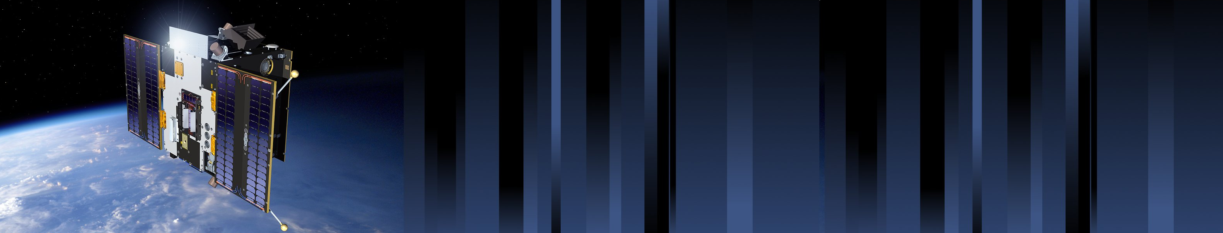

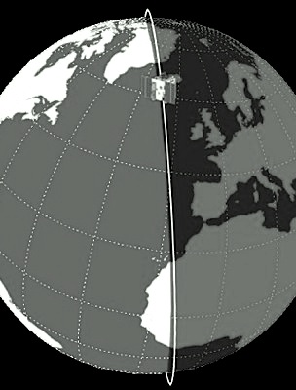
PROBA2 orbit
PROBA2 orbit:
Heliosynchronous
Polar
Dawn-dusk
725 km altitude
Duration of 100 min
Occultation season:
  Visible:October-February
  Maximum duration 20 min per orbit

Slide 3
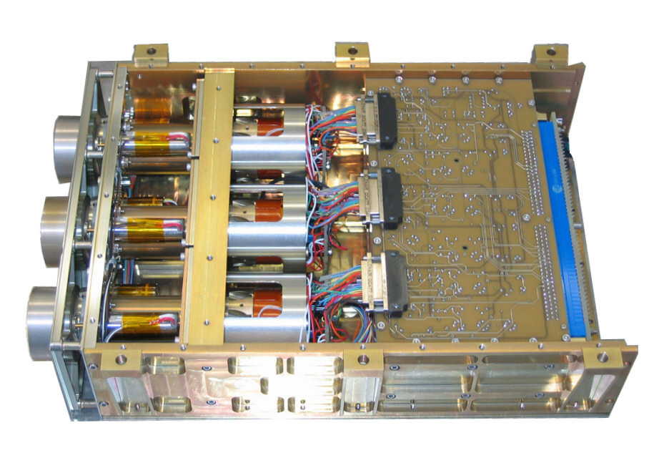
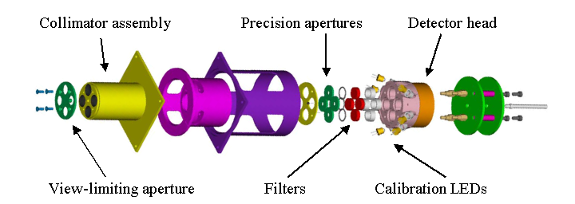
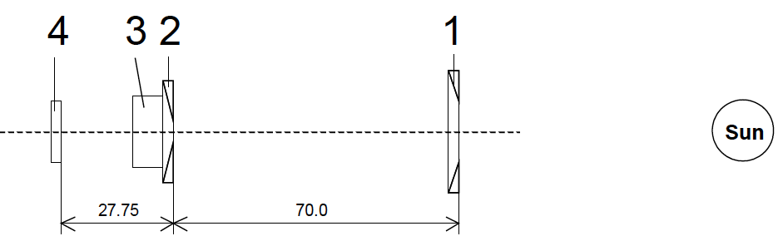
LYRA highlights
1: View-limiting aperture (Ø 8mm)
2: precision aperture (Ø 3mm)
3: filter
4: LEDs (λ 375 and 465 nm)
5: detector (Ø 4mm)
5
4
mm
mm

Slide 4
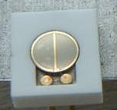
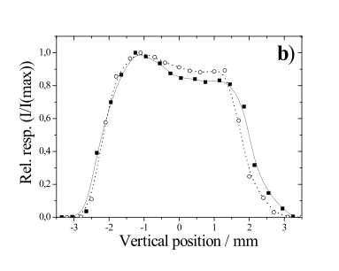
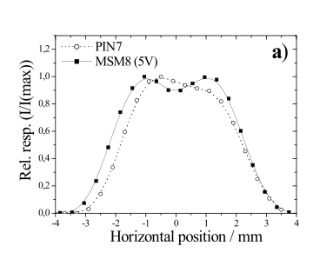
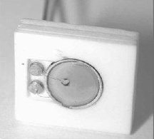
Diamond detectors

Slide 5
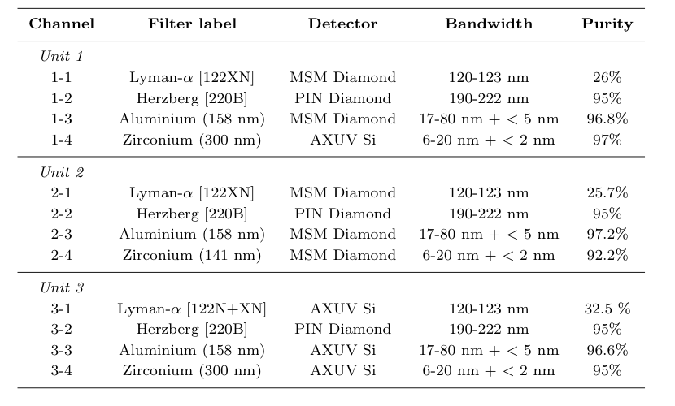
Details of LYRA channels

Slide 6
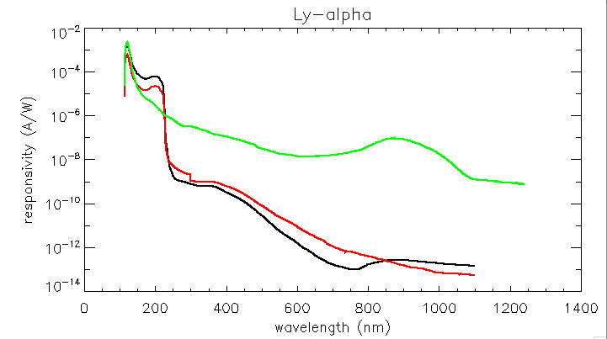
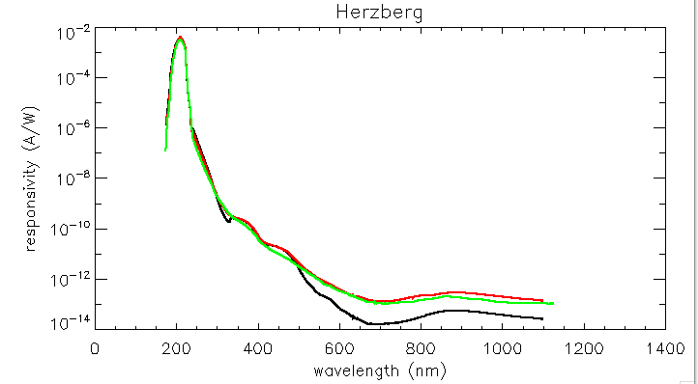
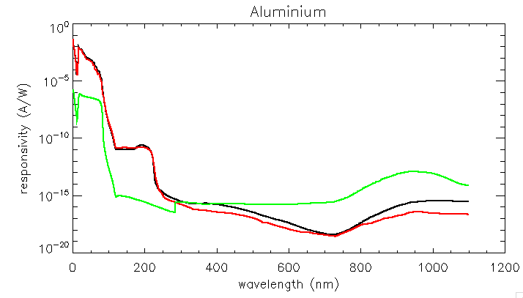
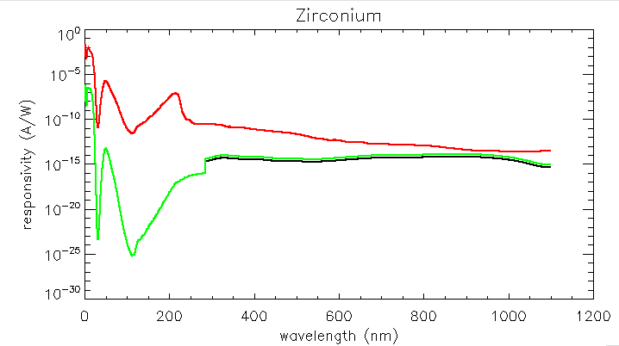
Filter + detector responsivity
Unit 1
Unit 2
Unit 3

Slide 7
Operation: systematic campaigns
 | Integra-tion time | Units | Cover status | LED status | Pointing | Occur-ence
Range | 10ms ➔ 10s | max. two at a time | open / close | off / 375nm / 465nm | 0° (Sun) ➔ 3°
Nominal | 50 ms | U2 | open | off | Sun | N/A
Back-up A | 50ms | U2+3 | open | off | Sun | 1 / 2weeks
Back-up B | 50ms | U2+1 | open | off | Sun | 1 / 3months
Calibra-tion | 50ms | 1) U2+1 2) U2+3 | close | off (DC) on (LED) | N/A | 1/ 2weeks
Paving | 50ms | - | open | off | From 0° to 3° | occasio-nal

Slide 8
Operation: occasional campaigns
Scientific campaigns
    Observation of flares: unit 2 and 3
    Occultations in all three units
    Eclipses in all three units
Bake-out => no real effect so far

Slide 9
Long term evolution
Work still in progress …
Various aspects (to be) investigated:
Degradation due to contaminant layer
Dark current evolution (detector degradation)
Response to LED signal acquisition (detector spectral evolution)
An alternative way to probe the spectral evolution (detector + filter): occultations
Flat-field evolution

Slide 10
Long term evolution
Work still in progress …
Various aspects (to be) investigated:
Degradation due to contaminant layer
Dark current evolution (detector degradation)
Response to LED signal acquisition (detector spectral evolution)
An alternative way to probe the spectral evolution (detector + filter): occultations
Flat-field evolution

Slide 11
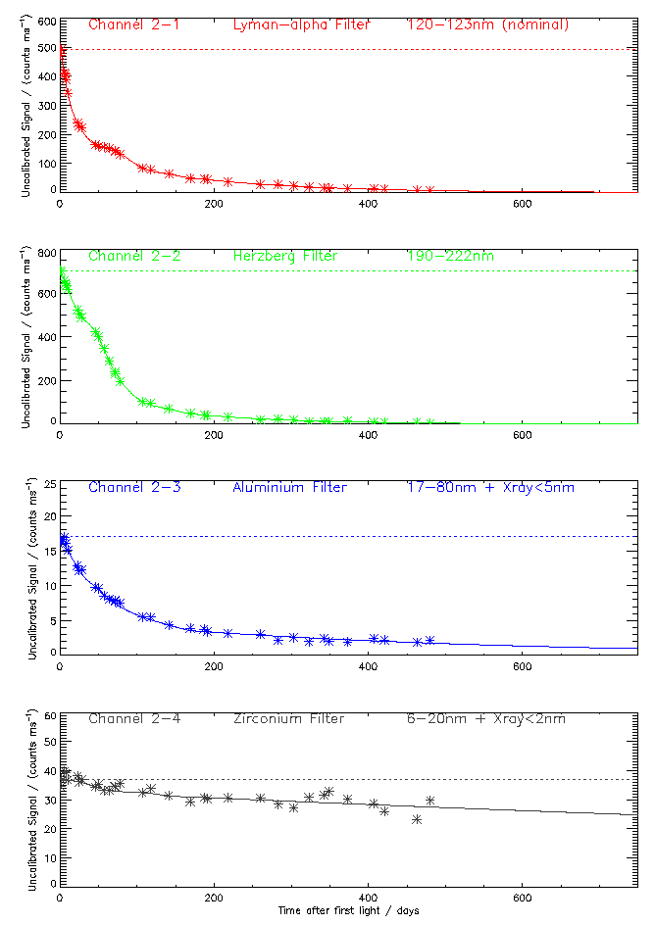
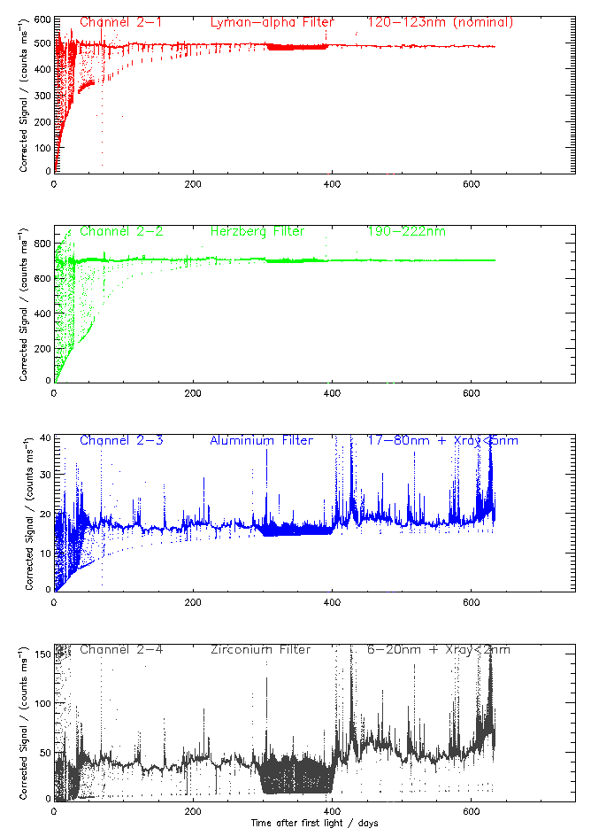
Degradation of unit 2
> 95%
> 95%
Uncalibrated signal (counts/ms)
Corrected signal (counts/ms)
~ 90%
~ 25%
Time after first light (days)
Time after first light (days)

Slide 12
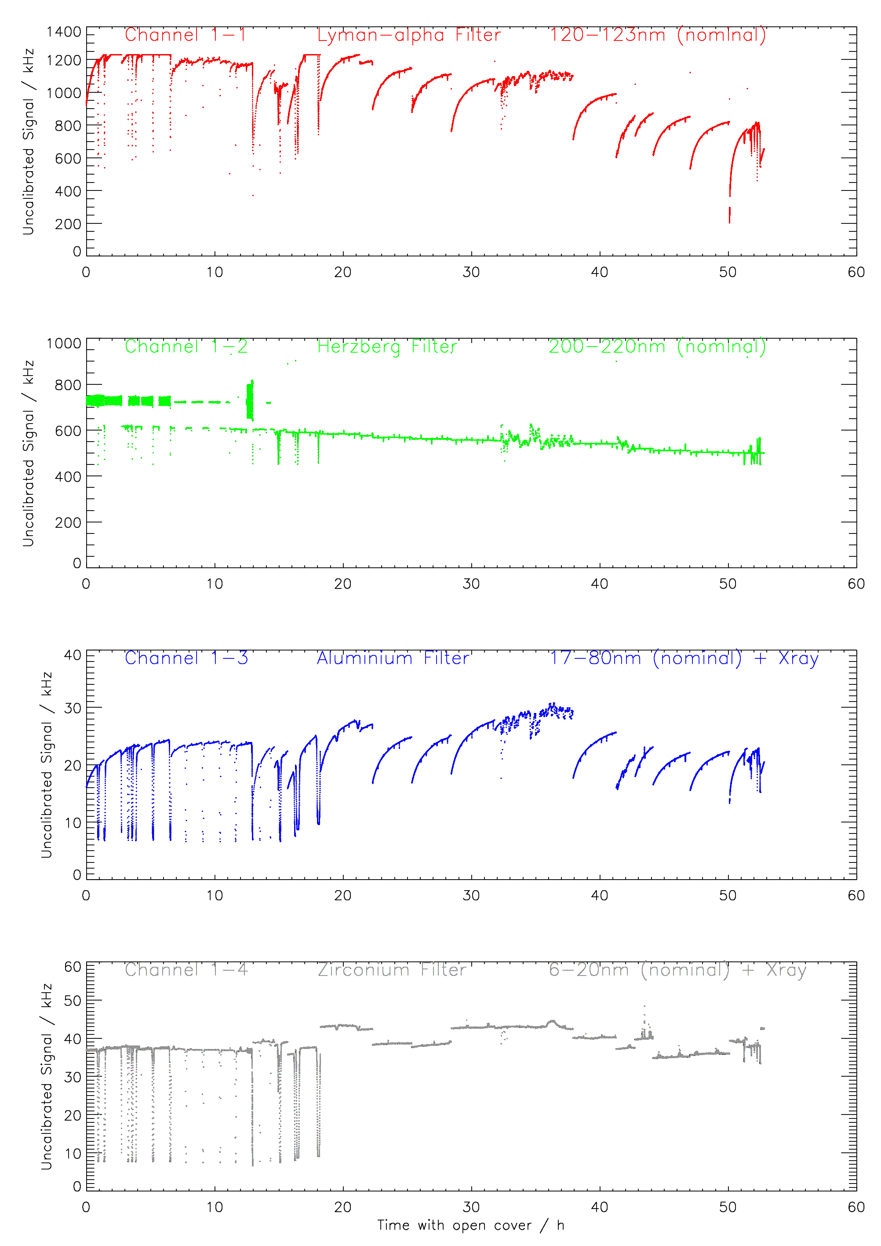
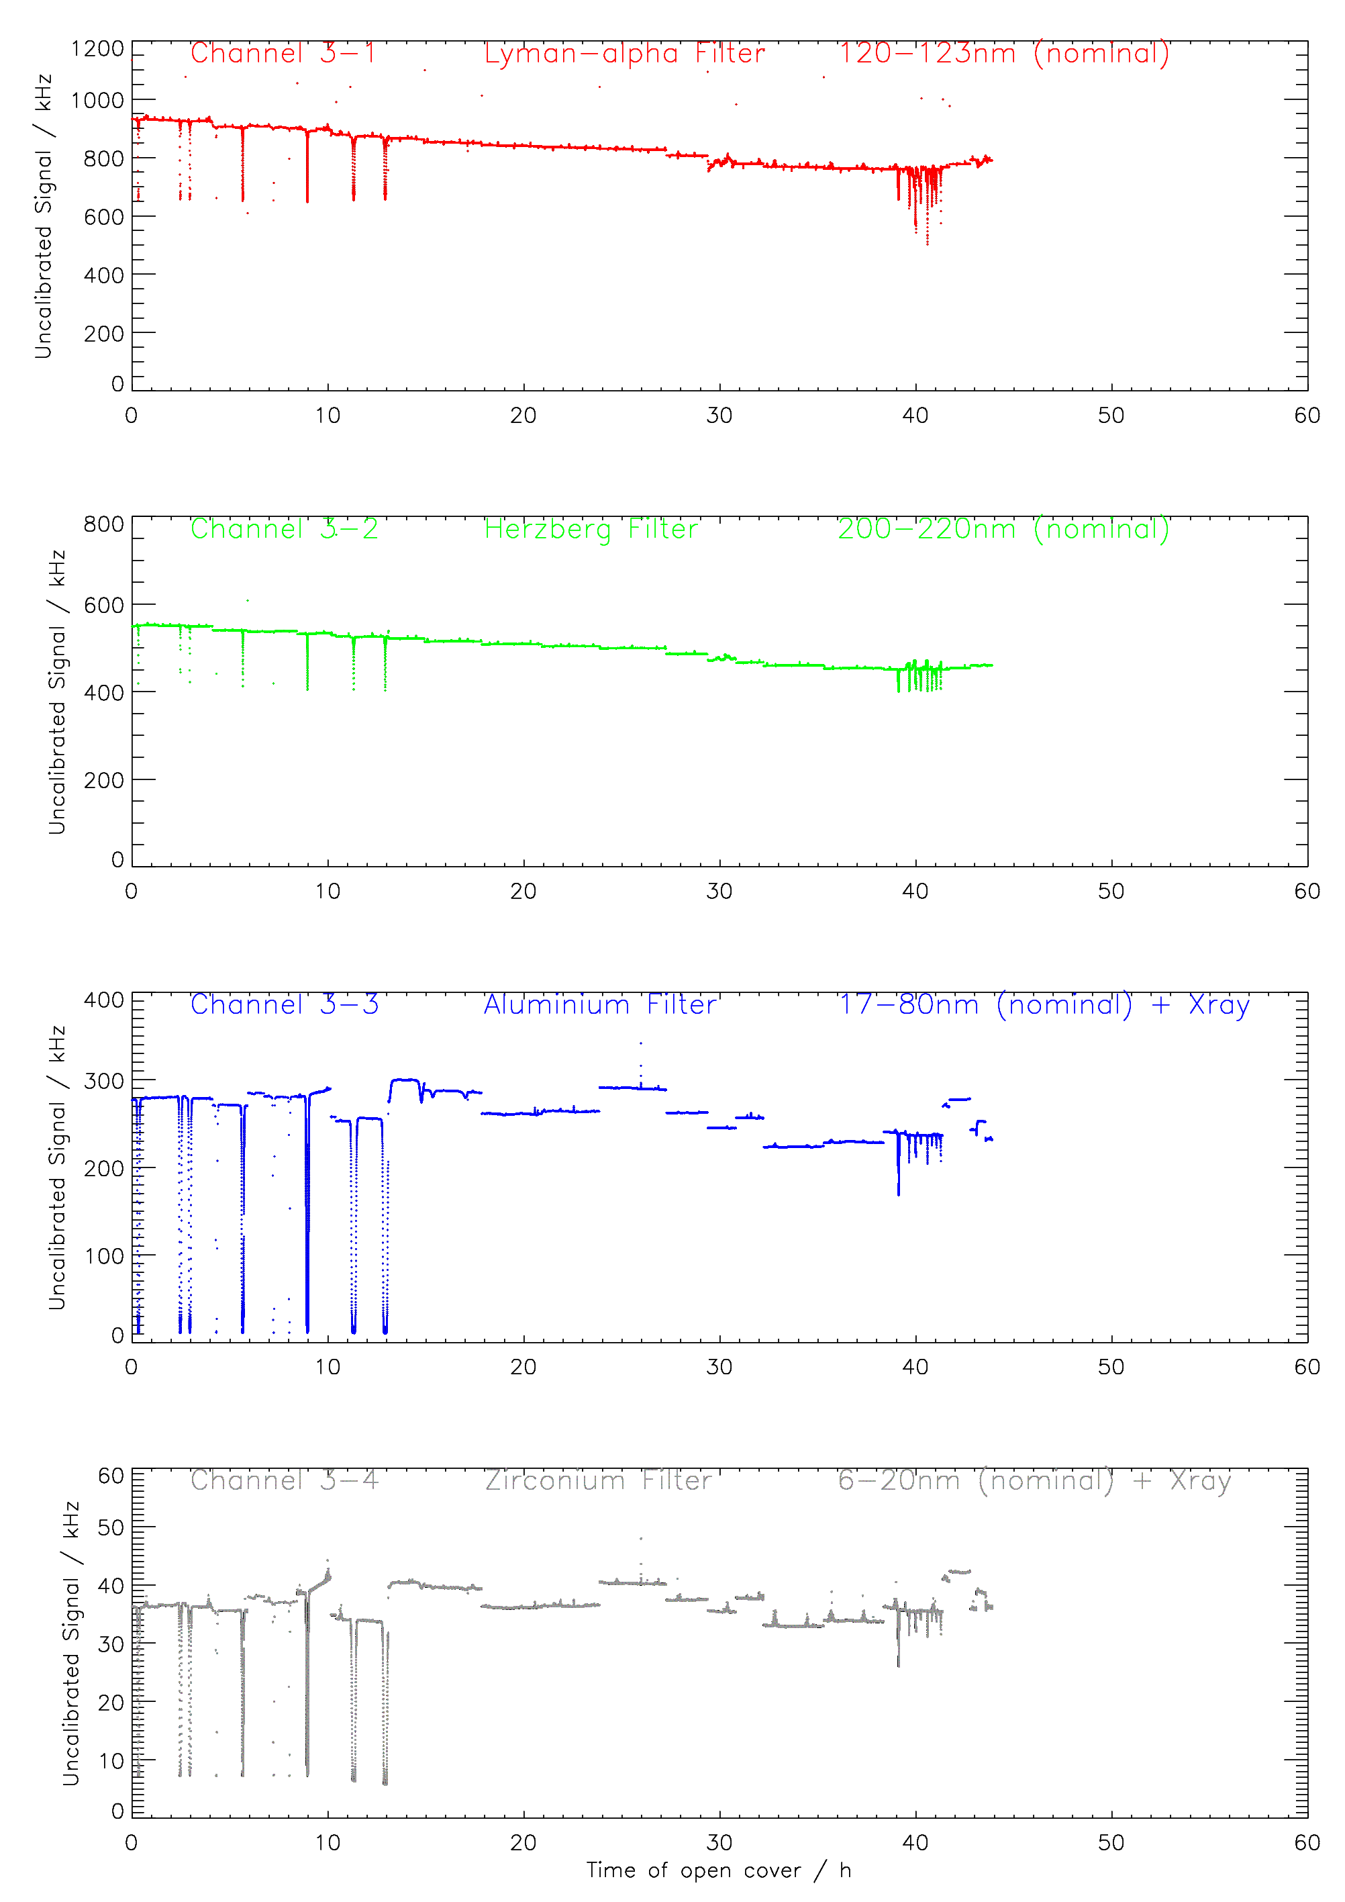
Degradation of units 1 and 3
30%
10%
15%
20%
10%
/
/
/

Slide 13
Long term evolution
Work still in progress …
Various aspects (to be) investigated:
Degradation due to contaminant layer
Dark current evolution (detector degradation)
Response to LED signal acquisition (detector spectral evolution)
An alternative way to probe the spectral evolution (detector + filter): occultations
Flat-field evolution

Slide 14
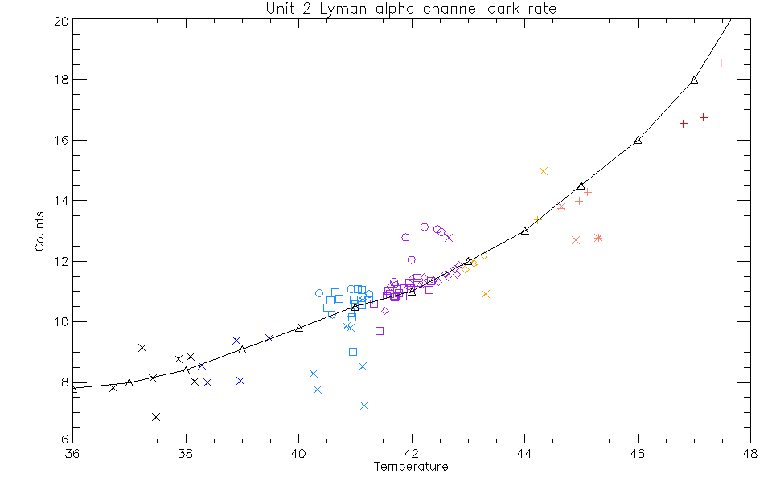
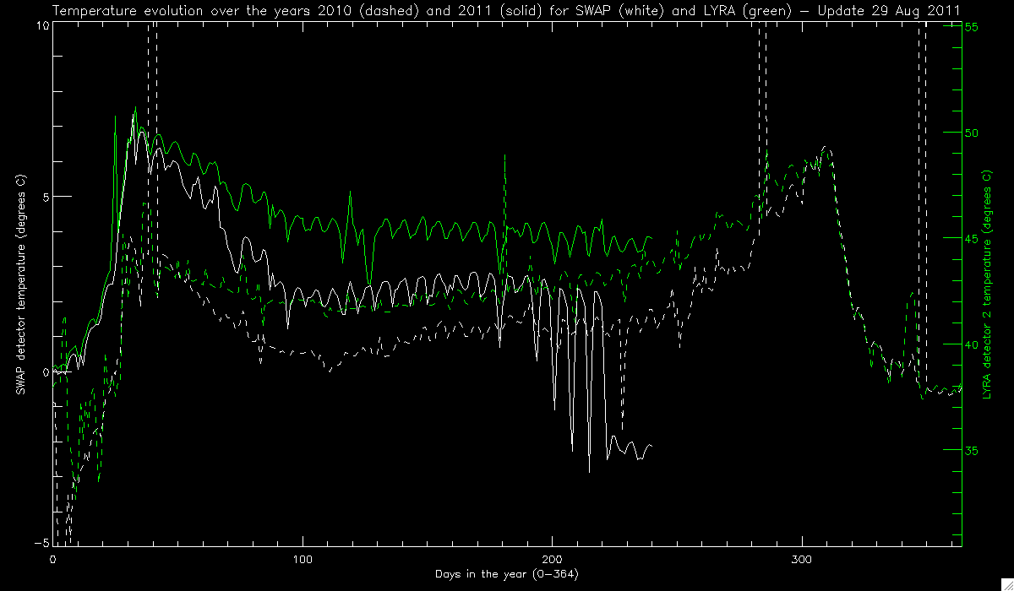
Dark current evolution
Variations correlated with temperature evolution
Dark current in Lyman alpha
Temperature evolution
I. Dammasch + M. Snow
A. De Groof

Slide 15
Long term evolution
Work still in progress …
Various aspects (to be) investigated:
Degradation due to contaminant layer
Dark current evolution (detector degradation)
Response to LED signal acquisition (detector spectral evolution)
An alternative way to probe the spectral evolution (detector + filter): occultations
Flat-field evolution

Slide 16
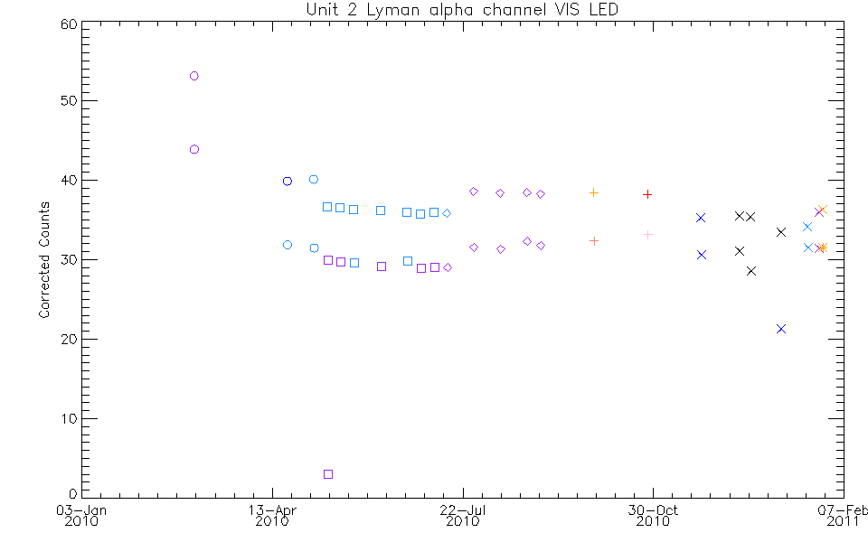
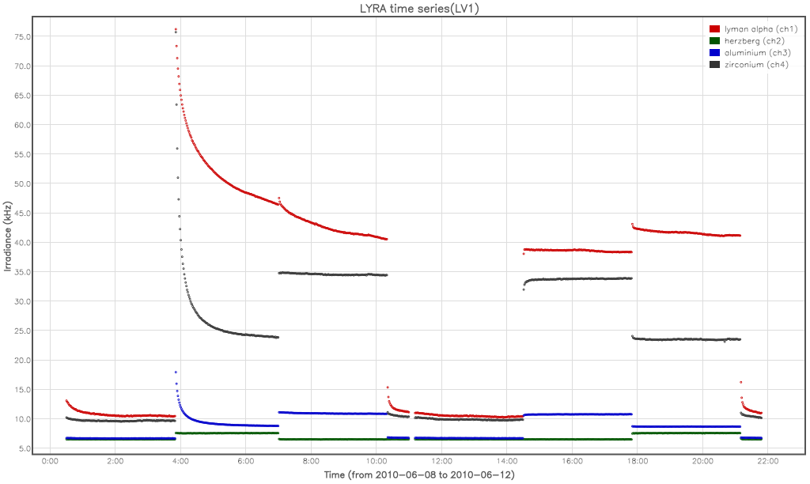
LED signal time series
Very little change over the mission.
Bimodal appearance is due to systematic difference between first and second measurements during each observing sequence.
M. Snow
Low detector degradation,
if any

Slide 17
Long term evolution
Work still in progress …
Various aspects (to be) investigated:
Degradation due to contaminant layer
Dark current evolution (detector degradation)
Response to LED signal acquisition (detector spectral evolution)
An alternative way to probe the spectral evolution (detector + filter): occultations
Flat-field evolution

Slide 18
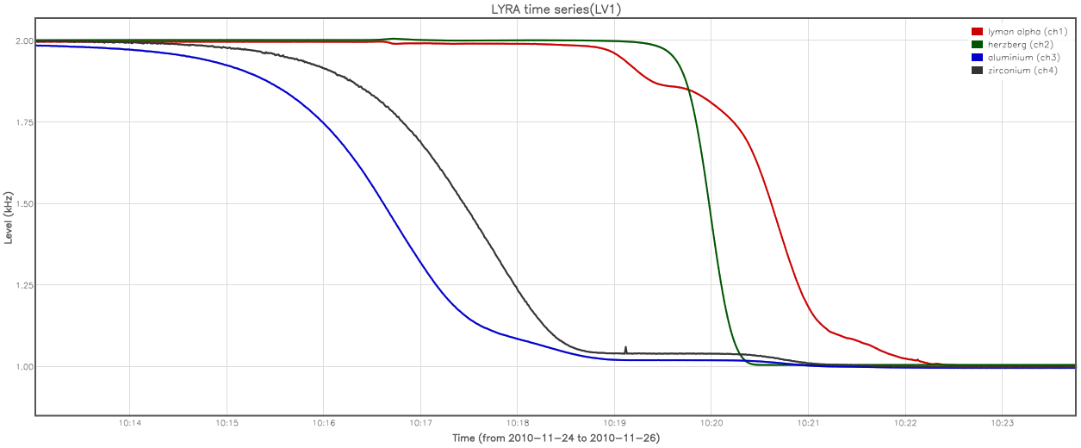
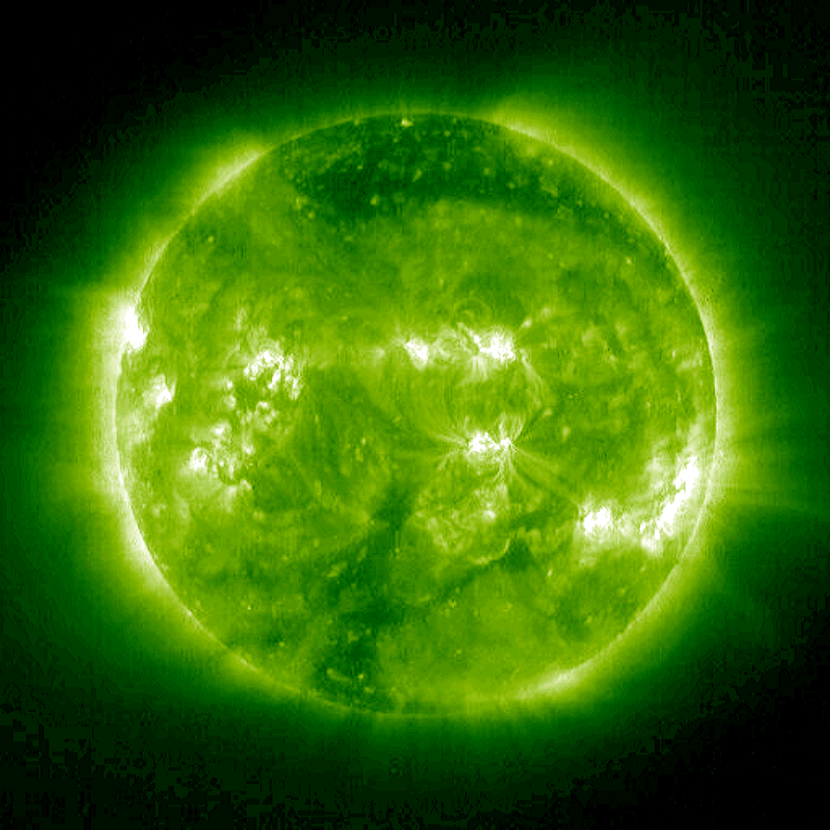
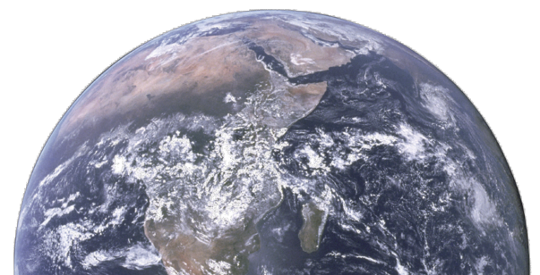
Probing the evolution of bandpasses: occultations
Unit 3
~ 900 nm

Slide 19
Long term evolution
Work still in progress …
Various aspects (to be) investigated:
Degradation due to contaminant layer
Dark current evolution (detector degradation)
Response to LED signal acquisition (detector spectral evolution)
An alternative way to probe the spectral evolution (detector + filter): occultations
Flat-field evolution

Slide 20
Flat-field evolution
Unit 1
7
1
2
3
4
5
6
3mm
Unit 2
(nominal)
5mm substrate
Unit 3

Slide 21
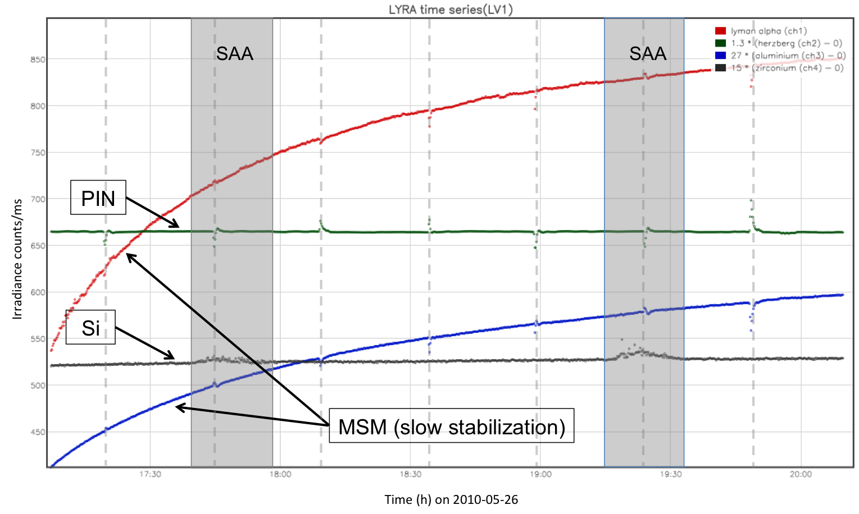
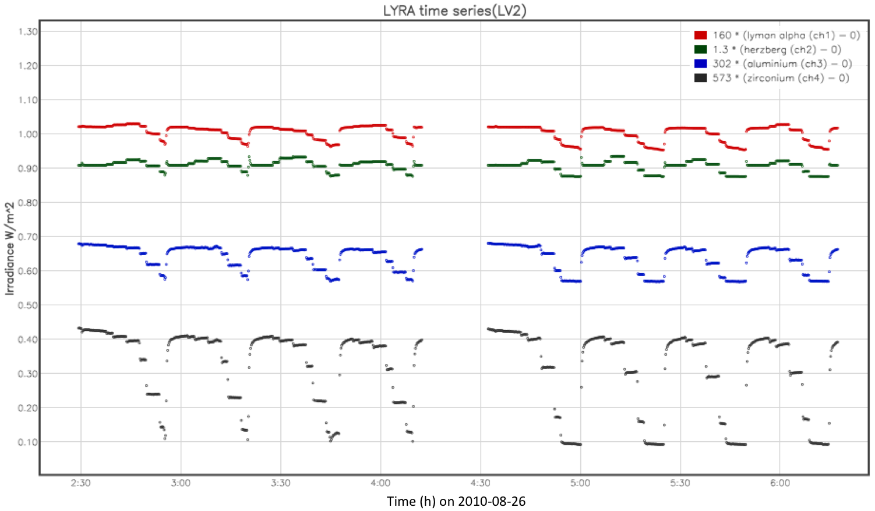
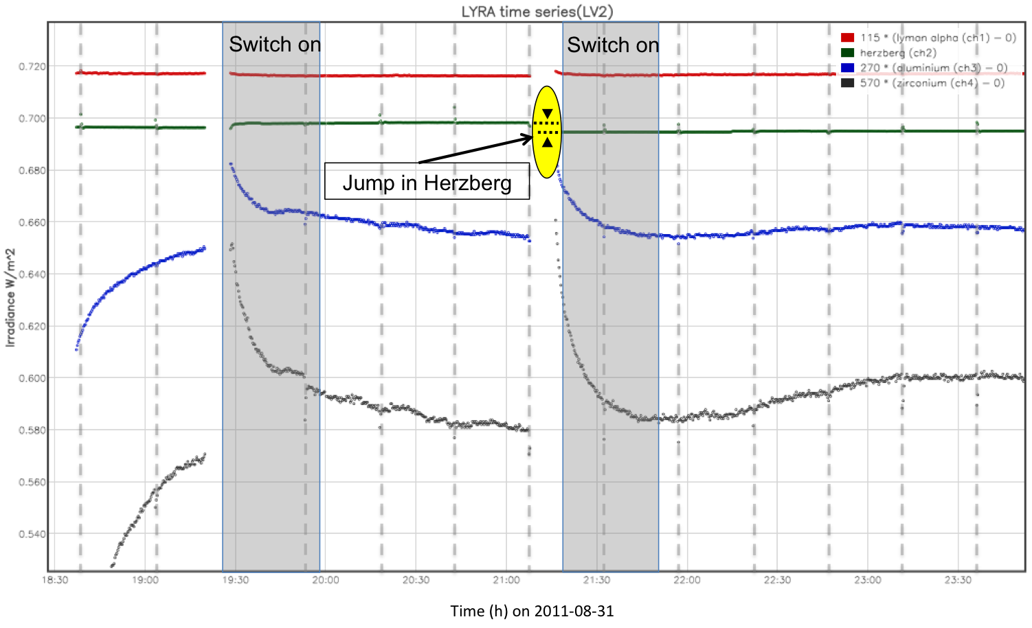
Non-solar features in LYRA data
Large Angle Rotations
Flat field
LAR: four times an orbit
SAA affects more Si detectors independently of their bandpass

Slide 22
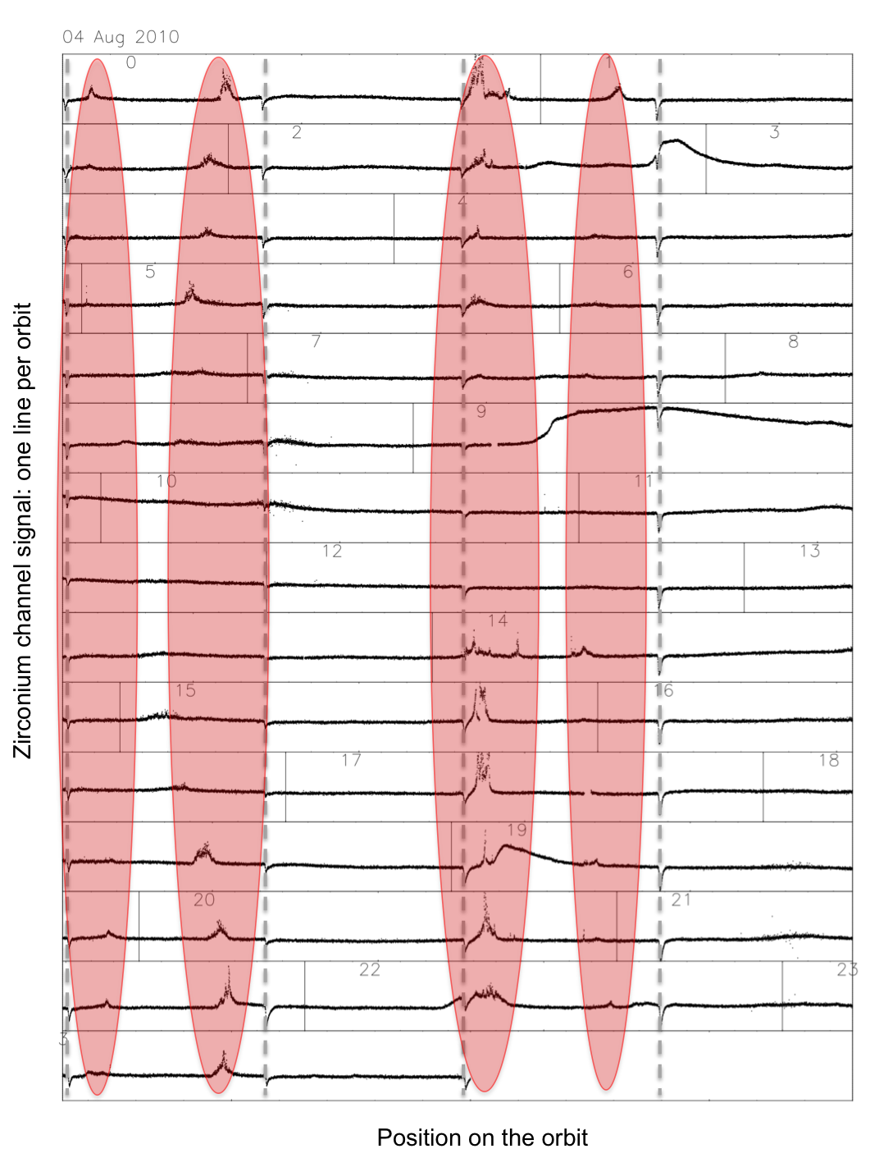
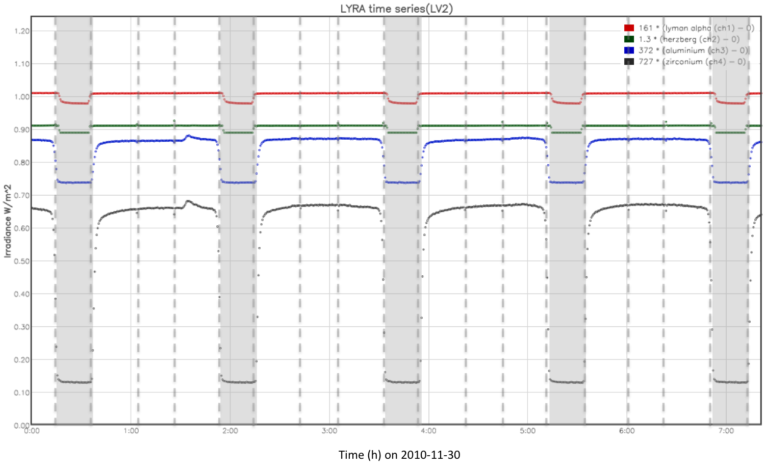
Non-solar features in LYRA data
Occultation: from mid-October to mid-February
Auroral perturbation
  Only when Kp > 3
  Only affects Al and Zr channels independently of the detector type
  Does not affects SWAP (though observing in the same wavelength range)
Occultations

Slide 23
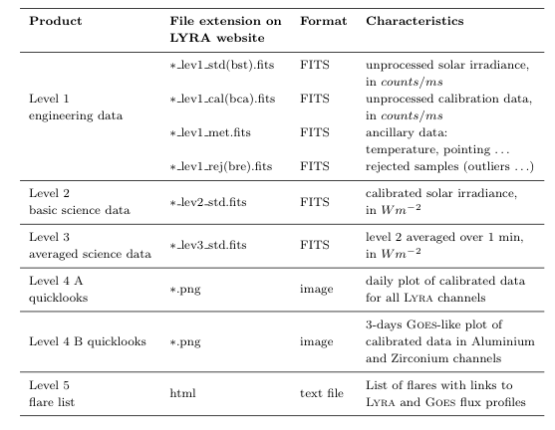
Data products
Data products and quicklook viewer on
http://proba2.sidc.be

Slide 24
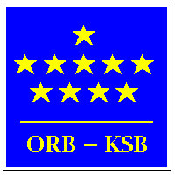




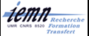


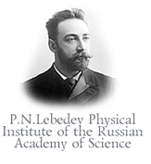



Collaborations

