Slide 1
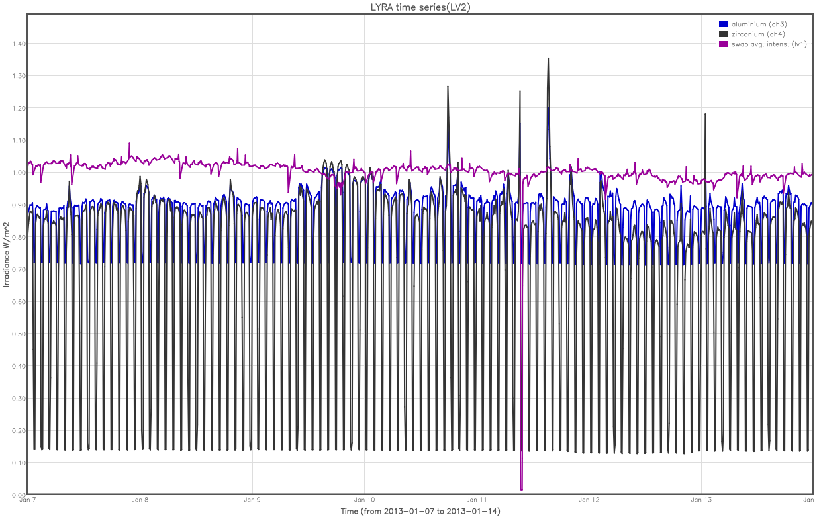
Off-point
ESP
LYRA
flare hunting
M1.0
C8.0
M1.2
M1.0
M1.7
Coordinated
Daily LYRA U3 +
SWAP imaging

