Slide 1
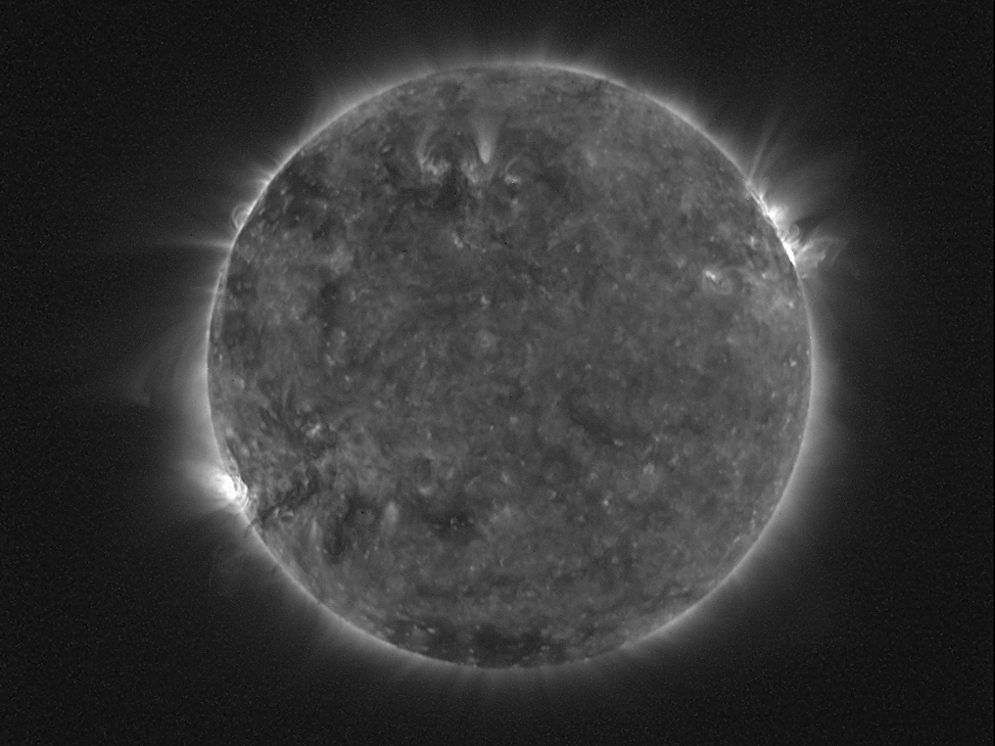
LYRA on-board PROBA2
M. Dominique, I.E. Dammasch, L. Wauters, T. Kastiyannis
http://proba2.oma.be

Slide 2
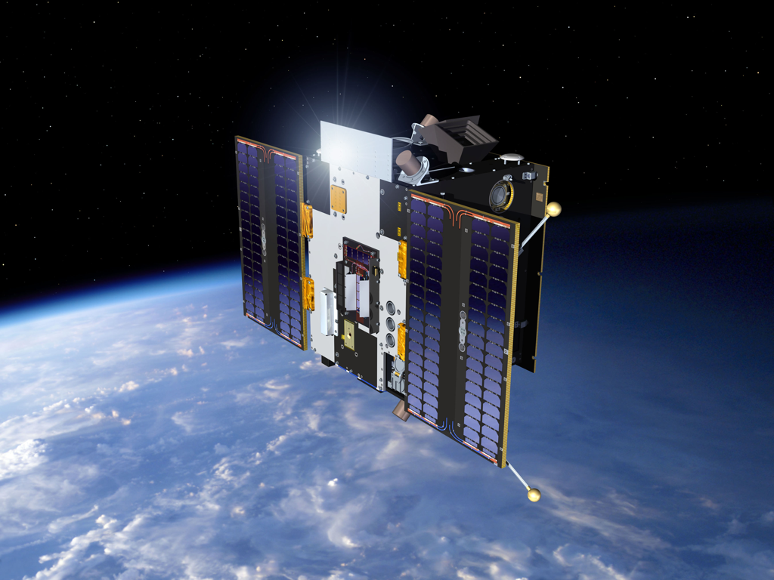
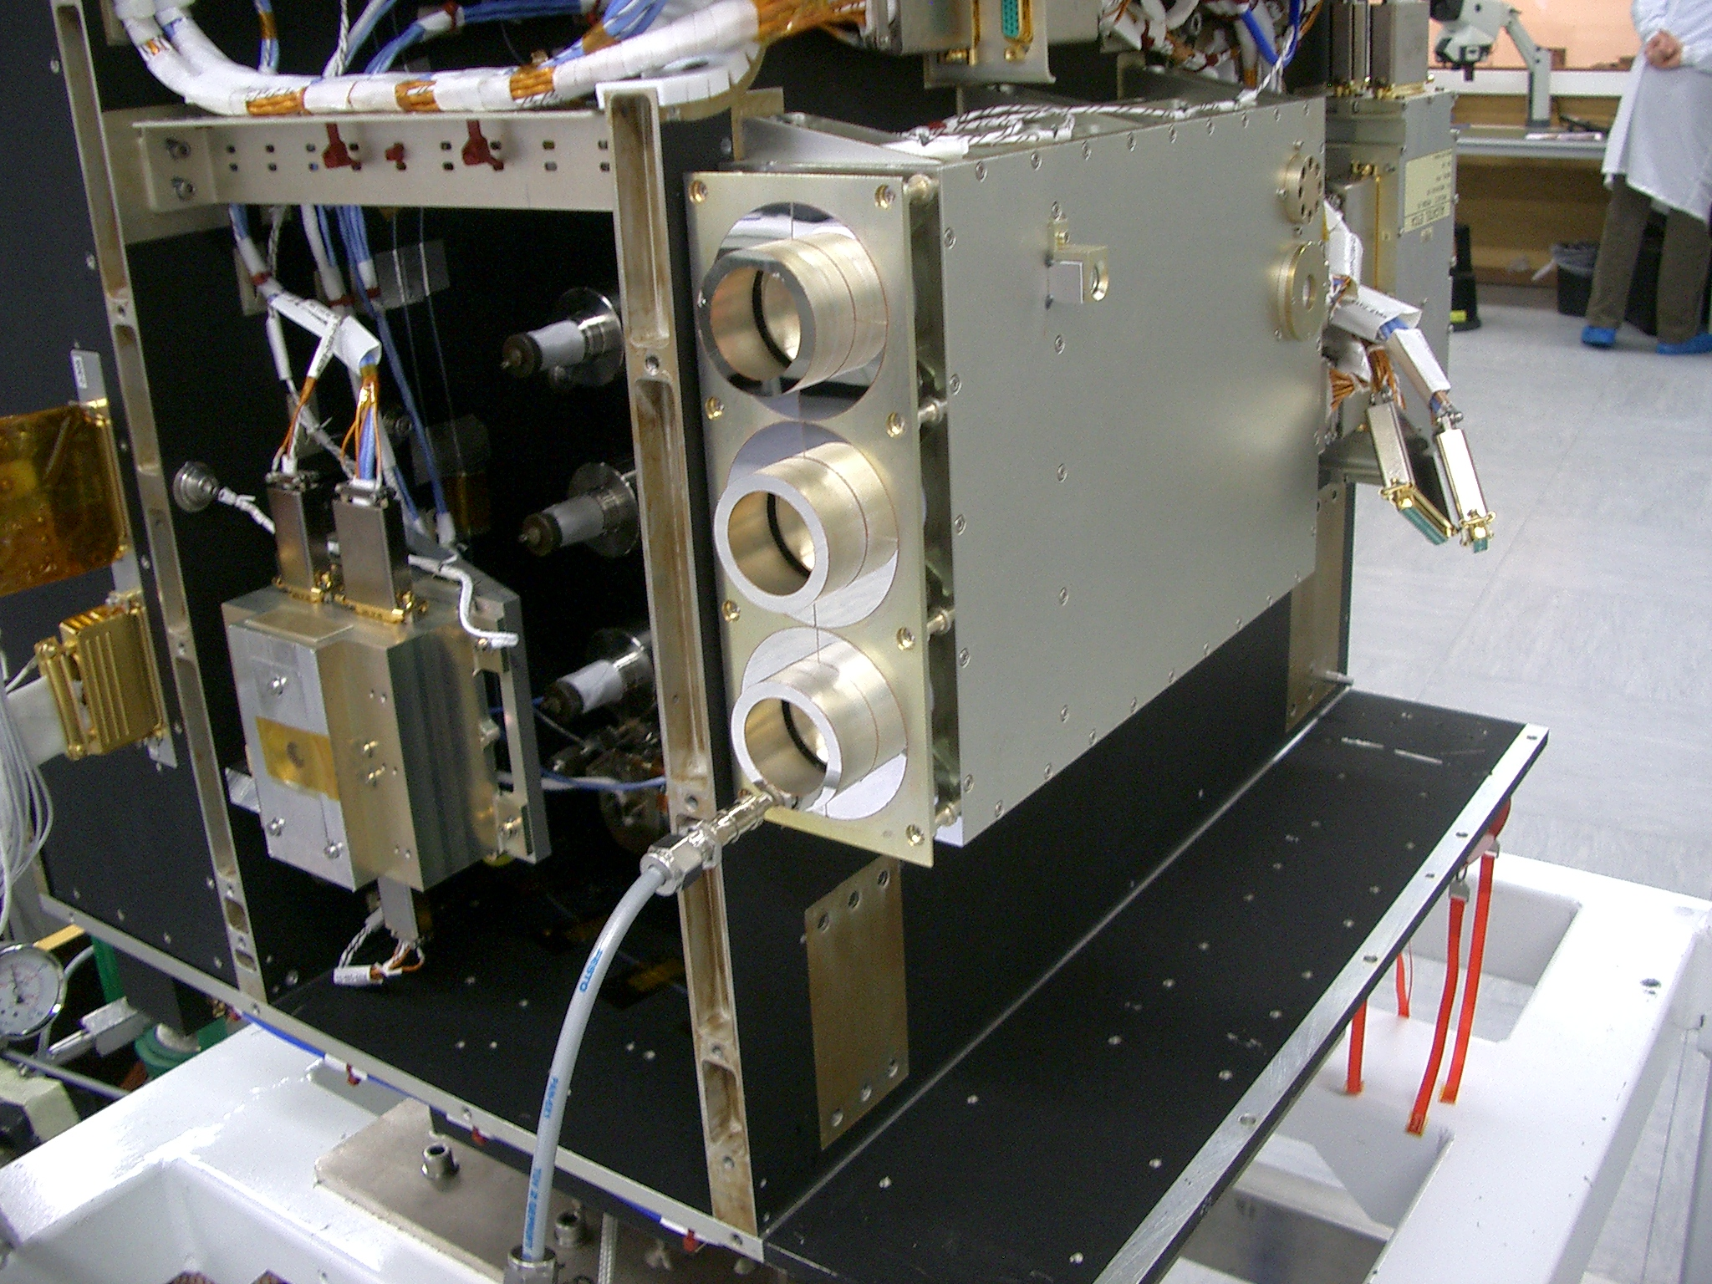
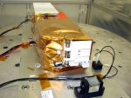
PROBA2: an ESA microsat
LYRA
SWAP
Launched on November 9, 2009
17 technology demonstrators + 4 scientific instruments
LYRA first light on January 6, 2010
Mission currently founded till end 2012. Extension procedure is on-going.

Slide 3
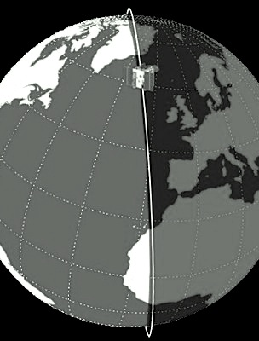
PROBA2 orbit
PROBA2 orbit:
Heliosynchronous
Polar
Dawn-dusk
725 km altitude
Duration of 100 min
Occultation season:
From October to February
Maximum duration 20 min per orbit

Slide 4
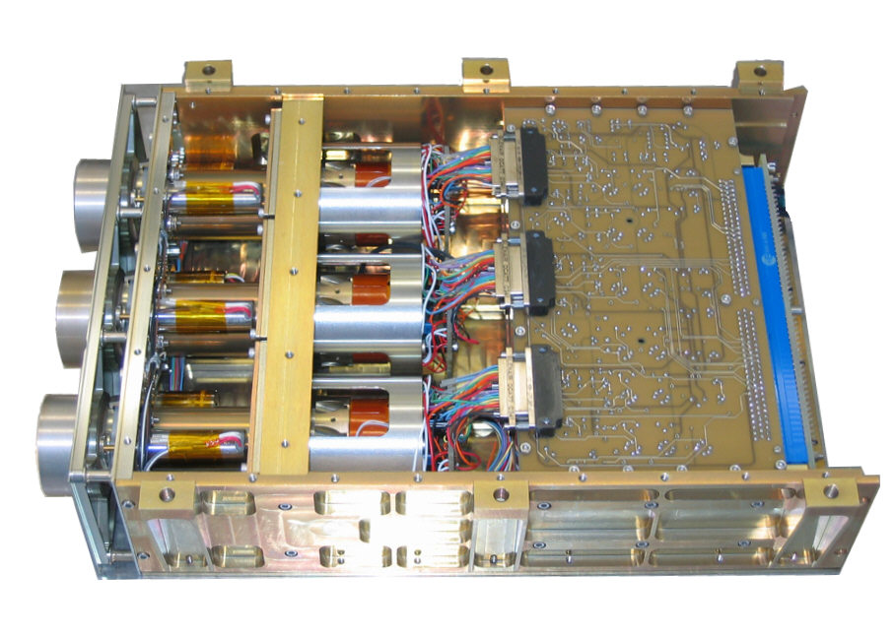
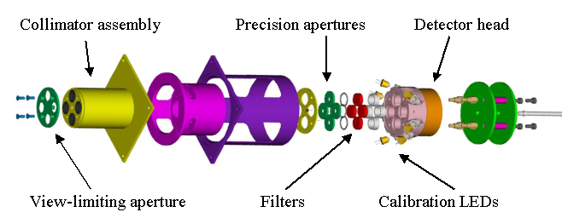
LYRA highlights
3 redundant units protected by independent covers
4 broad-band channels
High acquisition cadence: nominally 20Hz
3 types of detectors:
Standard silicon
2 types of diamond detectors: MSM and PIN
radiation resistant
blind to radiation > 300nm
Calibration LEDs withλof 370 and 465 nm

Slide 5
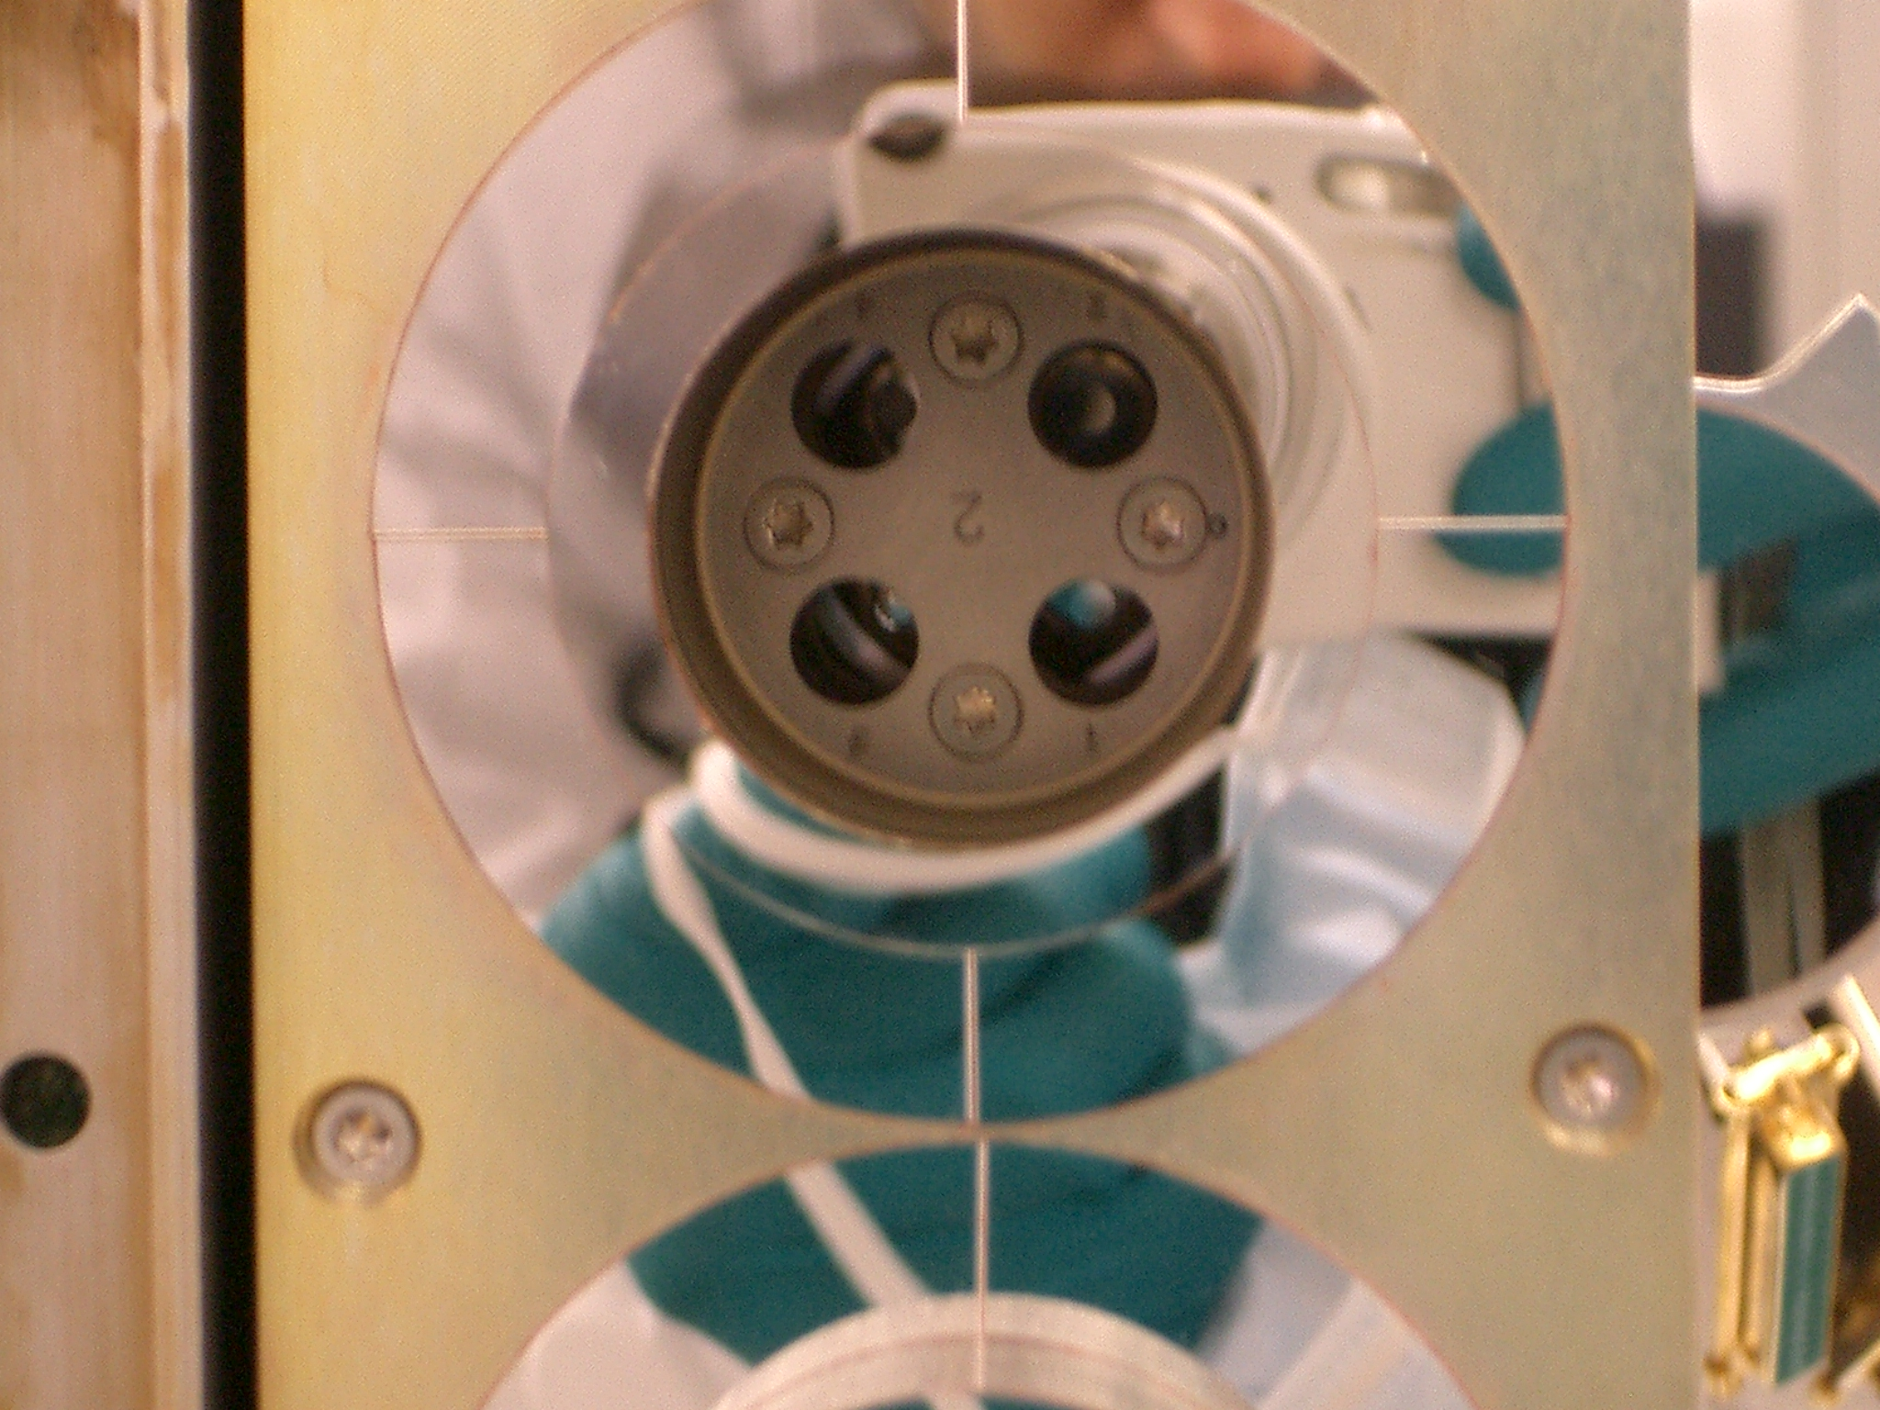
Details of LYRA channels
Channel 1 – Lyman alpha
120-123 nm
Purity : ∼25%
Channel 3 – Aluminium
17-80 nm + < 5nm
Purity : ∼97%
Unit 1 | Unit 2 | Unit 3
MSM | MSM | Si
Unit 1 | Unit 2 | Unit 3
MSM | MSM | Si
Channel 2 – Herzberg
190-222 nm
Purity : ∼95%
Channel 4 – Zirconium
6-20 nm + < 2nm
Purity : ∼95%
Unit 1 | Unit 2 | Unit 3
PIN | PIN | PIN
Unit 1 | Unit 2 | Unit 3
Si | MSM | Si

Slide 6
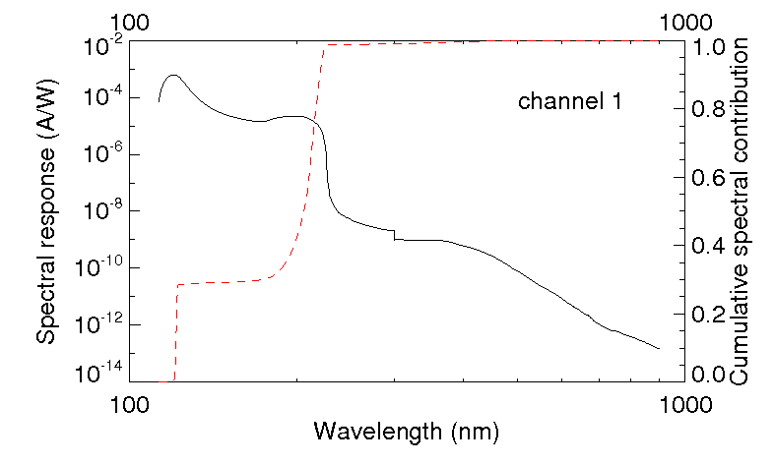
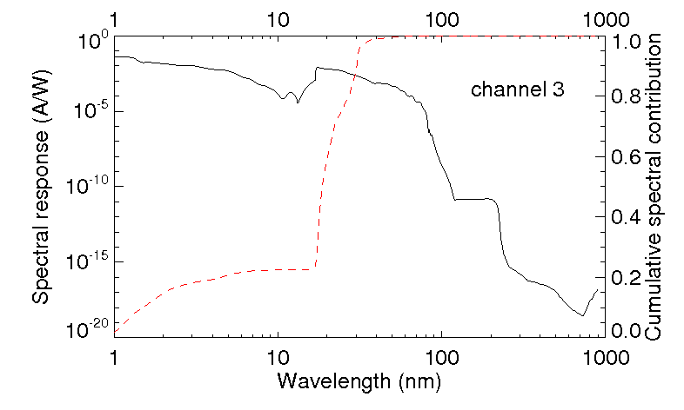
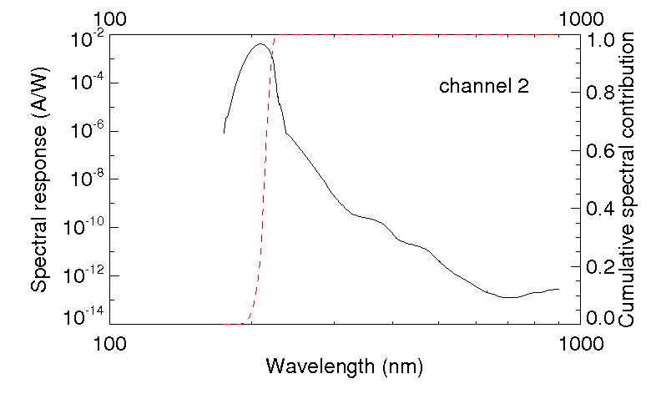
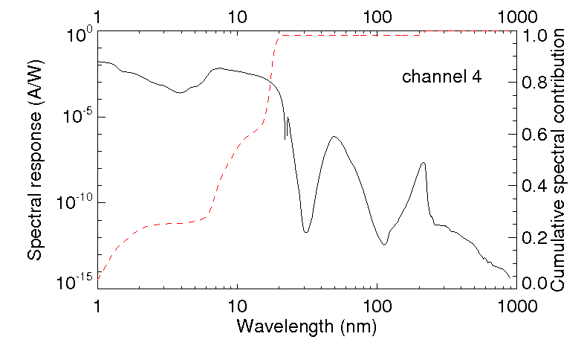
LYRA channels convolved with quiet Sun spectrum
Channel 1 – Lyman alpha
120-123 nm
Channel 3 – Aluminium
17-80 nm + < 5nm
Channel 2 – Herzberg
190-222 nm
Channel 4 – Zirconium
6-20 nm + < 2nm

Slide 7
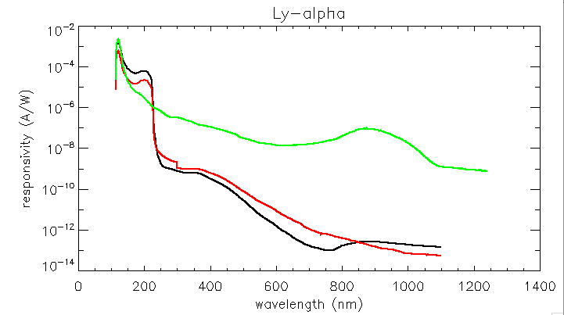
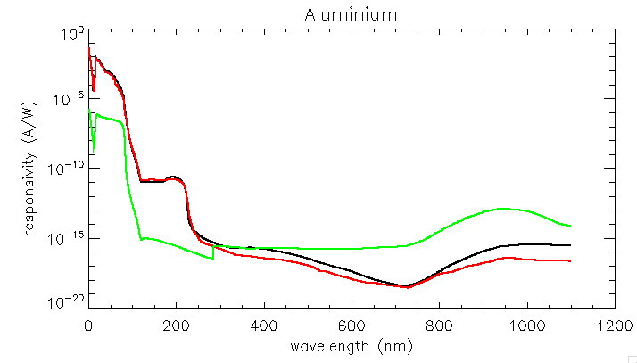
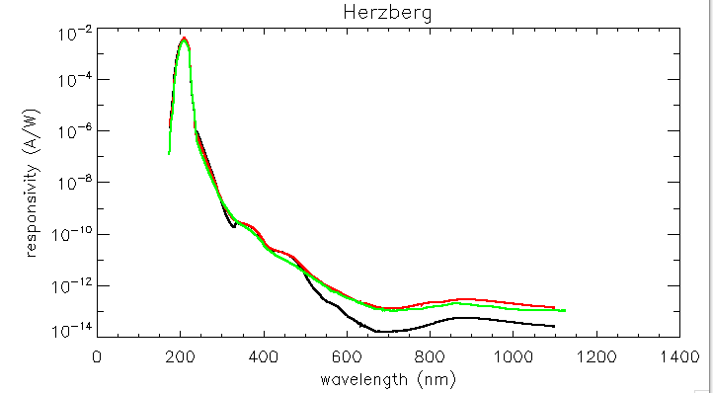
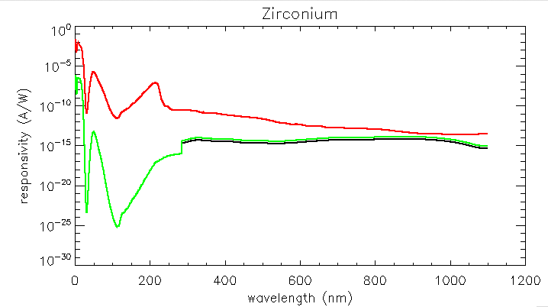
Filter + detector combined responsivity
Bump in C around 220nm
Bump in Si around 900nm
Diamond cut-off
Unit 1
Unit 2
Unit 3

Slide 8
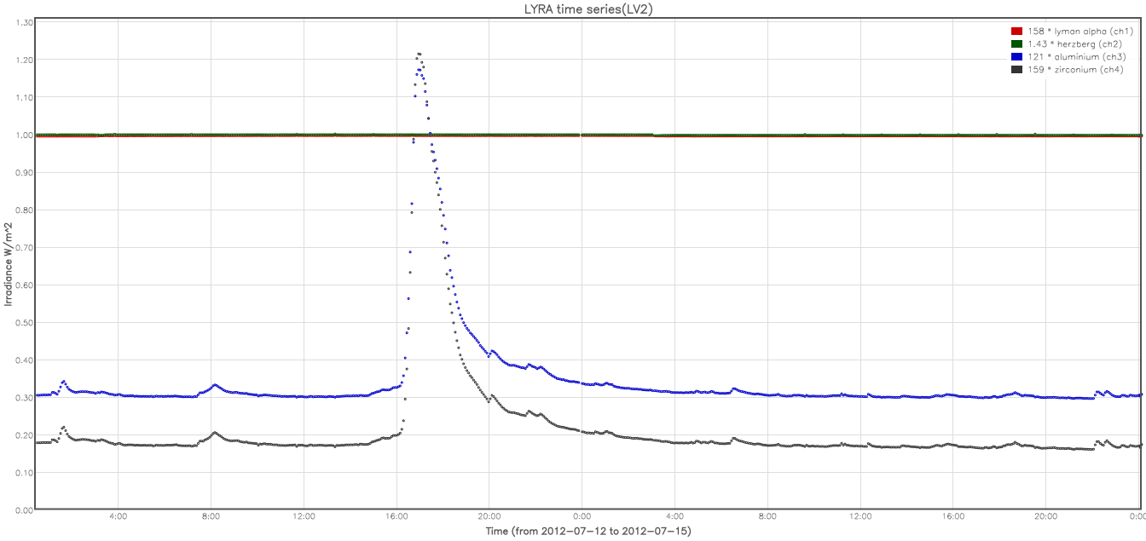
Example of LYRA data

Slide 9
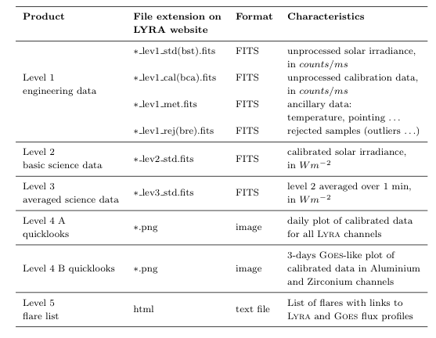
Data products
Data products and quicklook viewer on
http://proba2.oma.be

Slide 10
Calibration
Includes:
Dark-current subtraction
Additive correction of degradation
Rescale to 1 AU
Conversion from counts/ms into physical units (W/m2)
ATTENTION: this conversion uses a synthetic spectrum from SORCE/SOLSTICE and TIMED/SEE at first light => LYRA data are scaled to TIMED/SORCE ones
Does not include (yet)
Flat-field correction
Stabilization trend for MSM diamond detectors

Slide 11
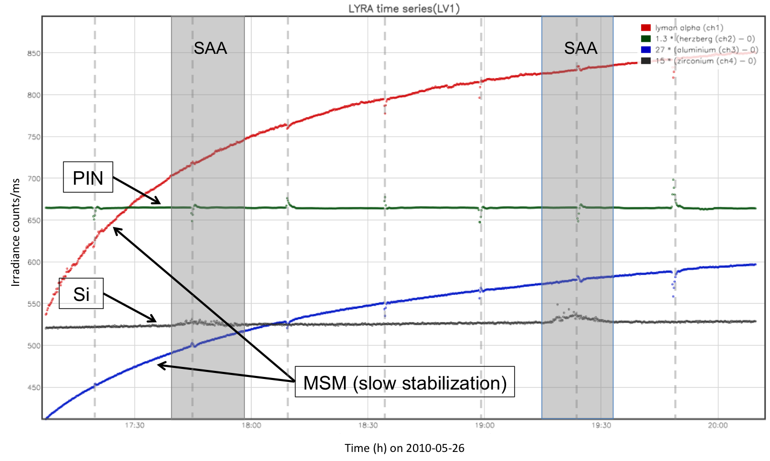
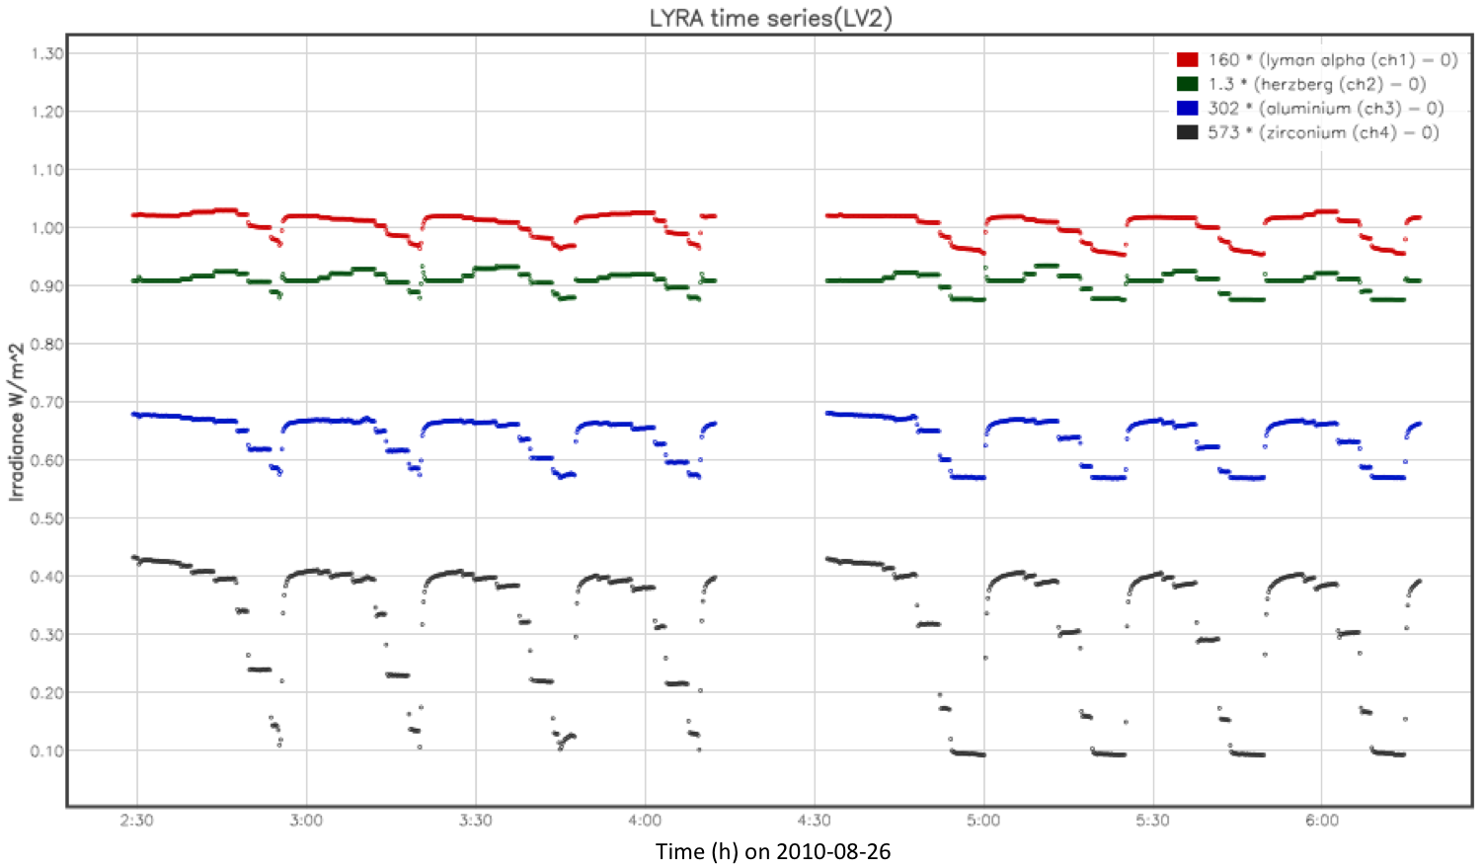
Non-solar features in LYRA data
Large Angle Rotations
LAR: four times an orbit
SAA affects more Si detectors independently of their bandpass
Flat-field: Proba2 pointing is stable up to 5arcsec /min (from SWAP). Jitter introduces fluctuations in the LYRA signal of less than 2%.
Flat field

Slide 12
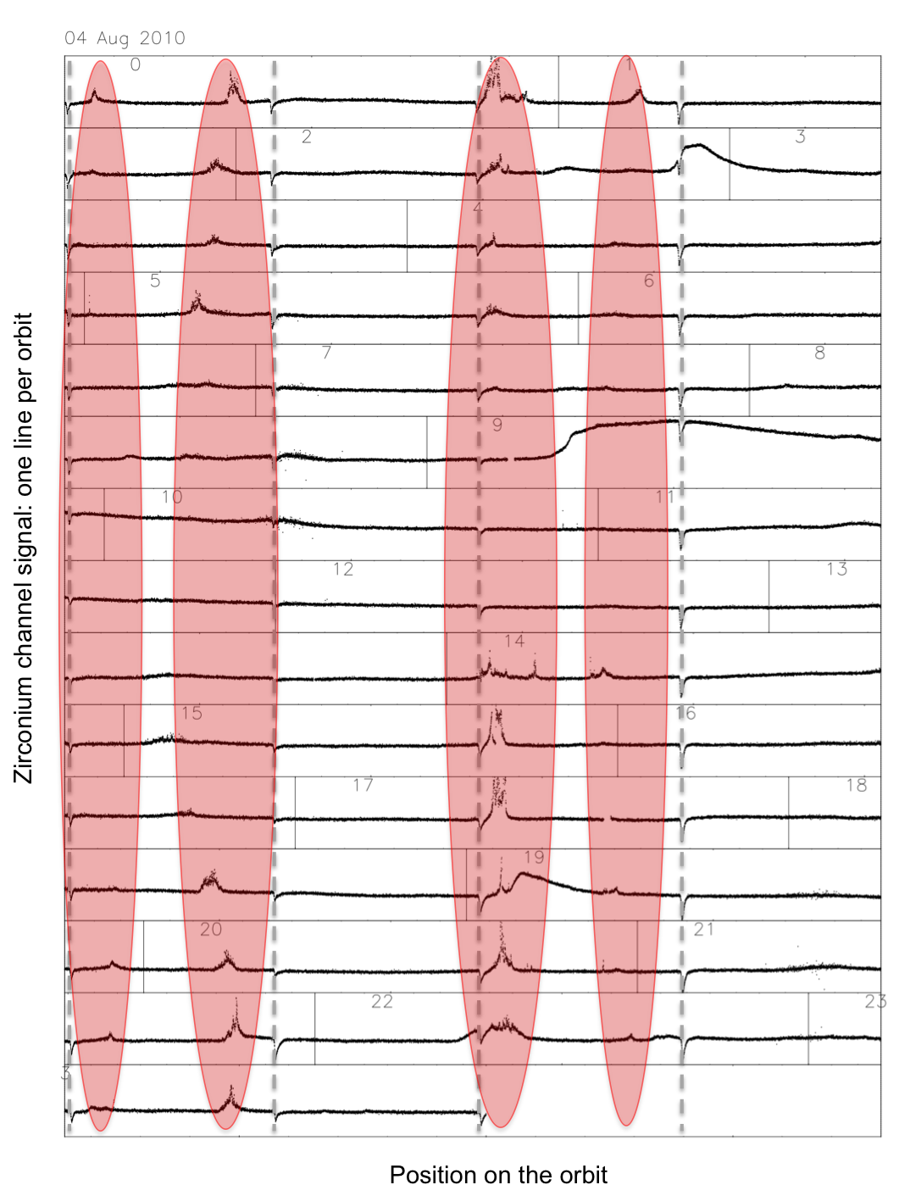
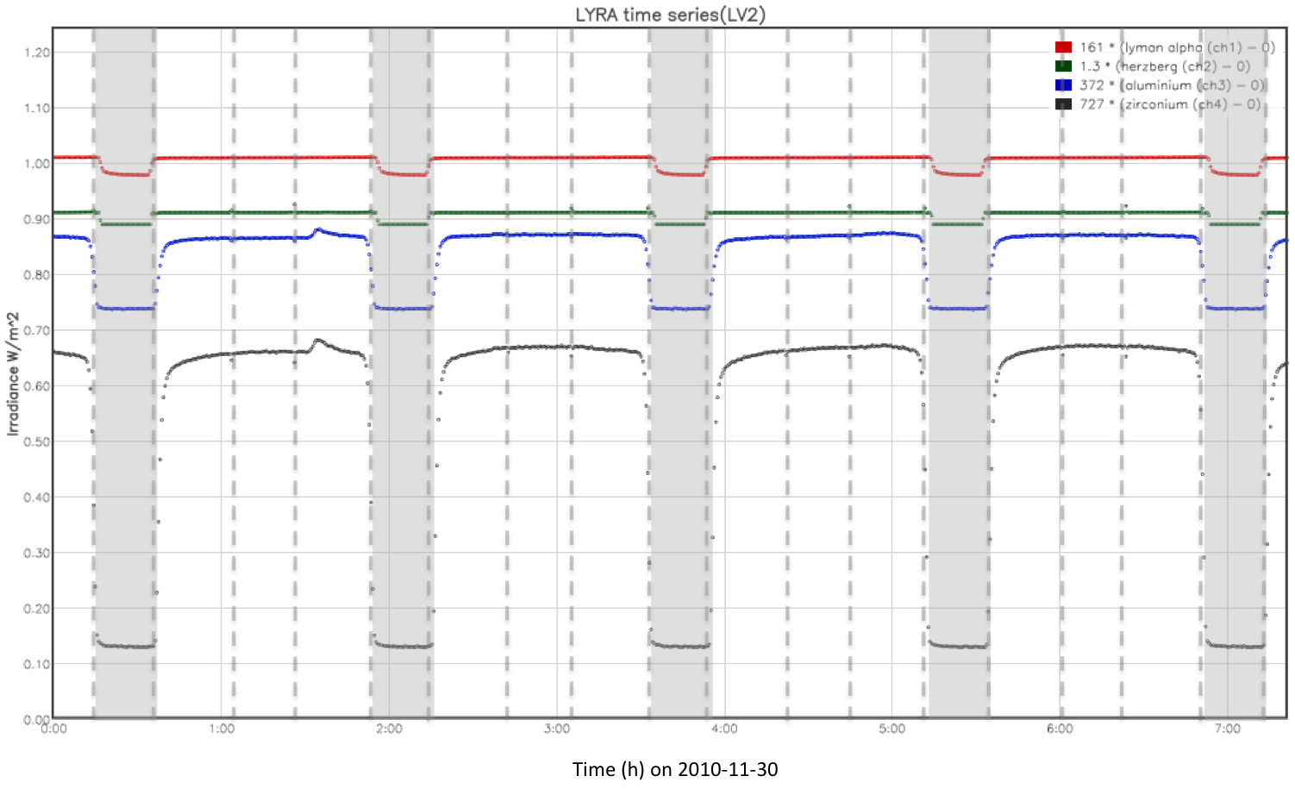
Non-solar features in LYRA data
Occultation: from mid-October to mid-February
Auroral perturbation
Only when Kp > 3
Only affects Al and Zr channels independently of the detector type
Does not affects SWAP (though observing in the same wavelength range)
Occultations

Slide 13
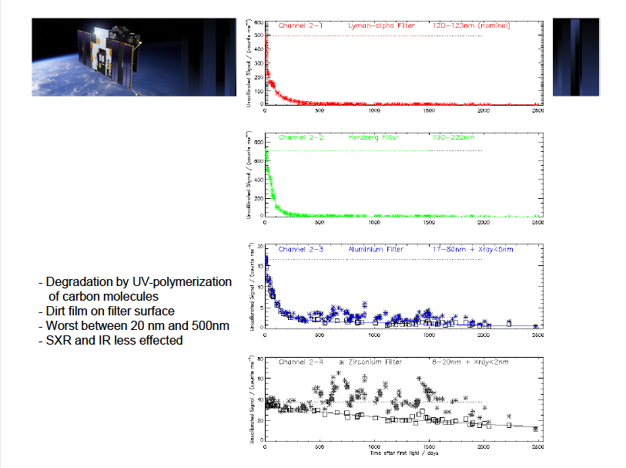

Slide 14
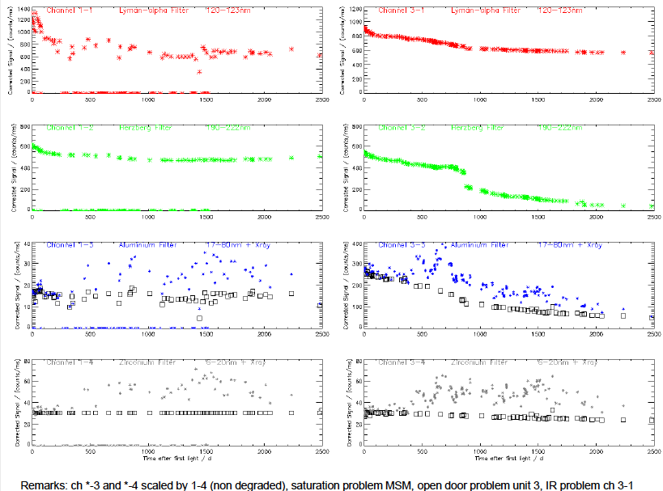

Slide 15
Degradation
Status on February 15, 2016
Channel | Remaining signal
Unit 1
Channel 1-1 | 62%
Channel 1-2 | 75%
Channel 1-3 | 100%
Channel 1-4 | 100%
Channel | Remaining signal
Unit 2
Channel 2-1 | 0.6%
Channel 2-2 | 0.03%
Channel 2-3 | 3%
Channel 2-4 | 30%
Channel | Remaining signal
Unit 3
Channel 3-1 | 61%
Channel 3-2 | 9%
Channel 3-3 | 19%
Channel 3-4 | 71%
=> Slow evolution

Slide 16
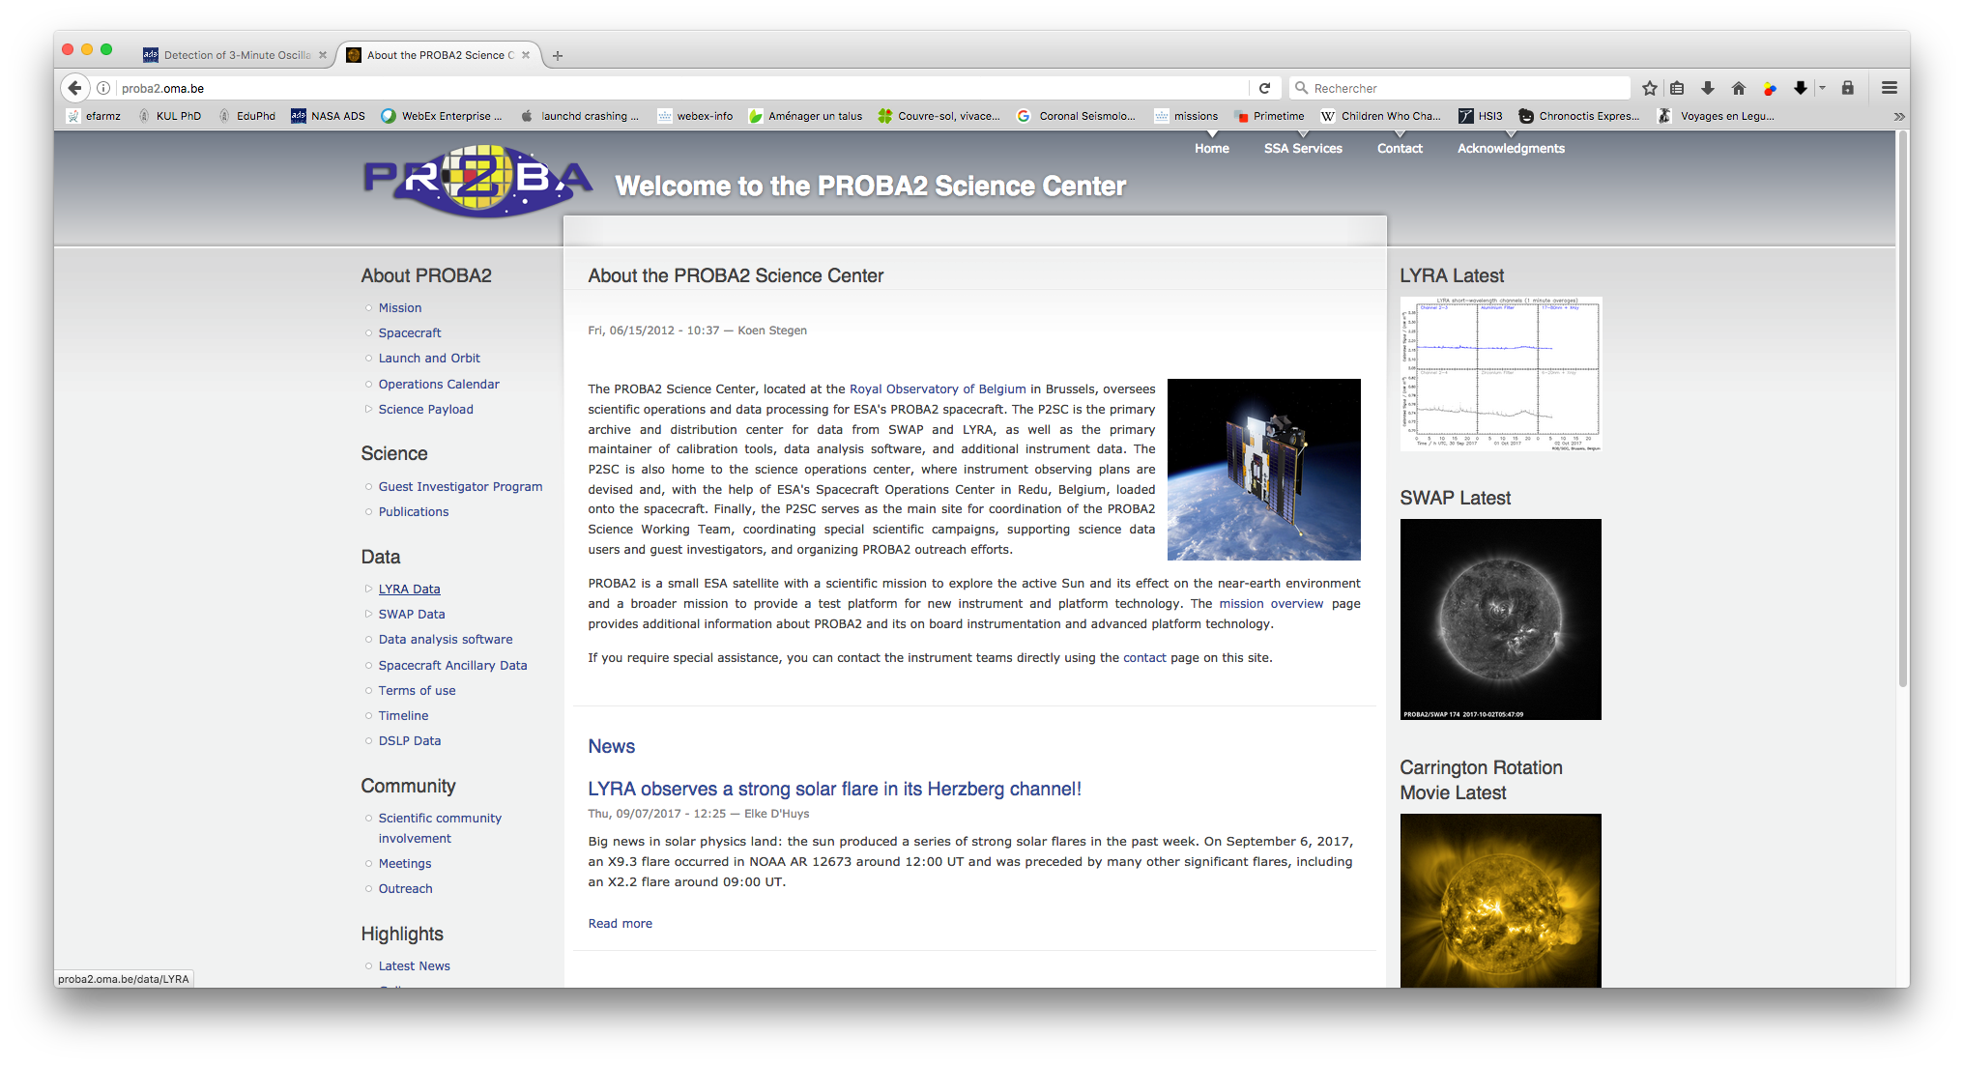
Getting LYRA data

Slide 17
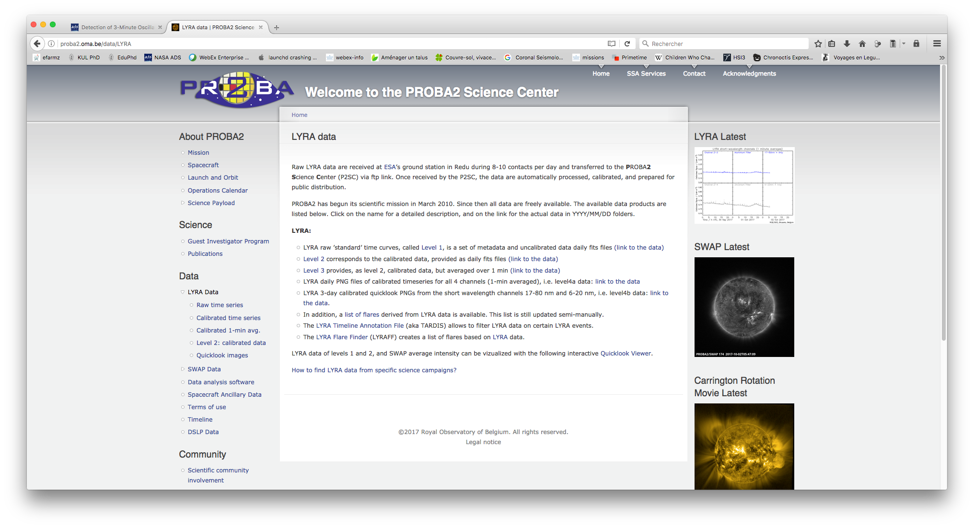
Getting LYRA data: description

Slide 18
Getting LYRA data: link to the data
… or
lyra_download_data and read_lyra/read_lyrametadata in SolarSoft
using sunpy.lightcurve in Python

Slide 19
Getting LYRA data: quicklook viewer

Slide 20
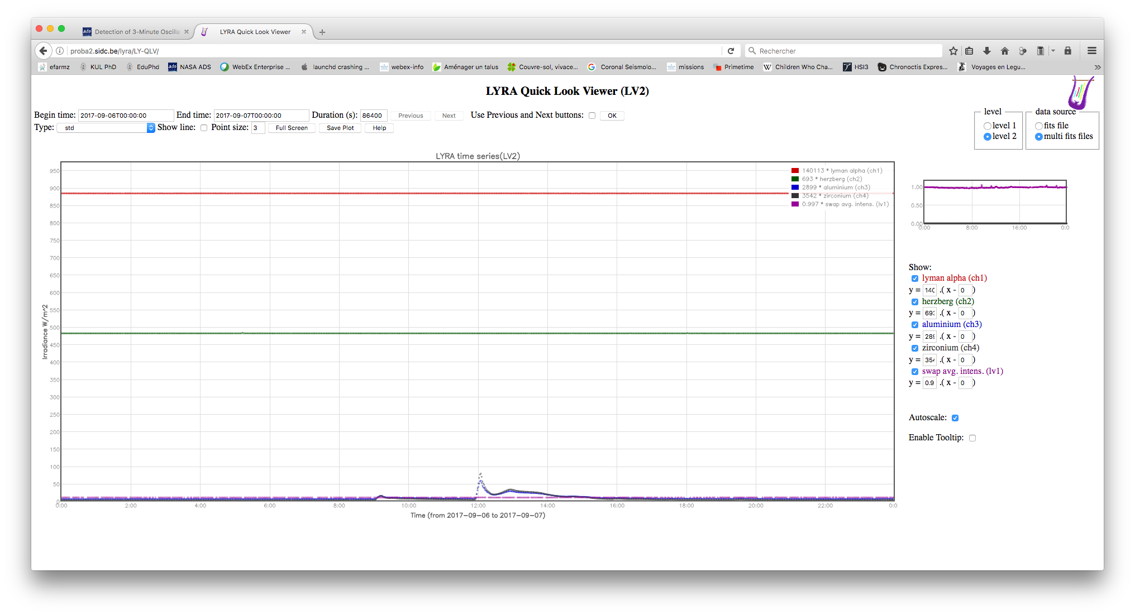
Quicklook viewer: nominal data

Slide 21
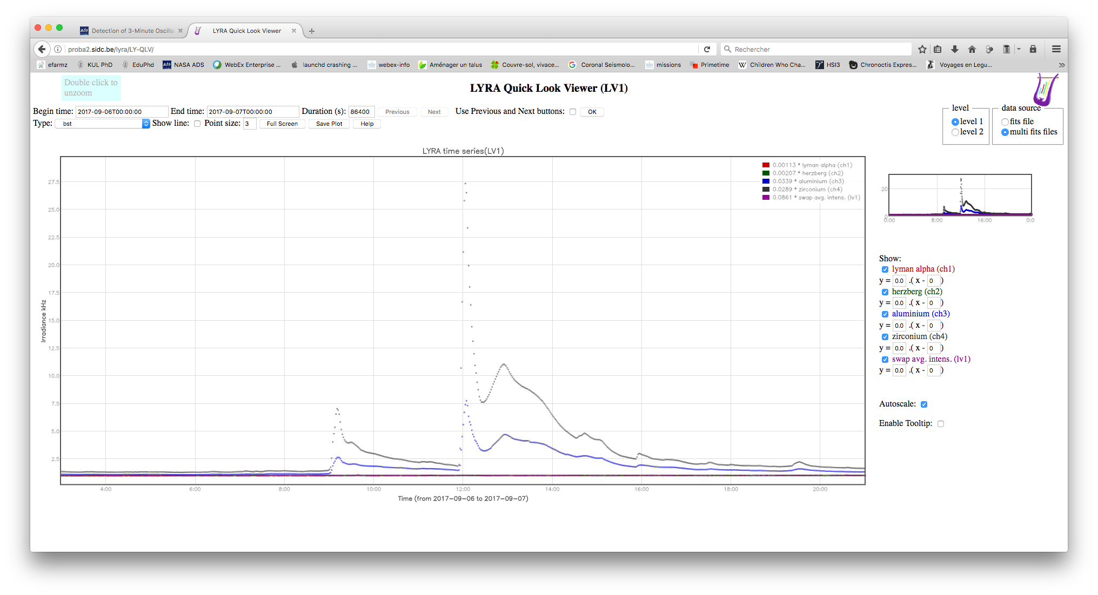
Quicklook viewer: backup uncalibrated data

Slide 22
Getting LYRA data: SolarSoft and SunPy

Slide 23
Getting LYRA data: SolarSoft and SunPy

Slide 24
Getting LYRA events

Slide 25
Getting LYRA events

Slide 26
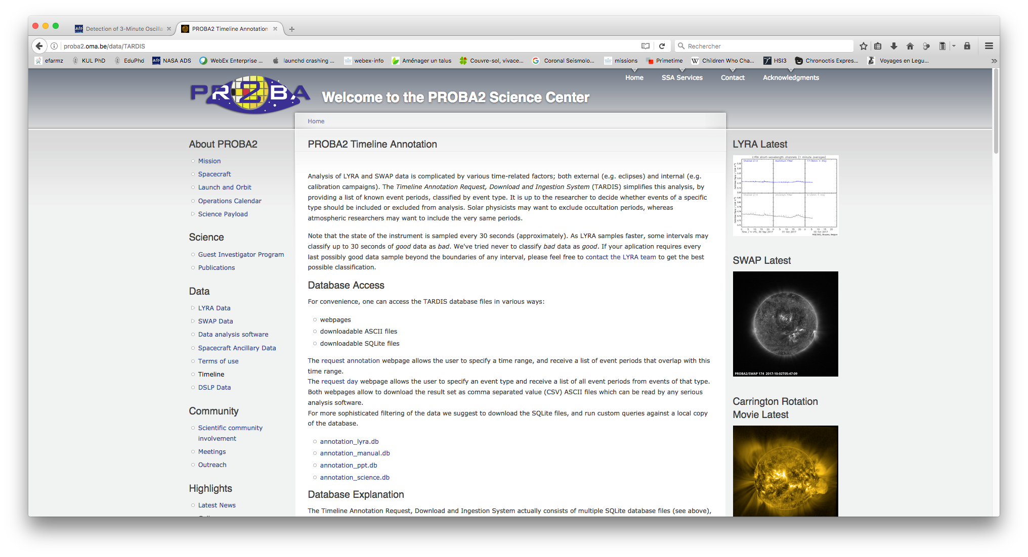
Getting LYRA events
… or lyra_download_events and lyra_remove_event in SolarSoft

Slide 27
Space weather monitoring

Slide 28
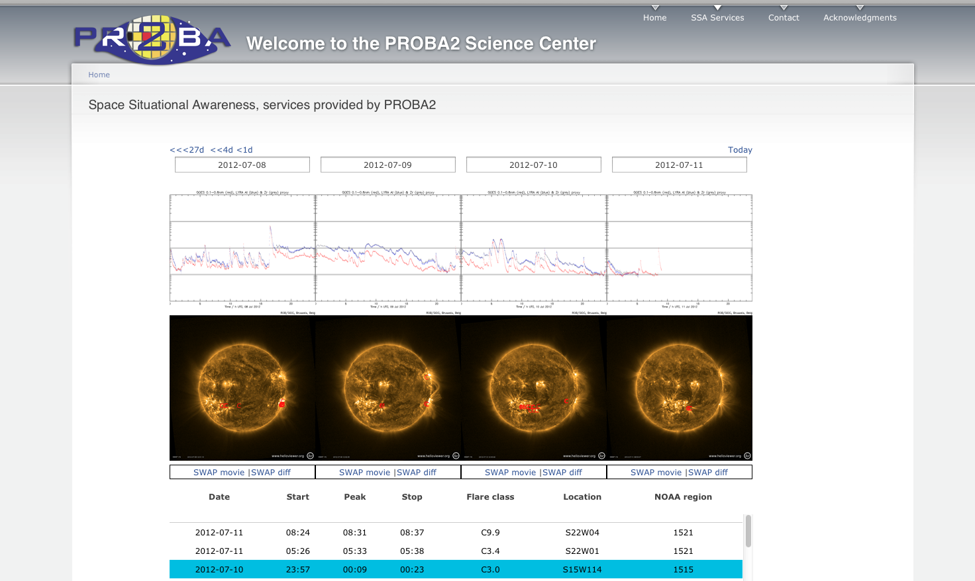
Space weather monitoring

Slide 29
Terms of use and acknowledgment

