Slide 1

LYRA status update

Slide 2
Problems encountered:
Cover 3 did not properly closed on
  Nov. 25, Dec. 6, Jan. 1
Data gaps due to on-board problems or packet corruptions on:
  Oct 28-31
  Dec 16 and 19
  Feb 12
Campaigns for next months:
The occultation season will end on Feb. 24. The nominal daily backup campaigns will resume.
Next solar eclipses on
  Feb. 26
  Aug. 21

Slide 3
LYRA campaigns
Daily occultation campaigns
No flare campaign
High-cadence (100Hz) backup campaign Oct 26-27

Slide 4
High-cadence campaign on Jun. 23 2015
June 23 2015
October 26 2016

Slide 5
Latest news
European Space Weather Week, 14-18 November, Oostende
  Posters on LYRA from I.E. Dammasch, L.Wauters, and T. Katsiyannis
Last SWT in parallel to the ESWW
  Presentations from L. Wauters and I. Dammasch
SDO 2016: Unraveling the Sun's complexity, October 17-21, Burlington, USA
  Talk from T. Katsiyannis

Slide 6
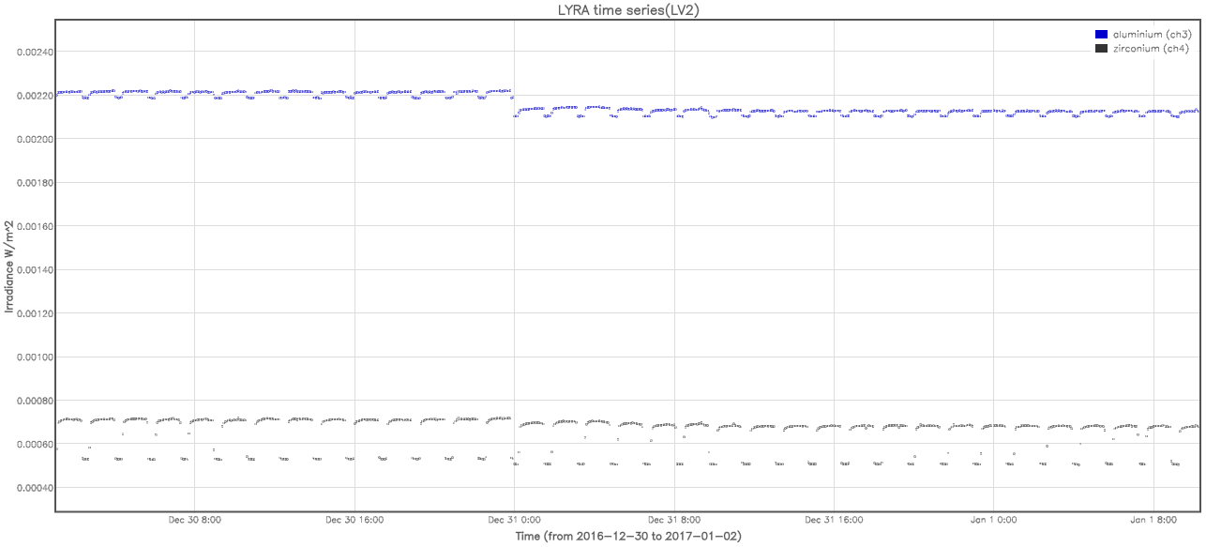
Latest news
Update of dark current correction in the LYRA calibration procedure on Jan 31
Resulted in a small shift of the data. This jump should disappear at the next reprocessing.

