Slide 1
Solar flare studies with the LYRA - instrument onboard PROBA2
Marie Dominique, ROB
Supervisor: G. Lapenta
Local supervisor: A. Zhukov

Slide 2
Doctoral plan
Analysis of the instrument performances, calibration of the data | 2011-2012
Cross-calibration with SDO-EVE and GOES, comparison of the instrument responses to flaring conditions | 2012-2013
Multi-instrumental analysis of the flare timeline as a function of the observed spectral range + prediction of LYRA spectral output of a theory-flare based on CHIANTI. | 2013-2014
Investigation of short-timescale phenomena during flares as observed with LYRA (e.g. quasi-periodic pulsations) | 2014-2015

Slide 3
LYRA performances, calibration of the data, cross-calibration

Slide 4

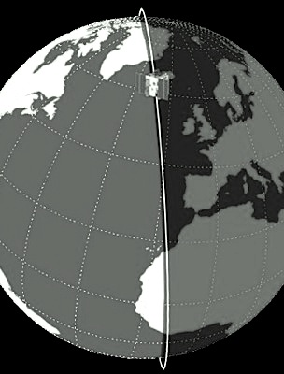
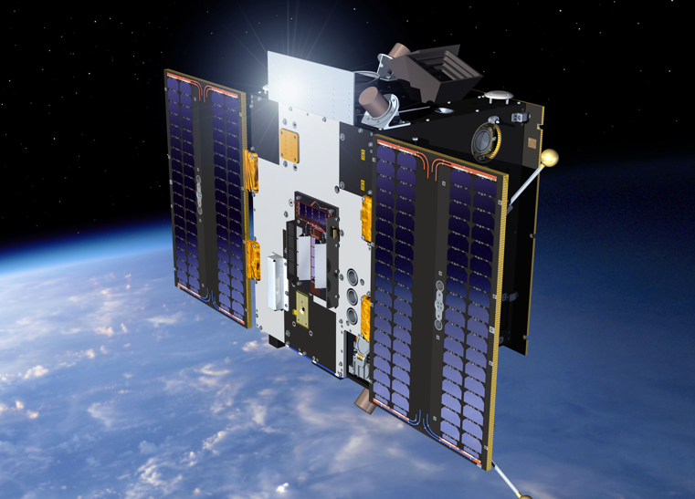
PROBA2: Project for On-Board Autonomy
PROBA2 orbit:
Heliosynchronous
Polar
Dawn-dusk
725 km altitude
Duration of 100 min
launched on November 2, 2009

Slide 5
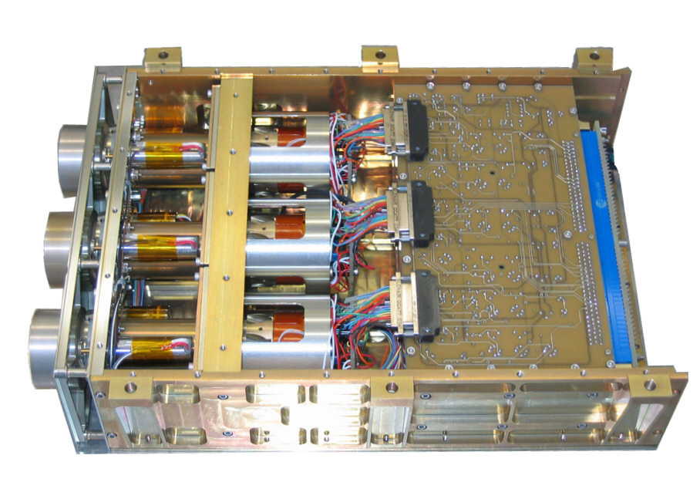
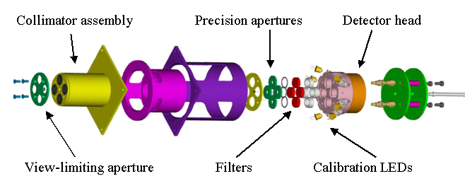
LYRA highlights
3 redundant units protected by independent covers
4 broad-band channels
High acquisition cadence: nominally 20Hz
3 types of detectors:
  standard silicon
  2 types of diamond detectors: MSM and PIN
    radiation resistant
    blind to radiation > 300nm
Calibration LEDs with λ of 370 and 465 nm

Slide 6
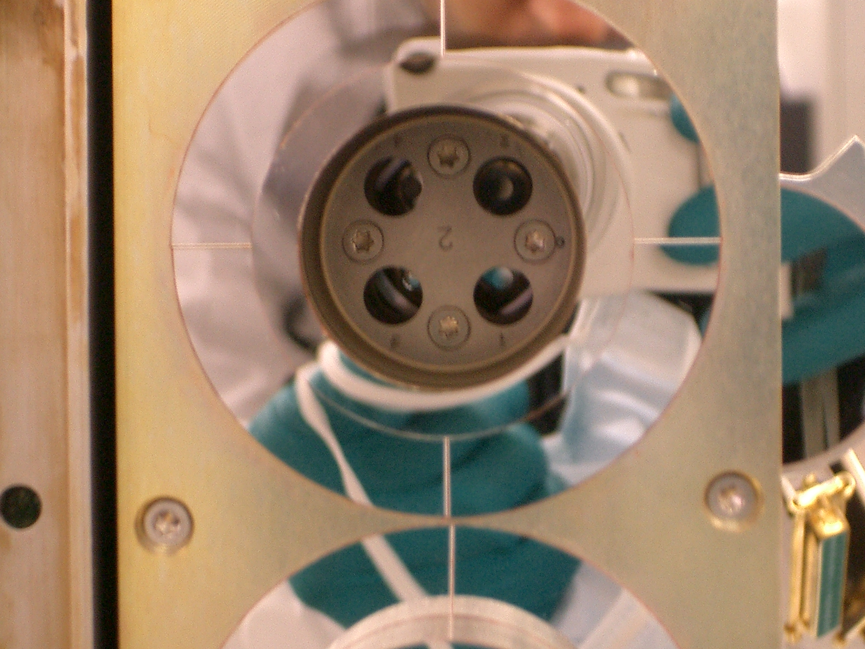
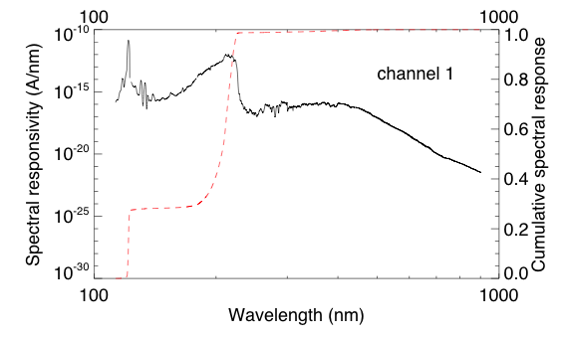
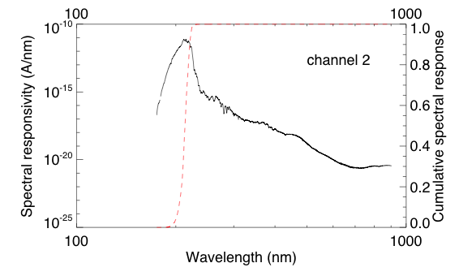
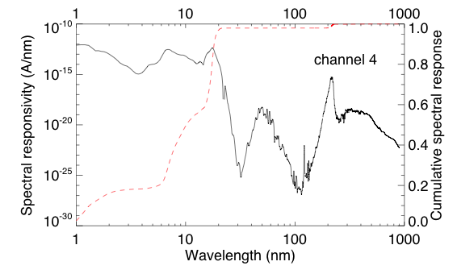
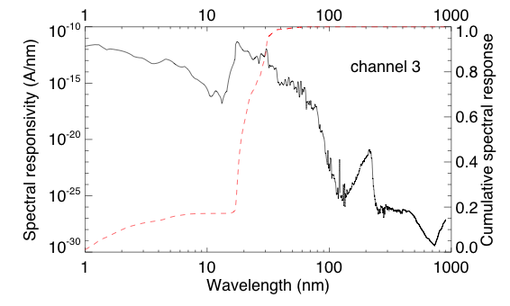
Details of LYRA channels convolved with quiet Sun spectrum
Channel 1 – Lyman alpha
120-123 nm
Channel 3 – Aluminium
17-80 nm + < 5nm
Channel 2 – Herzberg
190-222 nm
Channel 4 – Zirconium
6-20 nm + < 2nm

Slide 7
Calibration
Includes:
Dark-current subtraction
Additive correction of degradation
Rescaling to 1 AU
Conversion from counts/ms into physical units (W/m2)
WARNING: this conversion uses a synthetic spectrum from SORCE/SOLSTICE and TIMED/SEE at first light => LYRA data are scaled to TIMED/SORCE ones
Does not include (yet)
Flat-field correction
Stabilization trend for MSM diamond detectors

Slide 8
Long term evolution
Work still in progress …
Various aspects investigated:
  Degradation due to a contaminant layer
  Ageing caused by energetic particles
Investigation means:
  Dark current evolution (detector ageing)
  Response to LED signal acquisition (detector spectral evolution)
  Spectral evolution (detector + filter):
    Occultations
    Cross-calibration
    Response to specific events like flares
  Measurements in laboratory on identical filters and detectors

Slide 9
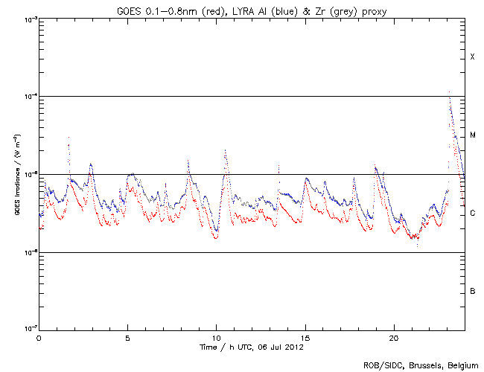

Comparison to other missions : GOES
Good correlation between GOES (0.1-0.8nm) and LYRA channels 3 and 4
For this purpose, EUV contribution has to be removed from LYRA signal
=> LYRA can constitute a proxy for GOES

Slide 10
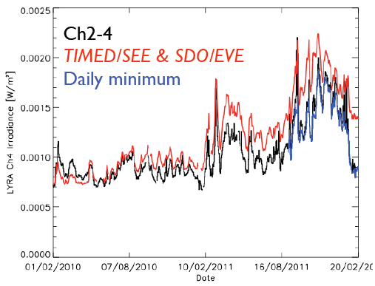
Comparison to other missions:
SDO/EVE
LYRA channel 4 can be reconstructed from a synthetic spectrum combining SDO/EVE and TIMED/SEE
Notes:
Graphe à refaire

Slide 11
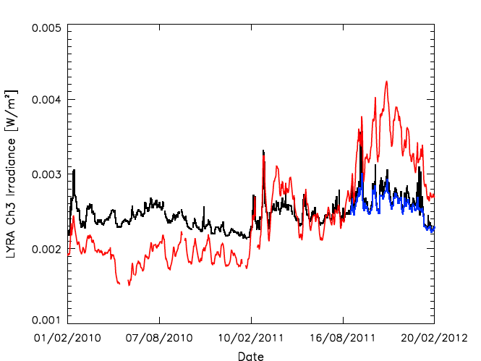
Comparison to other missions
Reconstruction of LYRA channel3 highlights the need of a spectrally dependant correction for degradation
=> To try to use spectrally dependant absorption curve
Example: Hydrocarbon contaminant
transmission
Channel extinction
λ (nm)
Layer thickness (nm)
Notes:
Graphe channel 2-3 même format que précédent

Slide 12
Thermal evolution of a flare

Slide 13
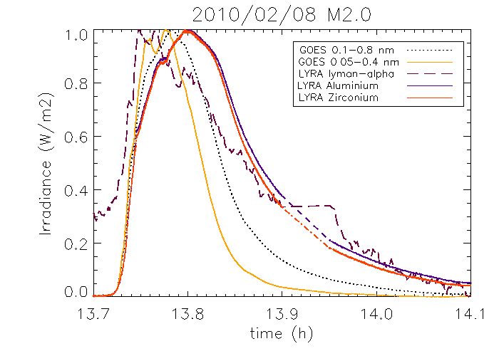
Thermal evolution of a flare
Various bandpasses exhibit different flare characteristics (peak time, overall shape …), that can be explained by Neupert effect, associated with heating/cooling processes

Slide 14
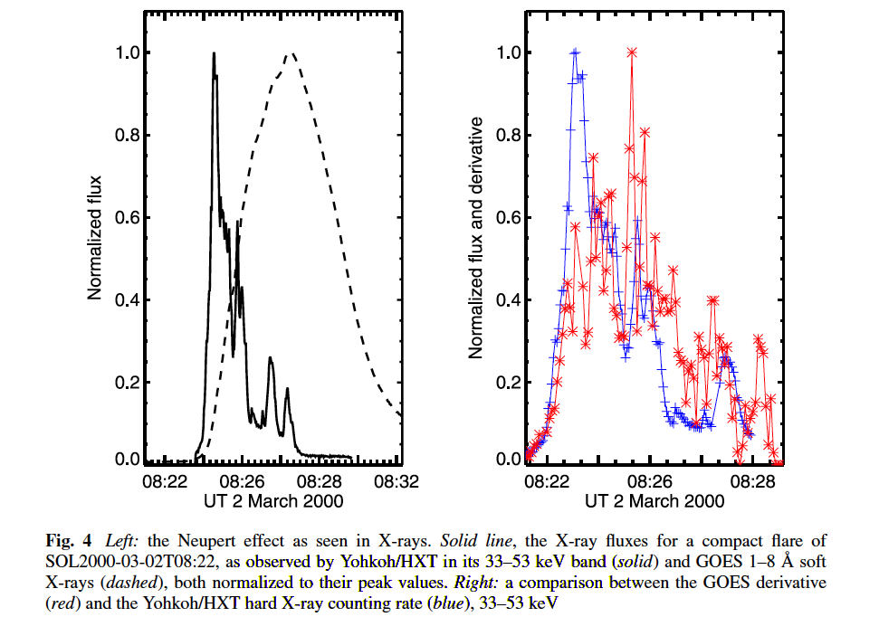
Neupert effect in SWAP and LYRA
In collaboration with K.Bonte:
Analysis of the chronology, based on LYRA, SWAP, SDO/EVE, SDO/AIA, GOES, RHESSI
Compare the derivative of LYRA Al-Zr channels to RHESSI data
Hudson 2011
Notes:
The final time-behavior mentioned here is the Neupert effect – the phenomenon that
in many flares the time integral of the non-thermal emissions tracks the time profile of
the thermal emissions.

Slide 15
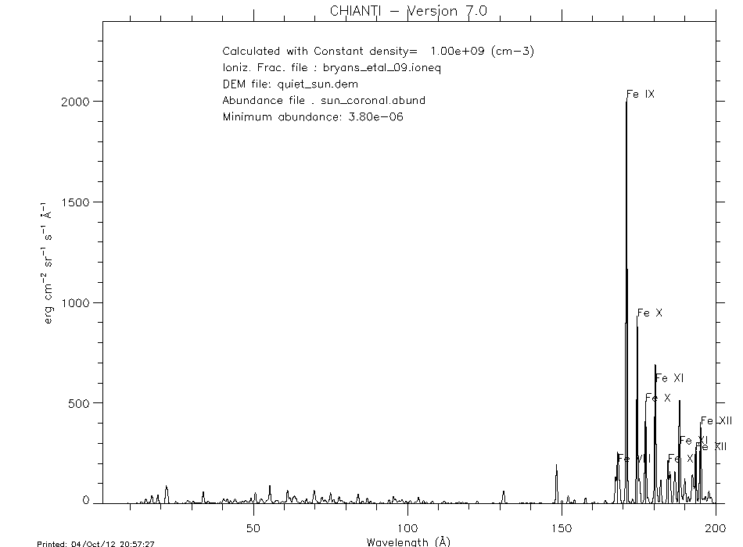
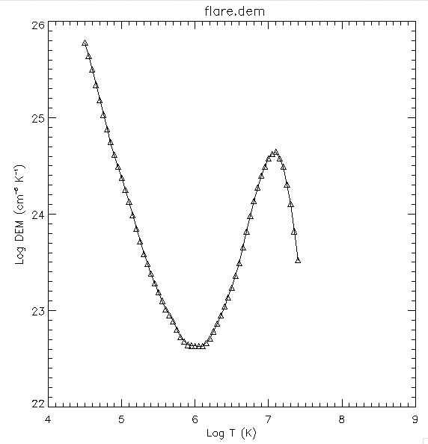
Reconstruction of LYRA flaring curves based on
Prediction of LYRA-EVE response to a flare based on CHIANTI database + comparison with measurements
Notes:
Poru modéliser le flare, prendre à la fois du soleil calme et du flare en proportion relative à la surfacez

Slide 16
Quasi-periodic pulsations in flares

Slide 17
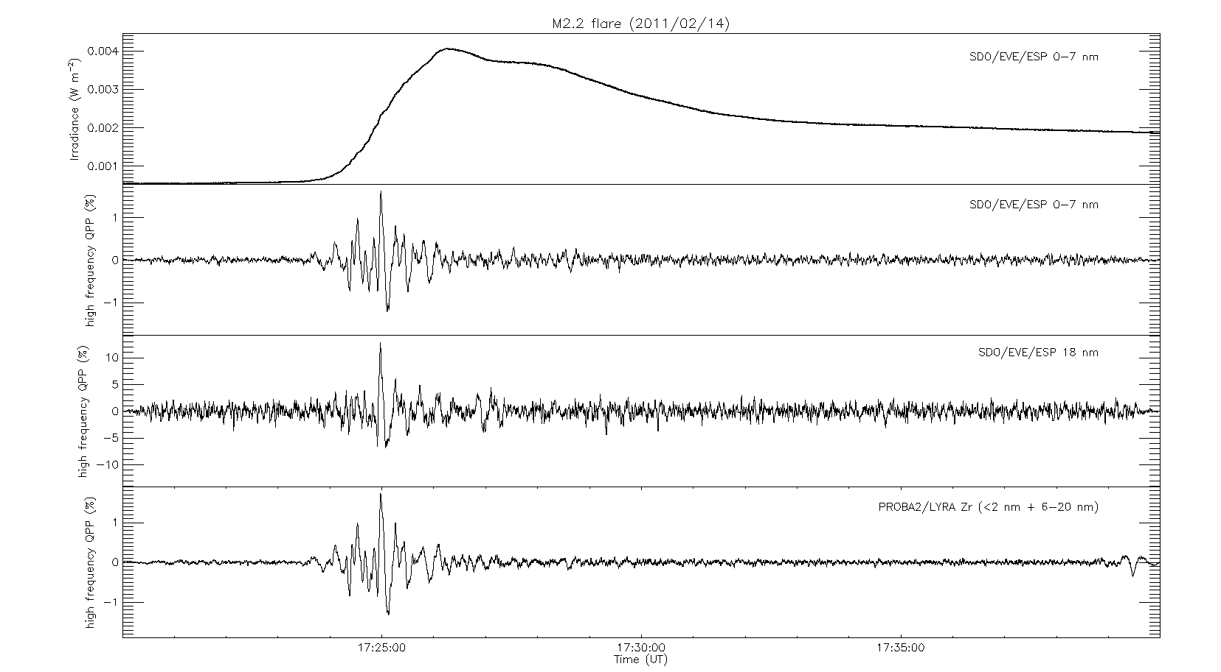
Quasi-periodic pulsations
Known phenomenon: observed in radio, HXR, EUV
During the onset of the flare (although some might persist much longer)

Slide 18
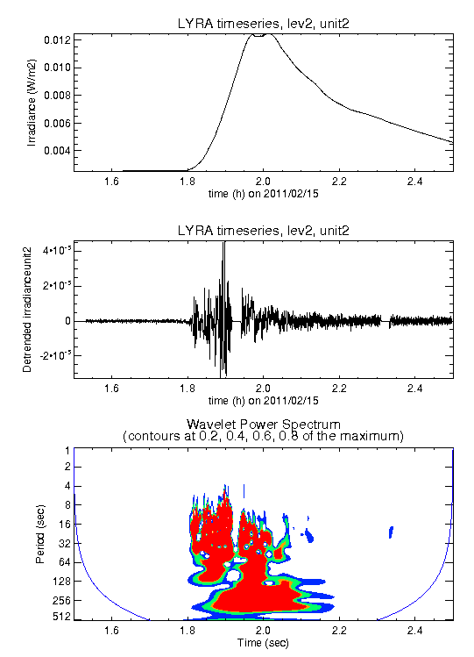
Observations with LYRA
Long (~70s) and short (~10s) periods detected in Al, Zr, Ly channels of LYRA by Van Doorsselaere (KUL) and Dolla (ROB)
Oscillations match in several instruments (and various passbands)
Delays between passbands seems to be caused by a cooling effect

Slide 19
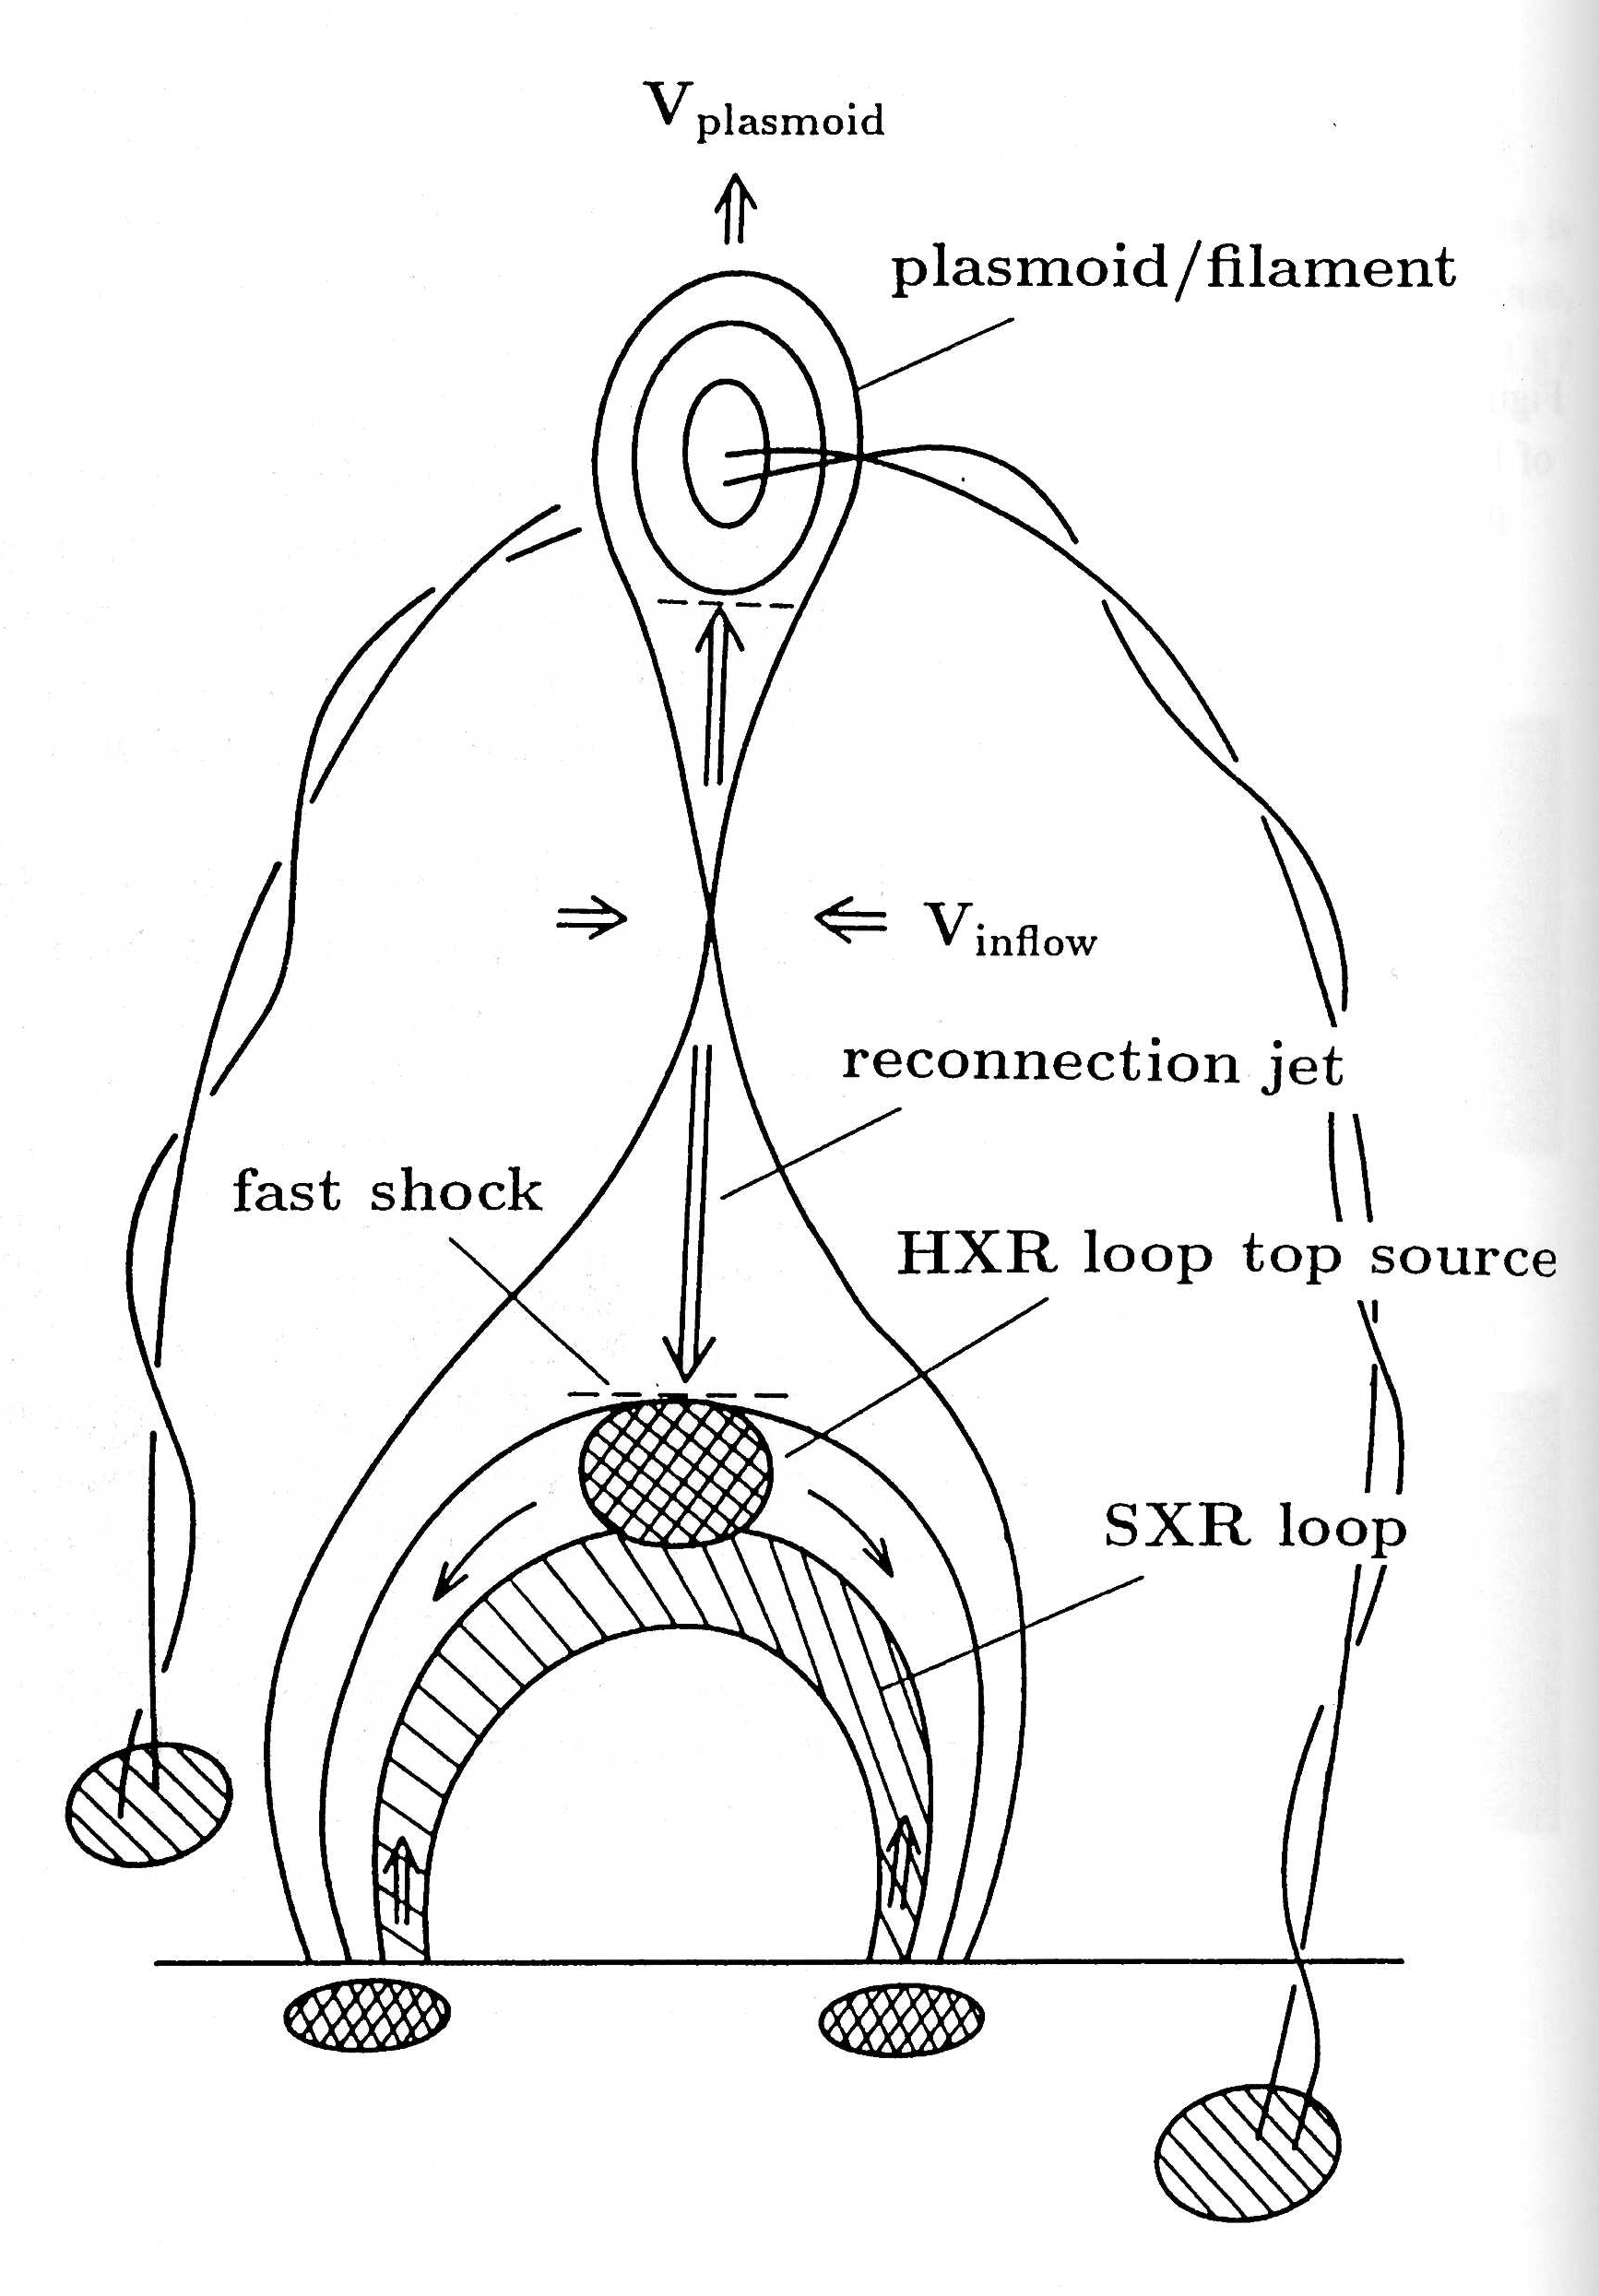
Origin of the QPP?
Three possible mechanisms
Periodic behavior at the reconnection site
External wave (e.g. modulating the electron beam)
Oscillation of the flare loops
1
2
3

Slide 20
What next?
Try to identify the location of QPP source
  Are QPP visible when the footpoints are occulted?
    → LYRA, ESP
  Are the radio sources collocated with ribbons
    AIA, Nobeyama
Use the QPP to perform coronal seismology
  Overdense cylinder aligned with the magnetic field
  Slow and fast sausage modes propagating in the same loop, fundamental mode only => same wavelength
=> Try to determine the magnetic field, density, beta, temperature
=> Periods observed by LYRA to be compared with theoretical predictions

Slide 21
Conclusion
The main objectives of this PhD are:
To assess the pertinence of LYRA to study flares and to sum up the lessons learned for future missions
To confront our analysis to the main flare models

Slide 22
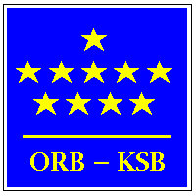




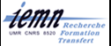


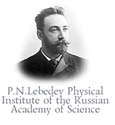



Collaborations
THANK YOU!

Slide 23



What next?
Try to identify the location of QPP source
  Are QPP visible when the footpoints are occulted?
    → LYRA, ESP
  Are the radio sources collocated with ribbons
    AIA, Nobeyama
Use the QPP to perform coronal heliosismology
  Overdense cylinder aligned with the magnetic field
  Slow and fast sausage modes propagating in the same loop, fundamental mode only => same wavelength
  Pressure balance between interior and exterior of the loop

Slide 24
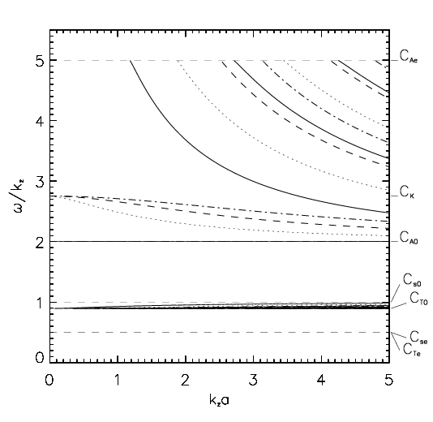

Short wavelength limit
Fast modes
Plain = sausage
Slow modes
But very unlikely case …

Slide 25


Long wavelength limit
Fast modes
Plain = sausage
We find a relationship
between βe, βi, ζ =>
Max value for density ratio
Min value for β
Slow modes
To be compared to NLFFF model

