Slide 1
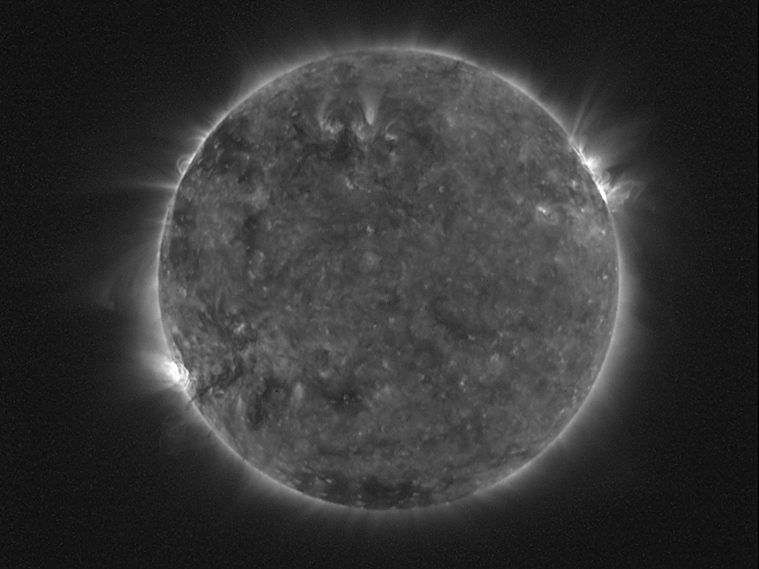
LYRA on-board PROBA2: instrument performances and latest results
M. Dominique ⁽¹⁾, I. Dammasch⁽¹⁾, M. Kretzschmar^{(1,2)}
      Royal Observatory of Belgium
      LPC2E, France
COSPAR, Mysore 2012

Slide 2
Structure of the talk
Generalities on PROBA2 and LYRA
LYRA current status and performances
Science with LYRA

Slide 3
Structure of the talk
Generalities on PROBA2 and LYRA
LYRA current status and performances
Science with LYRA

Slide 4
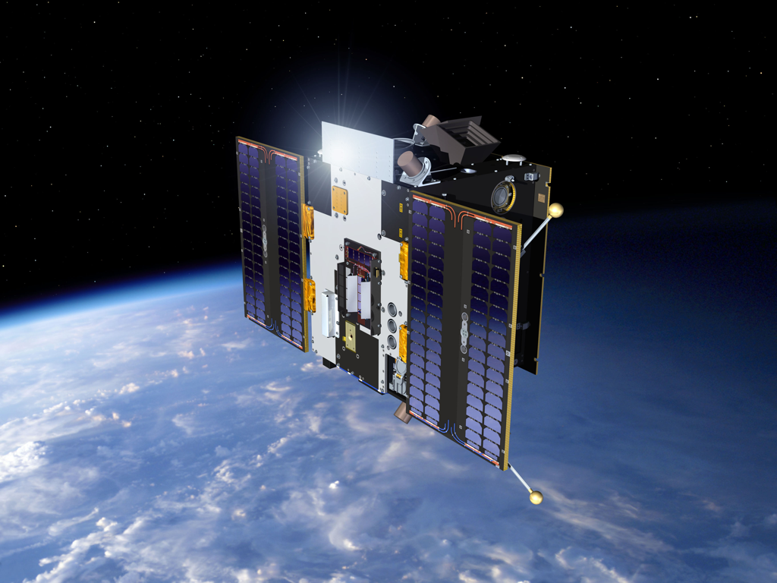
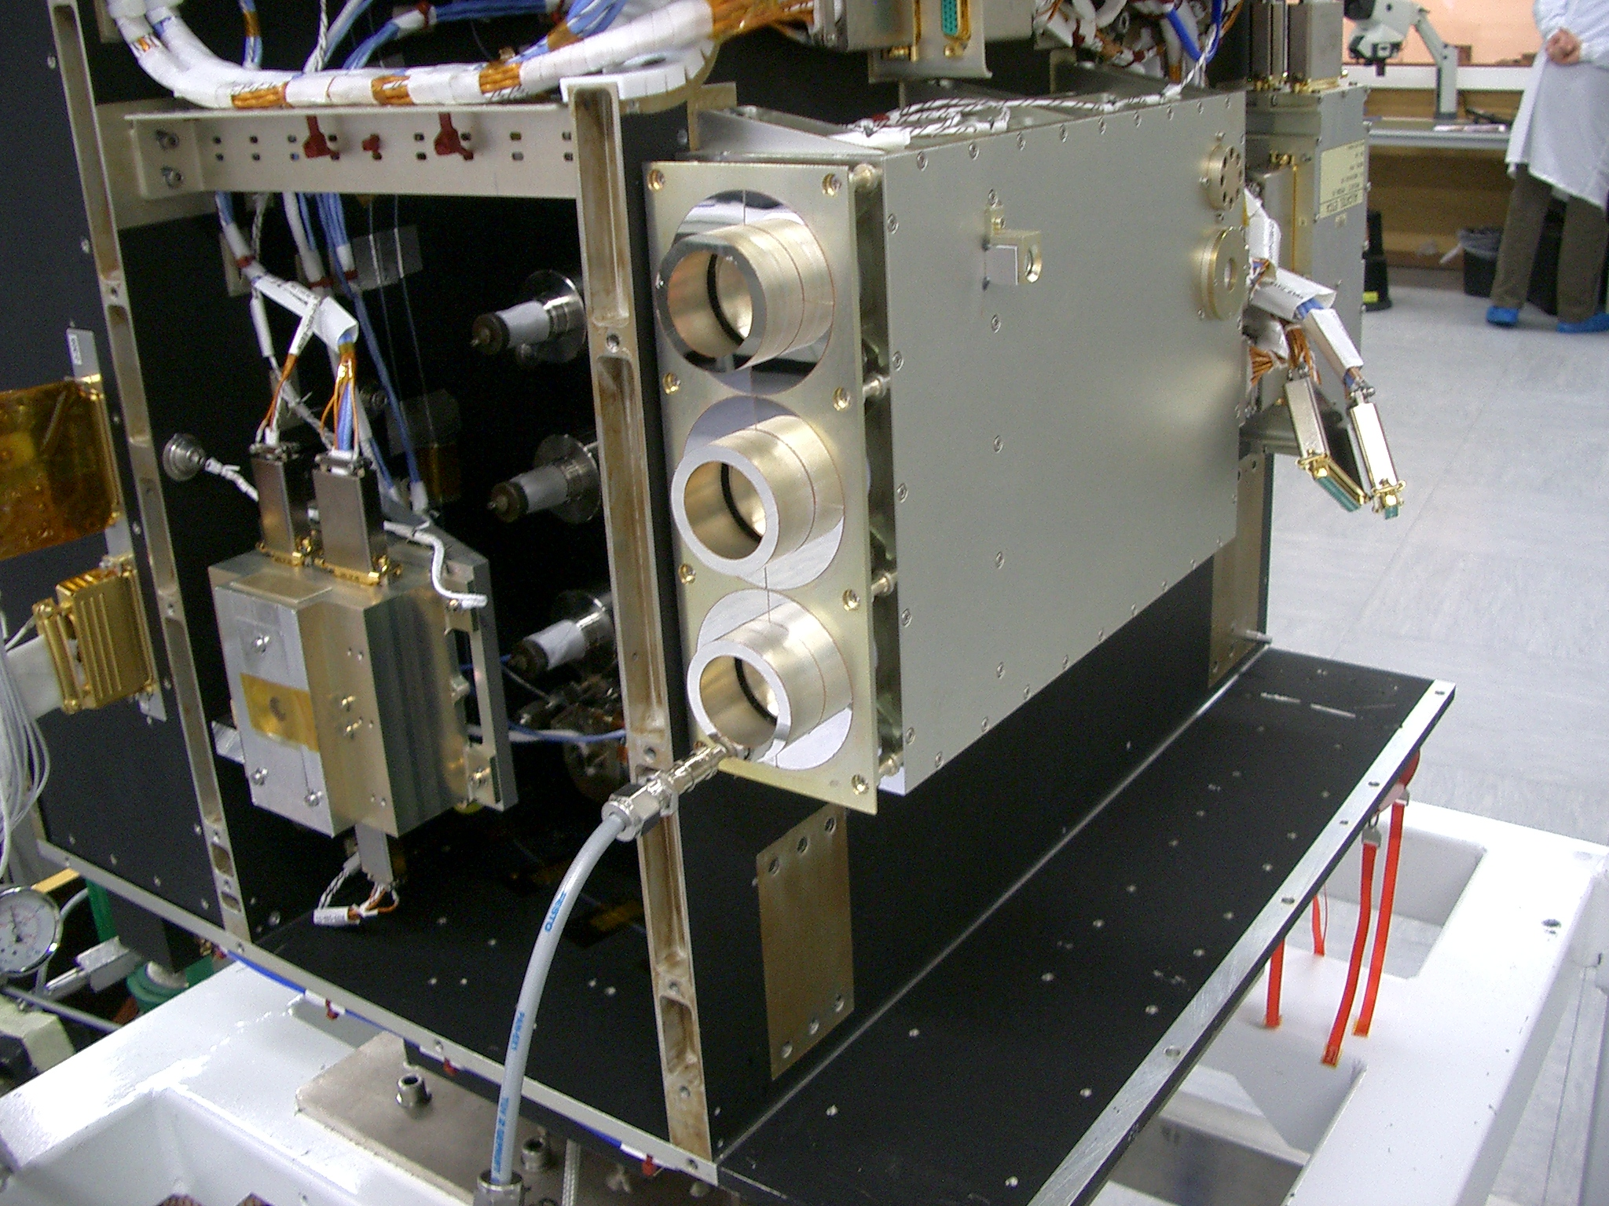
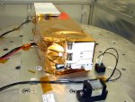
PROBA2: an ESA microsat
LYRA
SWAP
Launched on November 9, 2009
17 technology demonstrators + 4 scientific instruments
LYRA first light on January 6, 2010
Mission currently founded till end 2012. Extension procedure is on-going.

Slide 5

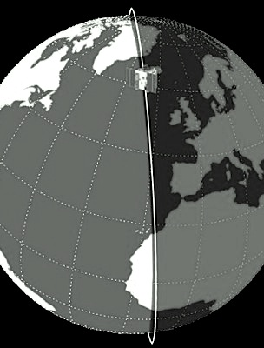
PROBA2 orbit
PROBA2 orbit:
Heliosynchronous
Polar
Dawn-dusk
725 km altitude
Duration of 100 min
Occultation season:
  From October to February
  Maximum duration 20 min per orbit

Slide 6
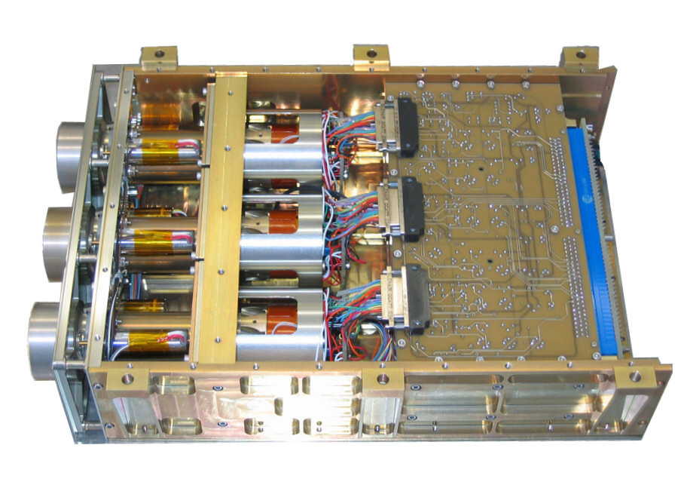
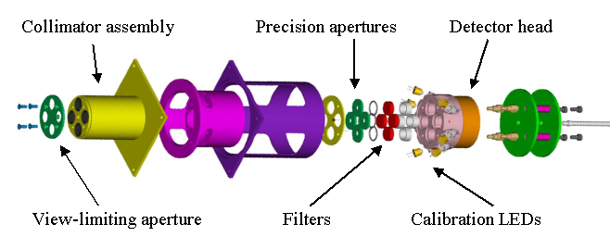
LYRA highlights
3 redundant units protected by independent covers
4 broad-band channels
High acquisition cadence: nominally 20Hz
3 types of detectors:
  Standard silicon
  2 types of diamond detectors: MSM and PIN
    radiation resistant
    blind to radiation > 300nm
Calibration LEDs withλof 370 and 465 nm

Slide 7
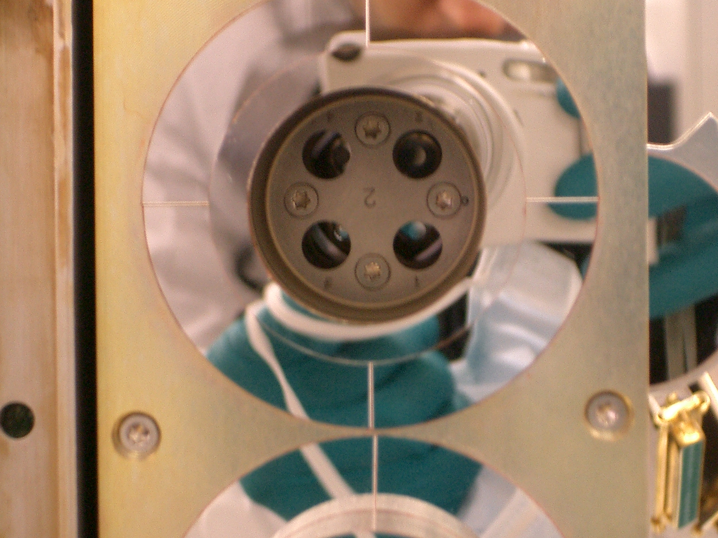
Details of LYRA channels
Channel 1 – Lyman alpha
120-123 nm
Purity : ∼25%
Channel 3 – Aluminium
17-80 nm + < 5nm
Purity : ∼97%
Unit 1 | Unit 2 | Unit 3
MSM | MSM | Si
Unit 1 | Unit 2 | Unit 3
MSM | MSM | Si
Channel 2 – Herzberg
190-222 nm
Purity : ∼95%
Channel 4 – Zirconium
6-20 nm + < 2nm
Purity : ∼95%
Unit 1 | Unit 2 | Unit 3
PIN | PIN | PIN
Unit 1 | Unit 2 | Unit 3
Si | MSM | Si

Slide 8
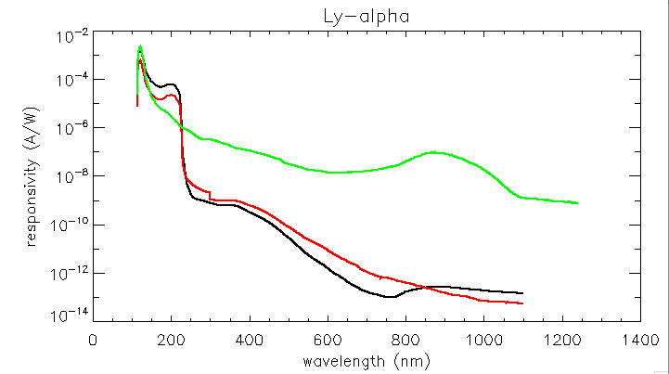
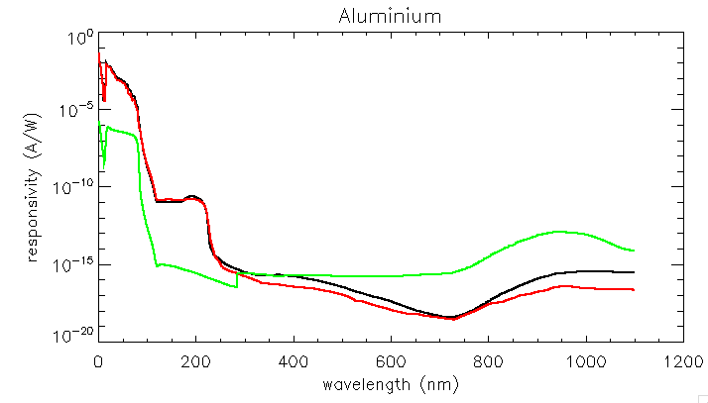
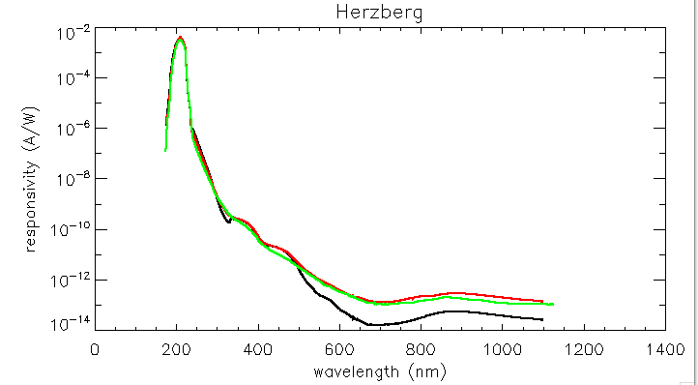
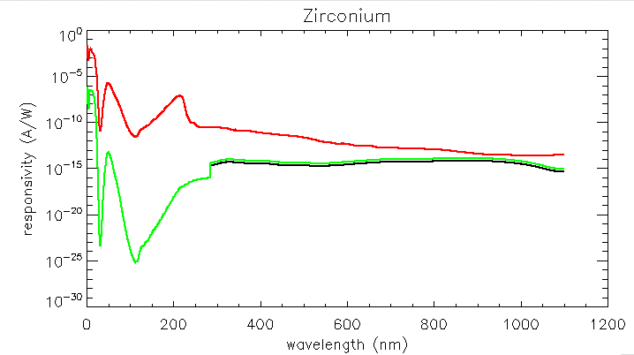
Filter + detector combined responsivity
Bump in C around 220nm
Bump in Si around 900nm
Diamond cut-off
Unit 1
Unit 2
Unit 3

Slide 9
Structure of the talk
Generalities on PROBA2 and LYRA
LYRA current status and performances
Science with LYRA

Slide 10
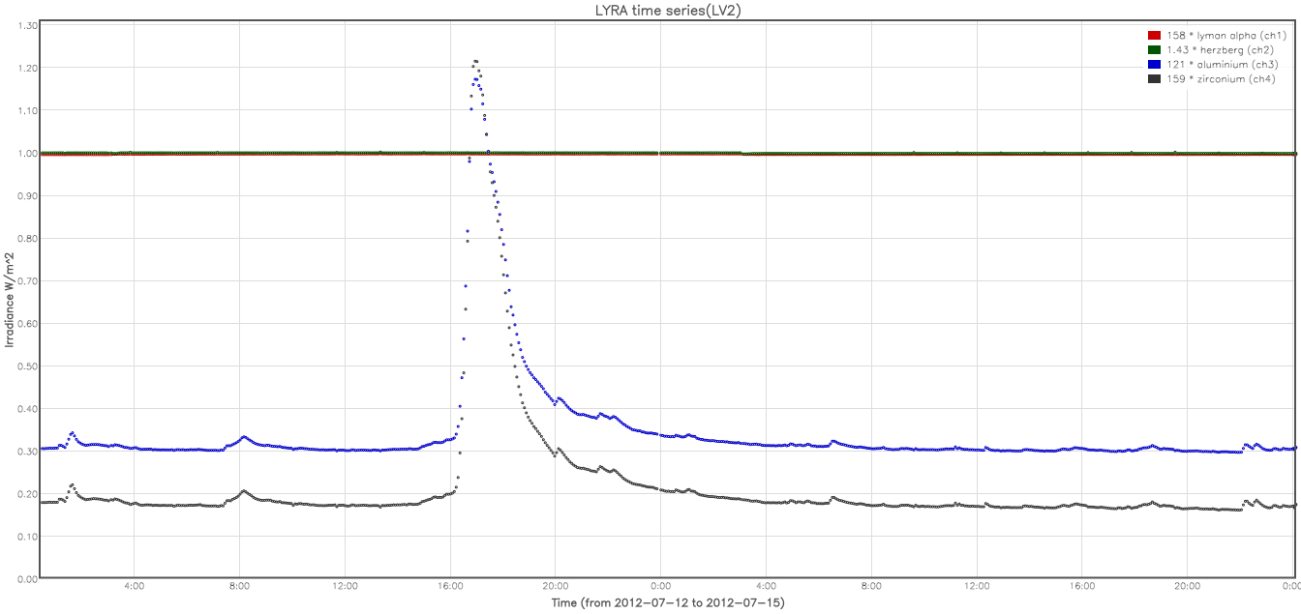
Example of LYRA data

Slide 11
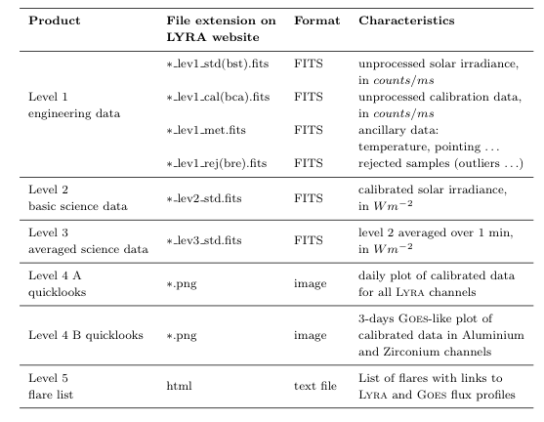
Data products
Data products and quicklook viewer on
http://proba2.sidc.be

Slide 12
Calibration
Includes:
Dark-current subtraction
Additive correction of degradation
Rescale to 1 AU
Conversion from counts/ms into physical units (W/m2)
ATTENTION: this conversion uses a synthetic spectrum from SORCE/SOLSTICE and TIMED/SEE at first light => LYRA data are scaled to TIMED/SORCE ones
Does not include (yet)
Flat-field correction
Stabilization trend for MSM diamond detectors

Slide 13
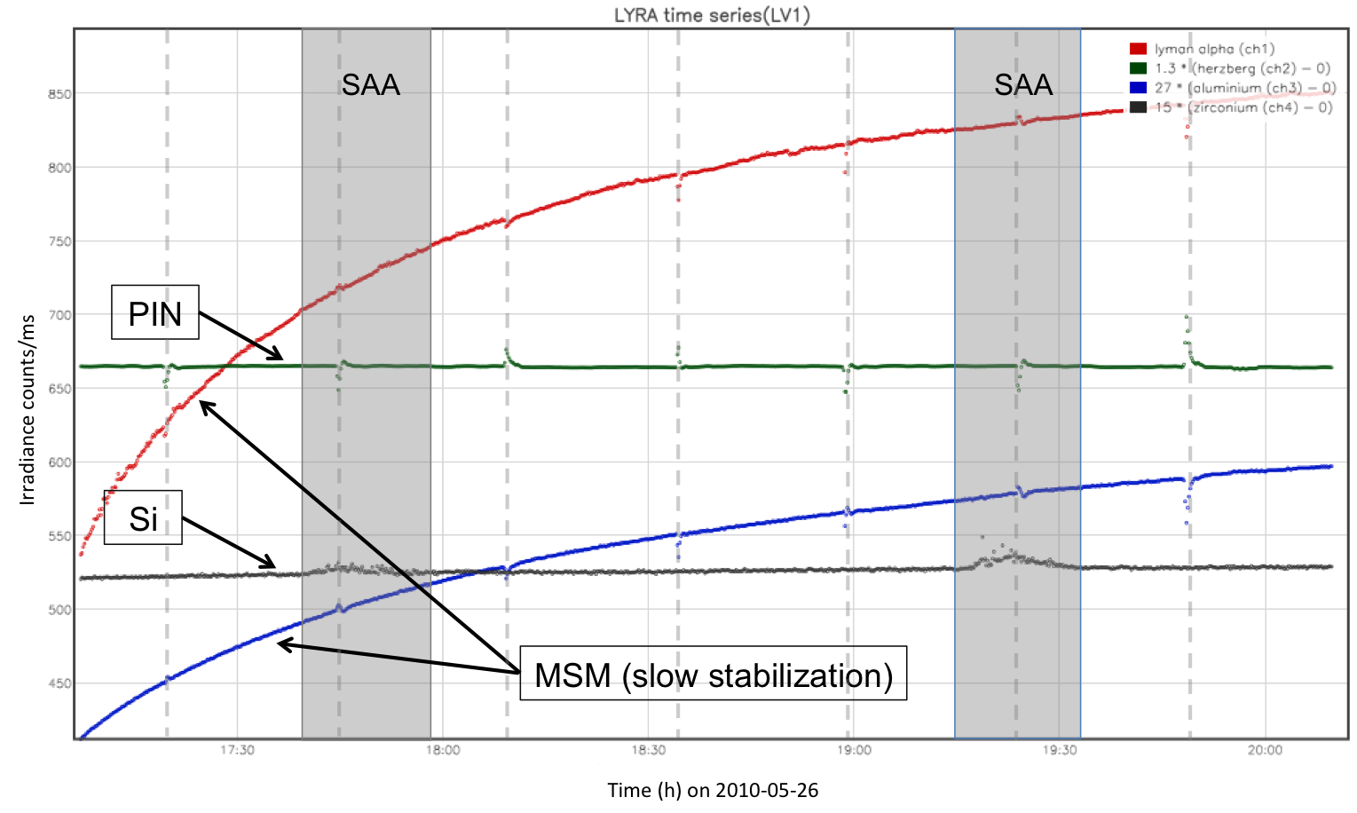
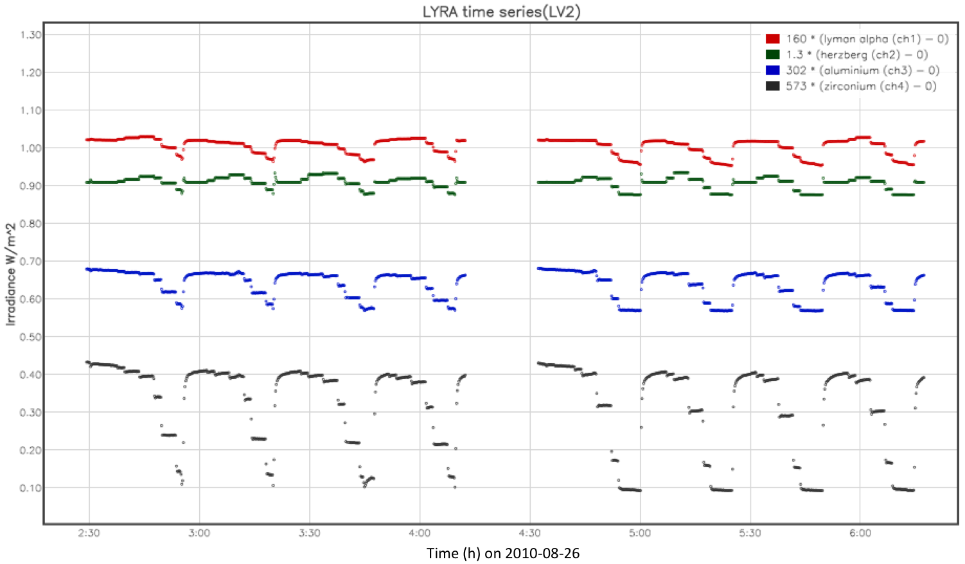
Non-solar features in LYRA data
Large Angle Rotations
LAR: four times an orbit
SAA affects more Si detectors independently of their bandpass
Flat-field: Proba2 pointing is stable up to 5arcsec /min (from SWAP). Jitter introduces fluctuations in the LYRA signal of less than 2%.
Flat field

Slide 14
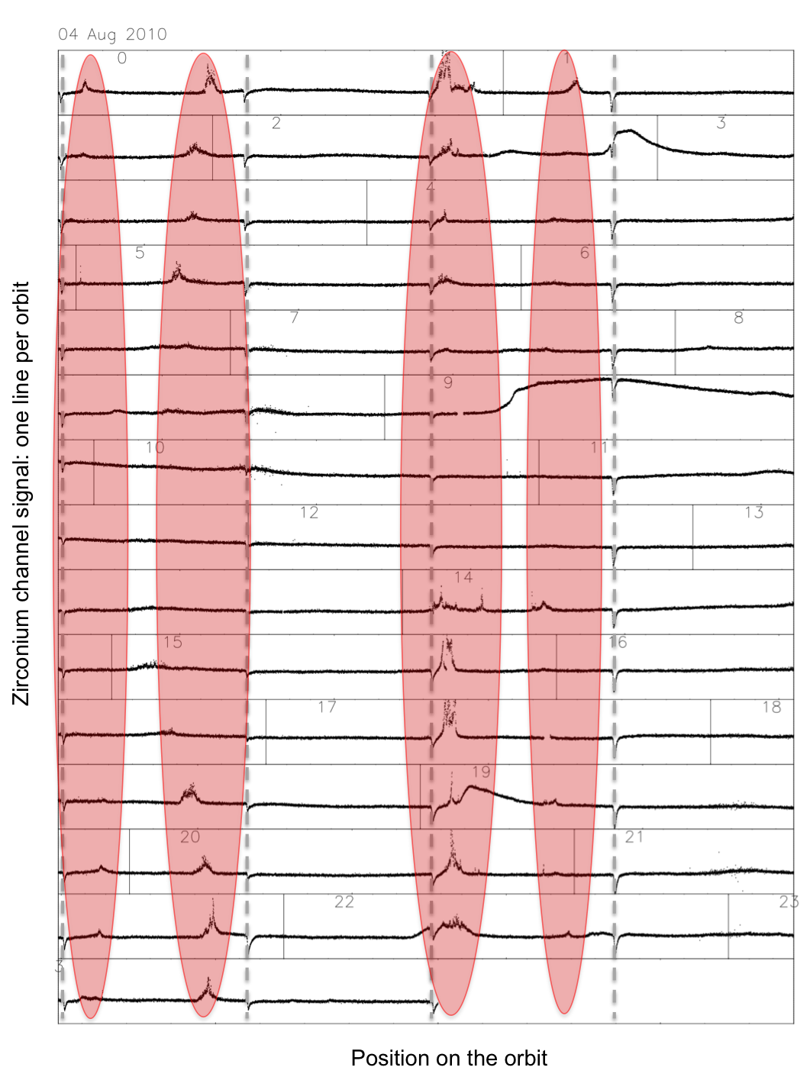
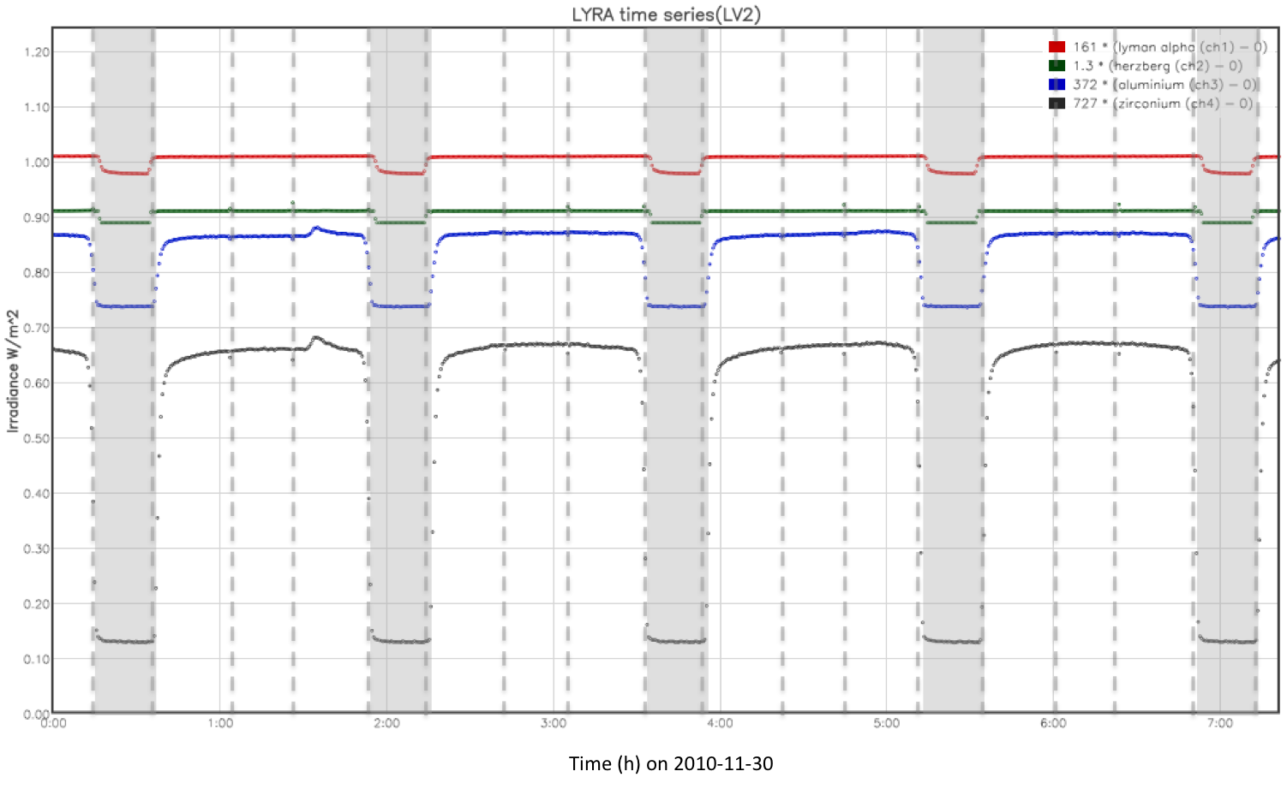
Non-solar features in LYRA data
Occultation: from mid-October to mid-February
Auroral perturbation
  Only when Kp > 3
  Only affects Al and Zr channels independently of the detector type
  Does not affects SWAP (though observing in the same wavelength range)
Occultations

Slide 15
Long term evolution
Work still in progress …
Various aspects investigated:
  Degradation due to a contaminant layer
  Ageing caused by energetic particles
Investigation means:
  Dark current evolution (detector ageing)
  Response to LED signal acquisition (detector spectral evolution)
  Spectral evolution (detector + filter):
    Occultations
    Cross-calibration
    Response to specific events like flares
  Measurements in laboratory

Slide 16
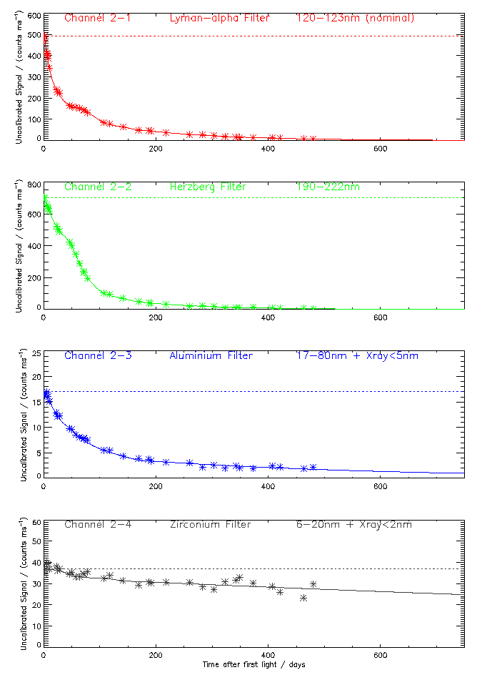
Degradation of unit 2 – the nominal unit
Degradation after 400h vs now:
  Ch1 : 58.3% | >99%
  Ch2 : 32.5% | >99%
  Ch3 : 28.7% | 90%
  Ch4 : 10% | 30%
Uncalibrated signal (counts/ms)
Time after first light ( over 700 days)

Slide 17
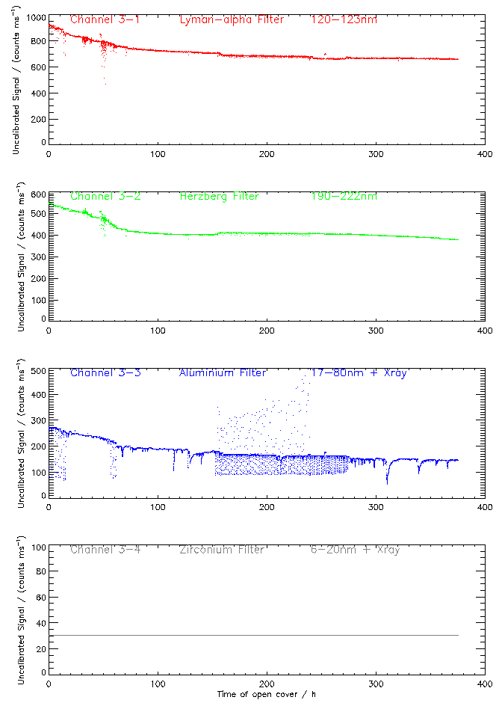
Degradation of unit 3 – dedicated campaigns
In March 2012, unit 3 has been observing for about 400h
Degradation unit3 vs unit2:
  Ch1 : 28.3% | 58.3%
  Ch2 : 30.9% | 32.5%
  Ch3 : 45.2% | 28.7%
  Ch4 : / | 10%
after removal of the long-term solar variability provided by channel 4

Slide 18
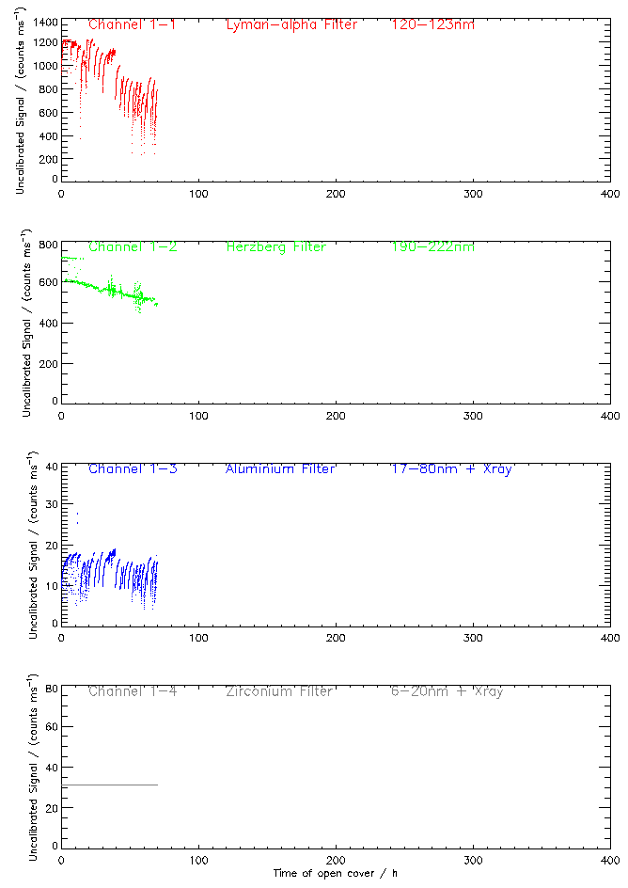
Degradation of unit 1 – calibration
Unit 1 has been observing for about 70h
Current degradation:
  Ch1 : 50%
  Ch2 : 15%
  Ch3 : 20%
  Ch4 : /
Approximate values

Slide 19
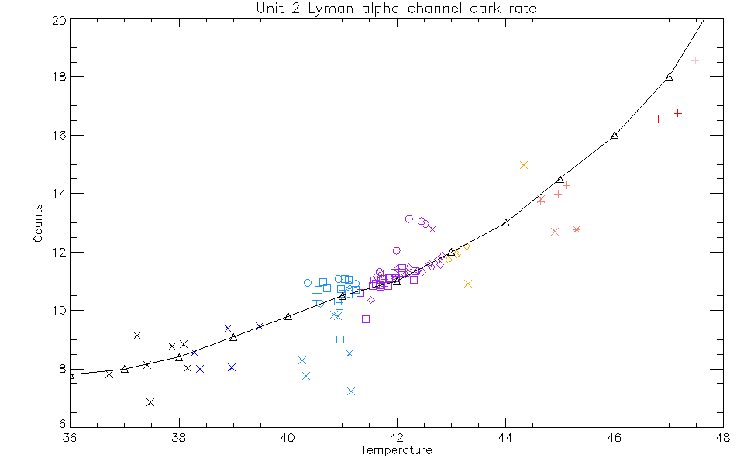
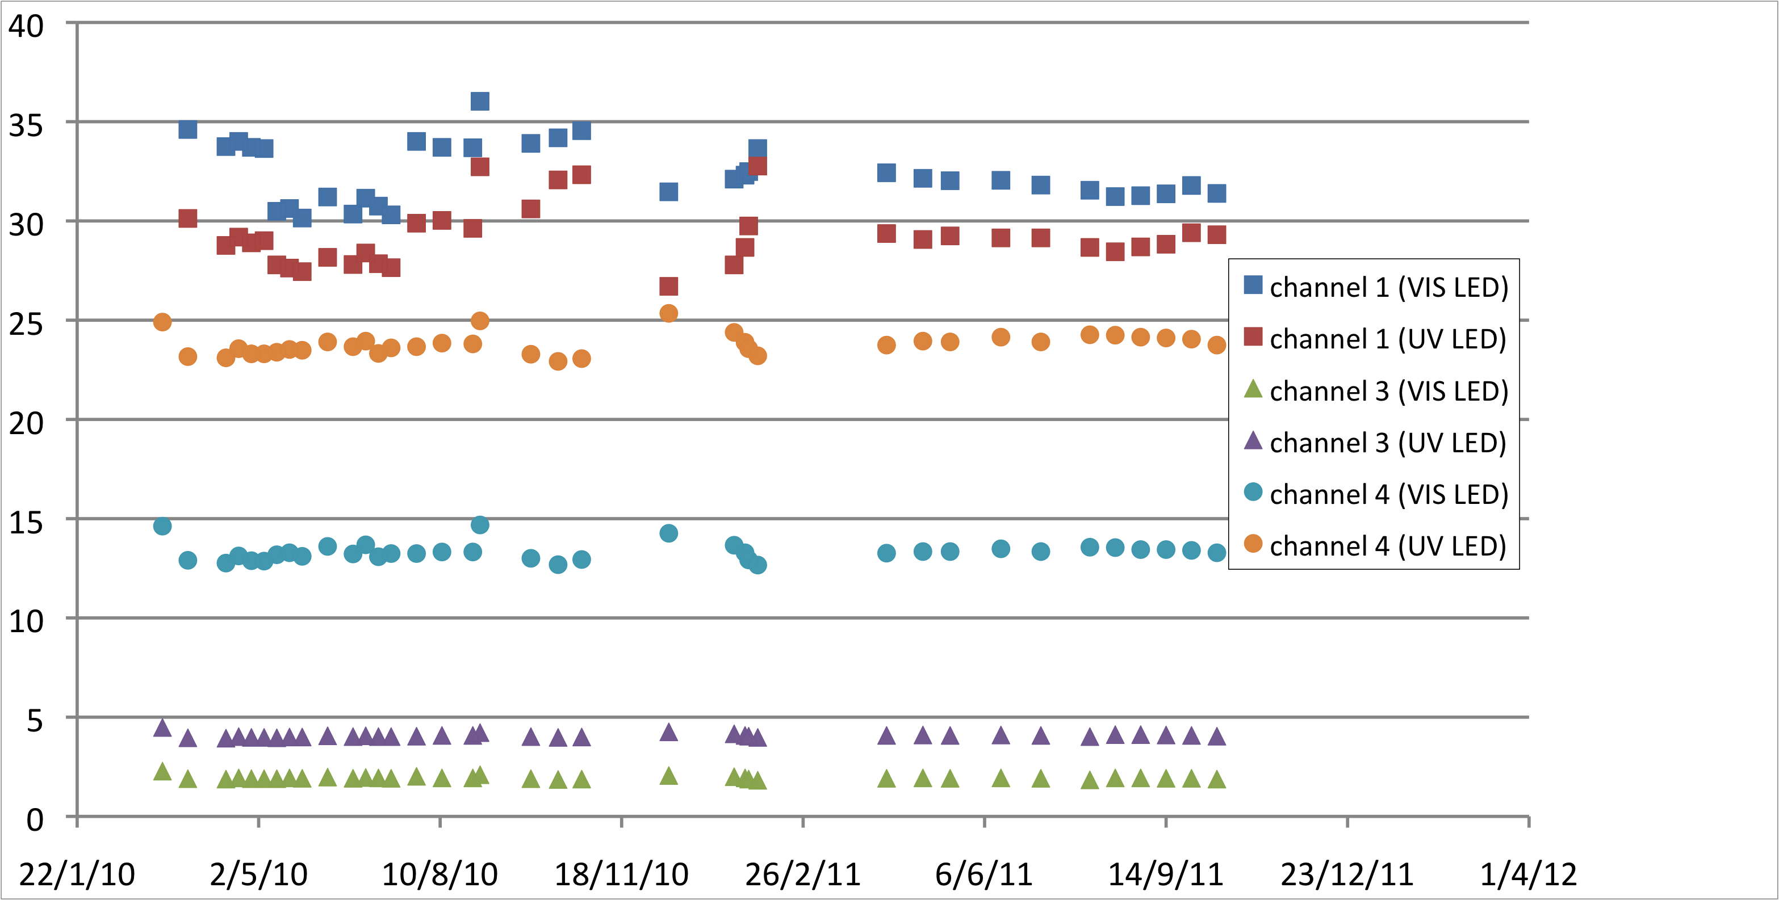
Dark current + LED signal evolution
DC variations correlated with temperature evolution
LED signal constant over the mission
Dark current in Lyman alpha
LED signal evolution
Unit 2 – dark current subtracted
Low detector degradation,
if any
I. Dammasch + M. Snow
M. Devogele

Slide 20
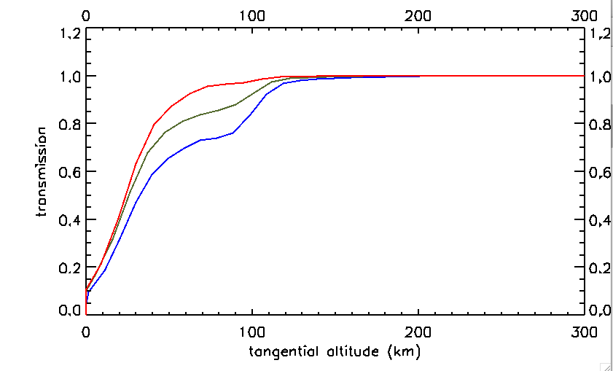
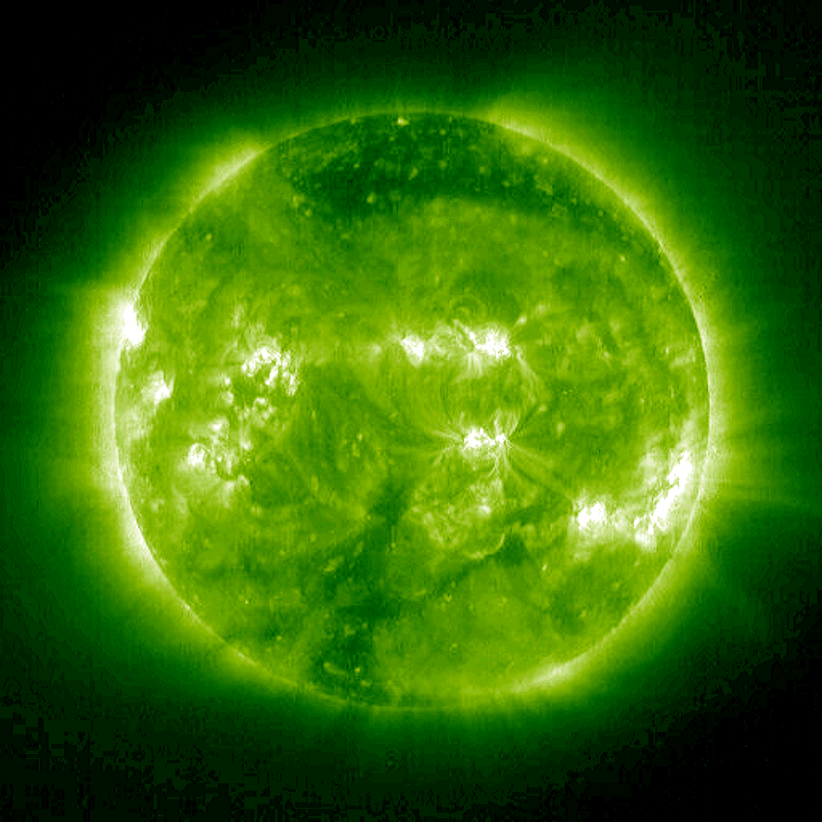
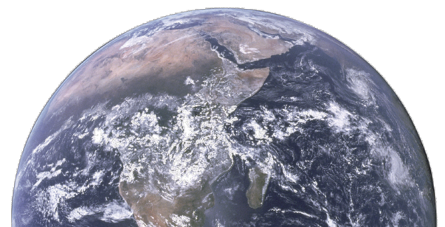
Probing the evolution of bandpasses: occultations
∼ 900 nm

Slide 21
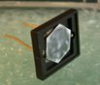
Si detector (AXUV) after proton tests (@14.5MeV)
NUV-VIS spectral response decreases (factor 1.5)
Dark current increases (x100)

Slide 22
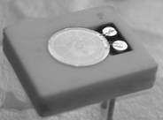
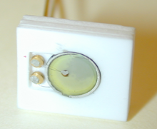
Diamond detectors after proton tests (@14.5MeV)
Dark current MSM24r
Dark current (PIN11)
DC increases (x7) but still negligible (> pA @ 0V)
@5V DC increases
by 1.3
→ spectral response to be measured (soon)

Slide 23
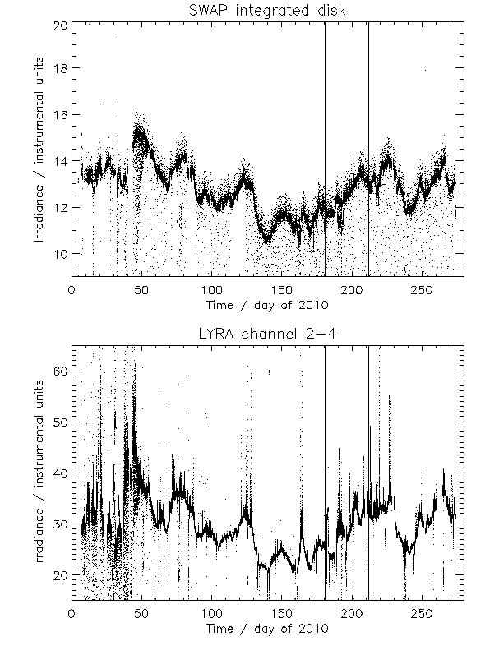
SWAP-LYRA cross-comparison
LYRA nominal channels 1 and 2 strongly degraded
no long term comparison
now using unit 3 on a daily basis
Good correlation between SWAP integrated value (17.4nm) and LYRA channels 3 and 4

Slide 24
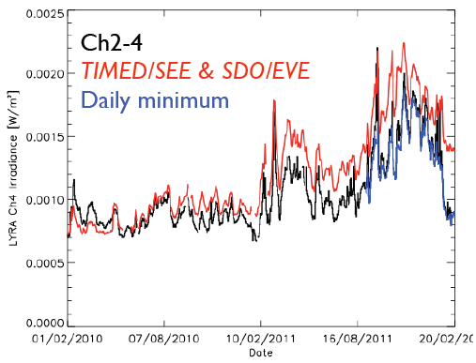
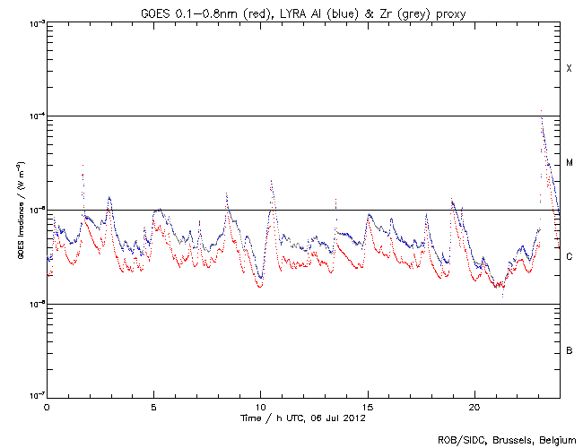

Comparison to other missions
LYRA channel 4 can be reconstructed from a synthetic spectrum combining SDO/EVE and TIMED/SEE
For channel 3, degradation has to be taken into account
Good correlation between GOES (0.1-0.8nm) and LYRA channels 3 and 4
EUV contribution has to be removed from LYRA signal
=> LYRA can constitute a proxy for GOES
proba2.sidc.be/ssa

Slide 25
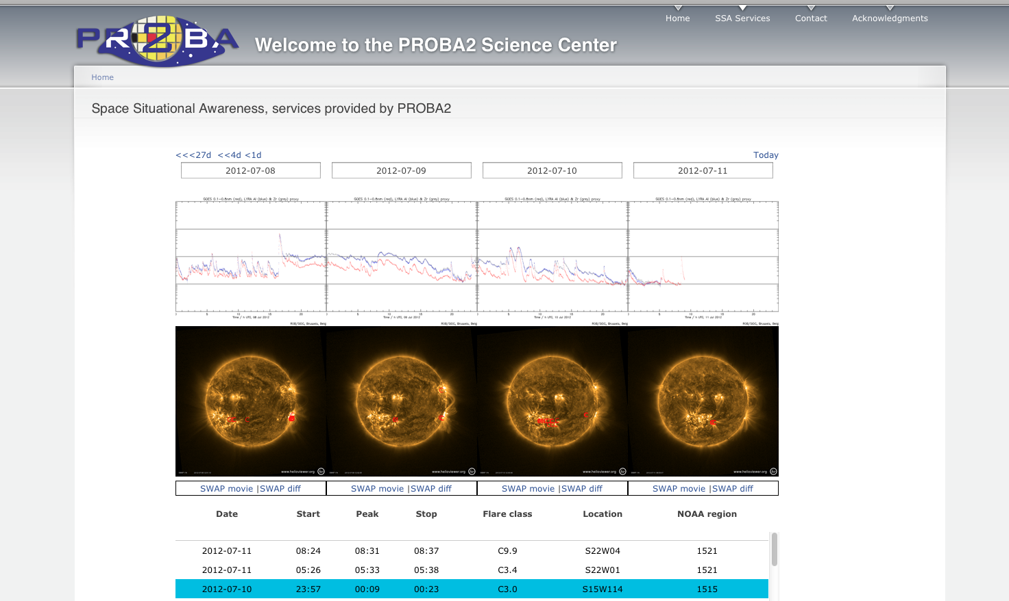

Slide 26
Structure of the talk
Generalities on PROBA2 and LYRA
LYRA current status and performances
Science with LYRA

Slide 27
Fields of investigation
Flares
  Detection of Lyman-alpha flares
  Multi-wavelength analysis of flares
  Short time-scale events, especially quasi-period pulsations
Variability of long term solar spectral irradiance
Sun-Moon eclipses
Occultations
Analysis of the degradation process and of ageing effects caused by energetic particles
Performances of wide-bandgap detectors
Comparison to other instruments (GOES, EVE …)
Talk L. Damé – PSW.3
Talk I. Dammasch – C1.2
Talk M. Kretzschmar – D2.5
Talk G. Cessateur– D2.5

Slide 28
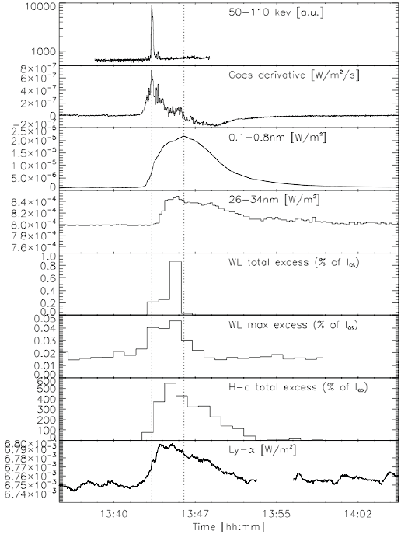
Solar flares with LYRA: Ly-αflare
LYRA has observed about 10 flares in Ly-
Very brief impulsive phase.
Ly- peaks very early, but mostly follows the gradual phase.
Looks well correlated with H- at the time resolution
LYRA probably underestimates the Ly- flare flux due to its large pass-bands (a factor10 at most).
The Ly- emission alone is small wrt to the total energy release.

Slide 29
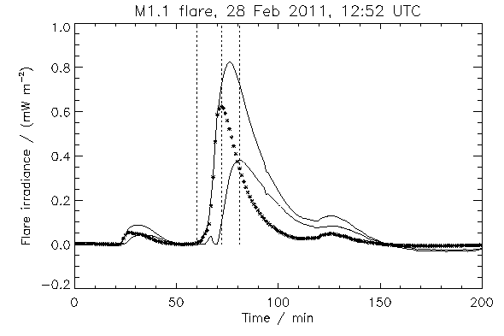
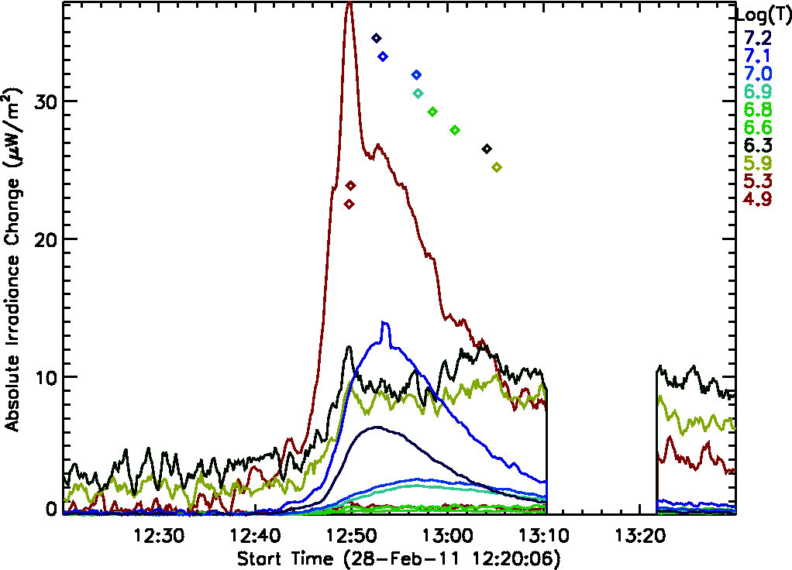
Multi-wavelength analysis of flares
Comparing with other instruments (e.g. SDO/EVE)
  Separate the SXR from EUV component
  Build a plot of the thermal evolution of flare
P. C. Chamberlin (NASA/GSFC)

Slide 30
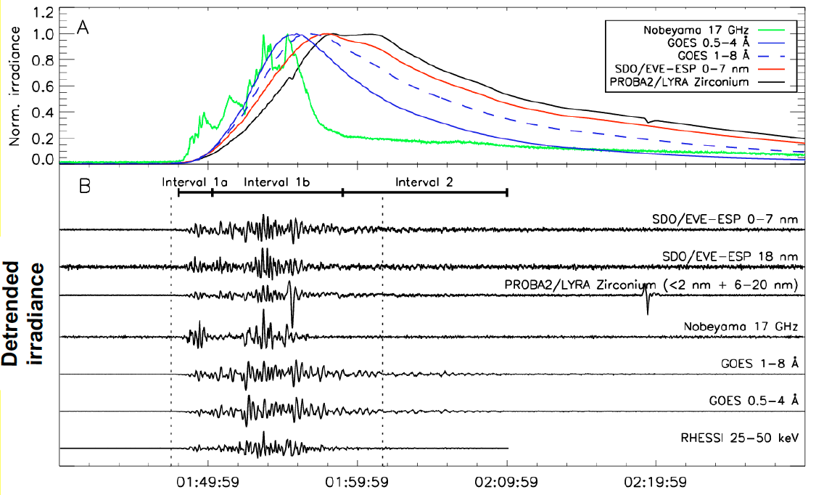
Solar flares with LYRA: QPP
QPP = quasi-periodic pulsations of solar irradiance observed during the onset of solar flares
Periods of about 10 sec and 2 min detected in LYRA
Comparison with other instruments: time delays between EUV and soft X-ray in the 2-30 s range.
Heliosismology => deduce de value of the plasmaβ

Slide 31
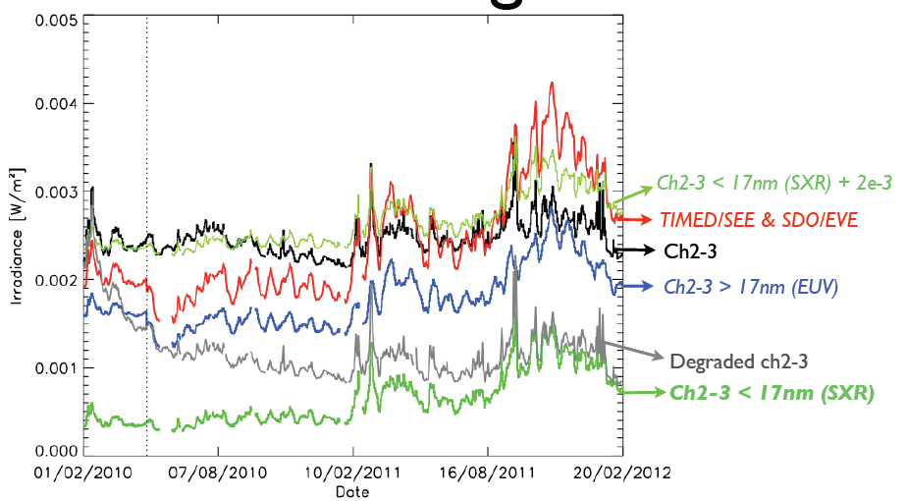
Long term solar irradiance
Two EUV channels of LYRA: nominal unit
Attention: In channel 3, to take degradation into account
Lyman-alpha and Herzberg: use of the daily campaigns with unit 3 (TBD)
Cross-comparison with SDO/EVE, TIMED/SEE, and SOHO/SEM

Slide 32
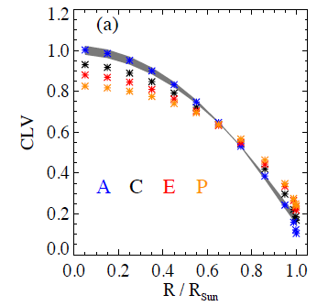
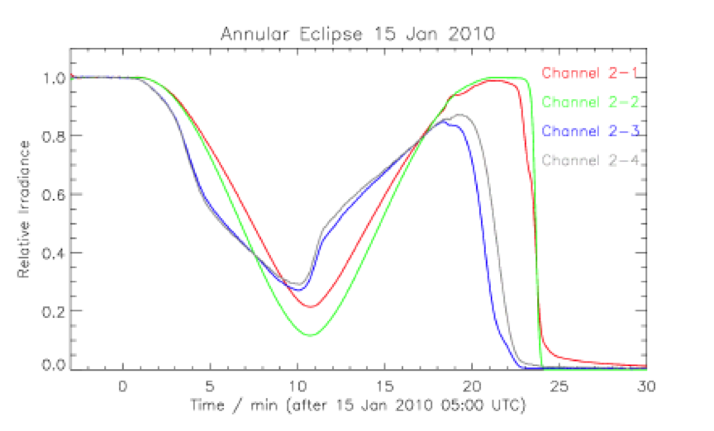
Sun-Moon eclipses
Assessment of models for center-to-limb variation (e.g. COSI) in the longer wavelengths channels
EUV channels: variability induced by active regions

Slide 33
Recent scientific papers
S.T. Kumara, et al. Preliminary Results on Irradiance Measurements from Lyra and Swap, Advances in Astronomy, 2012
A. I. Shapiro et al., Eclipses observed by LYRA - a sensitive tool to test the models for the solar irradiance, Solar Physics, 2012
A.V. Shapiro, et al. Solar rotational cycle as observed by LYRA, Solar Physics, 2012
L. Dolla, et al., Time delays in quasi-periodic pulsations observed during the X2.2 solar ﬂare on 15 February 2011, The Astrophysical Journal, 2012
T. Van Doorsselaere, et al. LYRA Observations of Two Oscillation Modes in a Single Flare, The Astrophysical Journal, 2011
… more to come in the PROBA2 topical issue of Solar Physics - to be released soon

Slide 34
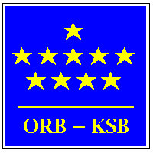







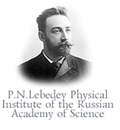



Collaborations
THANK YOU!

